Slide 1
School Results 2019 (National Results in Brackets)
Subject | Expected Standard | Higher Level
Reading | 81% (73%) | 32% (27%)
Writing | 93% (78%) | 28% (20%)
Maths | 92% (79%) | 33% (27%)
EGPAS | 89% (78%) | 35% (36%)
CRWM | 77% (65%) | 13% (11%)

Slide 2
The SATs Tests 2020
The children will complete tests in the following areas:
English Grammar, Punctuation and Spelling, (EGPS)
Reading
Maths

Slide 3
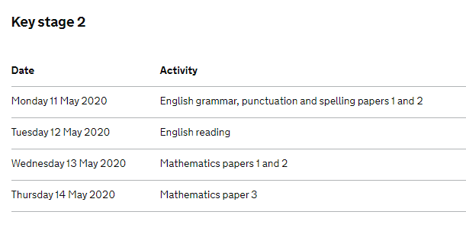
Access Arrangements: Scribe, Additional Time, MLP

Slide 4
Reading Paper
In KS2 English SATs your child will be assessed on a range of reading skills, such as the ability to interpret information and comment on writers' use of language, and they’ll have to demonstrate accurate punctuation and an extensive vocabulary in a piece of writing.
The reading test will be a single paper with questions based on three passages of text.
Children will have one hour, including reading time, to complete the test.
Types of questions:
Ranking/ordering, e.g. ‘Number the events below to show the order in which they happen in the story’
Labelling, e.g. ‘Label the text to show the title of the story’
Find and copy, e.g. ‘Find and copy one word that suggests what the weather is like in the story’
Short constructed response, e.g. ‘What does the bear eat?’
Open-ended response, e.g. ‘Look at the sentence that begins Once upon a time. How does the writer increase the tension throughout this paragraph? Explain fully, referring to the text in your answer.’

Slide 7
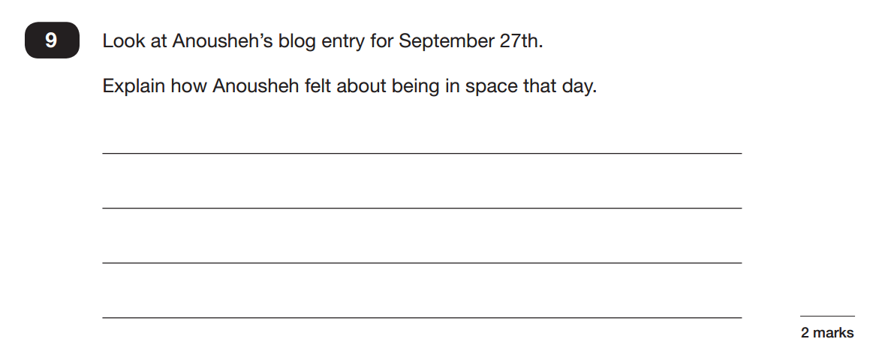

Slide 8
English, Grammar, Punctuation and Spelling (EGPS)
The grammar, punctuation and spelling test will consist of two parts: a grammar and punctuation paper requiring short answers, lasting 45 minutes, and an spelling test of 20 words, lasting around 15 minutes.
The grammar and punctuation test will include two sub-types of questions:
Selected response, e.g. ‘Identify the adjectives in the sentence below’
Constructed response, e.g. ‘Correct/complete/rewrite the sentence below,’ or, ‘The sentence below has an apostrophe missing. Explain why it needs an apostrophe.’

Slide 13
Spelling Test!
1)The children were …………….. to go on the ride next.
2) Out of …………………., the children walked along the left hand side of the corridor.
3) Miss Capper struggled with the ………………….. of some of the words in the spelling test!
1)guaranteed
2)convenience
3)pronunciation

Slide 14
Writing
There is not a Writing SATs paper, however Teacher Assessment Scores will be shared with parents.
These assessment scores will be based on the School’s assessment system.
Please see the exemplars.

Slide 15
Maths
In KS2 maths SATs they’ll be tested on a range of core skills, including knowing all times tables and using them to divide and multiply, using a protractor to measure angles, calculating the perimeter and area of shapes, solving problems by collecting and using information in tables, graphs and charts and solving problems involving ratio and proportion.
Children will sit three papers in maths:
Paper 1: arithmetic, 30 minutes
Papers 2 and 3: reasoning, 40 minutes per paper
Paper 1 will consist of fixed response questions, where children have to give the correct answer to calculations, including long multiplication and division. Papers 2 and 3 will involve a number of question types, including:
Multiple choice
True or false
Constrained questions, e.g. giving the answer to a calculation, drawing a shape or completing a table or chart
Less constrained questions, where children will have to explain their approach for solving a problem

Slide 16
2.55

Slide 17
70

Slide 18
9.12

Slide 19
36,612

Slide 20
1/5

Slide 21
63

Slide 22
Marking the Papers
The previous national curriculum levels have been scrapped, and instead children will be given then following…
a raw score (number of raw marks awarded)
a scaled score
confirmation of whether or not they attained the national standard
Scaled Score Information - https://www.gov.uk/guidance/scaled-scores

Slide 23
Scaled Scores
Subject | HNM | EXS | GDS
Reading /50 | <26 | 26 – 38 | >39
Maths /110 | <57 | 57 - 95 | >96
EGPS /70 | <35 | 35 - 55 | >56
Writing | WTS | EXS | GDS
HNM:Has Not Met, EXS: Expected Standard, GDS: Greater Depth Standard
WTS: Working Towards Standard
Reported to Secondary Schools

Slide 24
What to do now…
Learn all the time tables up to 12 x 12
Learn all the division facts up to 12 x 12
Practice standard methods of addition, subtraction, multiplication and division
Learn different grammatical terminology
Maximise Reading Plus
Maximise Spelling Shed
Revision Books
Make revision fun!

