Slide 1
Welcome to
Year 6

Slide 2
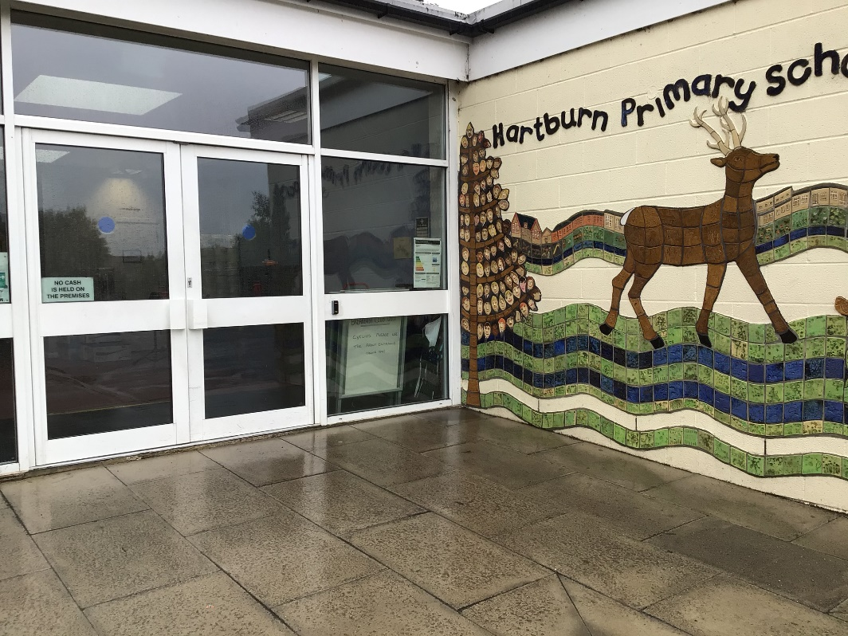
You will come in through this door.
Doors open at 8:45am and school starts at 9:00am.
Photo of door
It is really important that you are on time every morning!

Slide 3
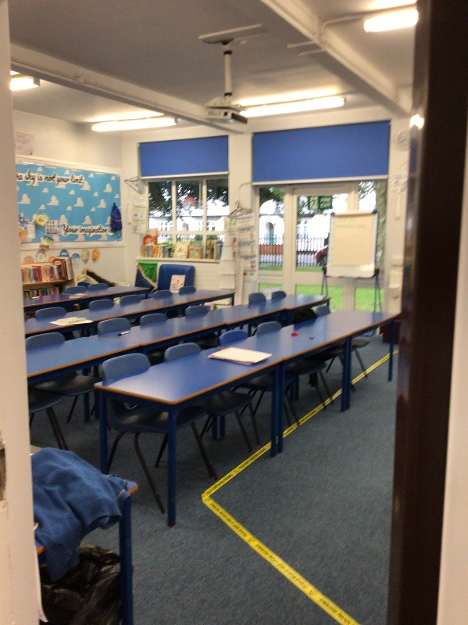
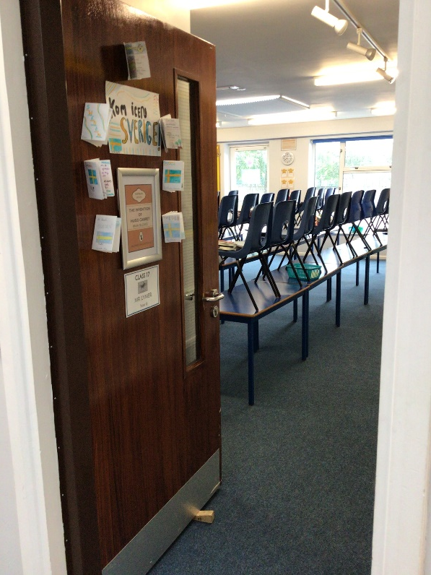
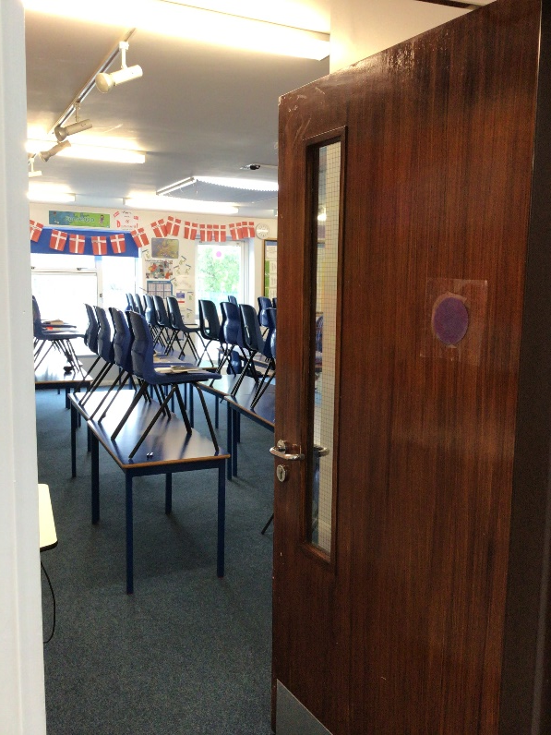
We have 3 classrooms in Year 6. Class 16, 17 and 18.
16
17
18

Slide 4
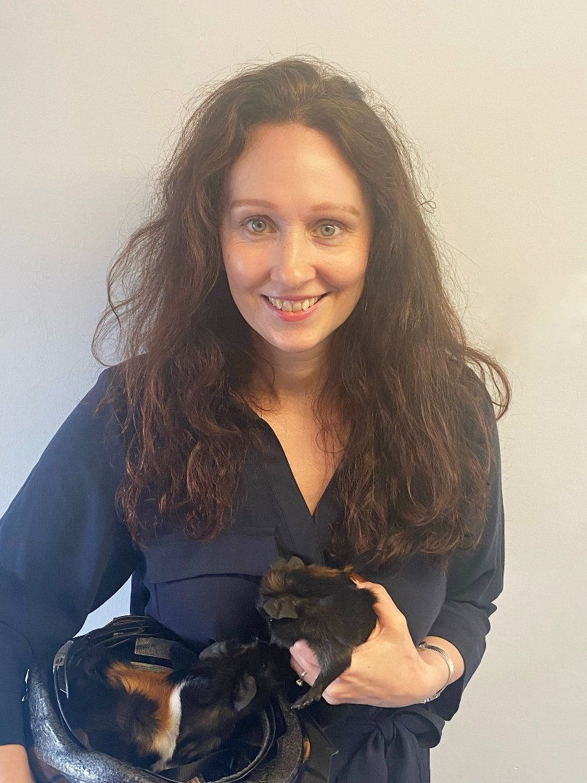
Class 16
Miss Danby

Slide 5
Class 17
Ms. McCarthy

Slide 6
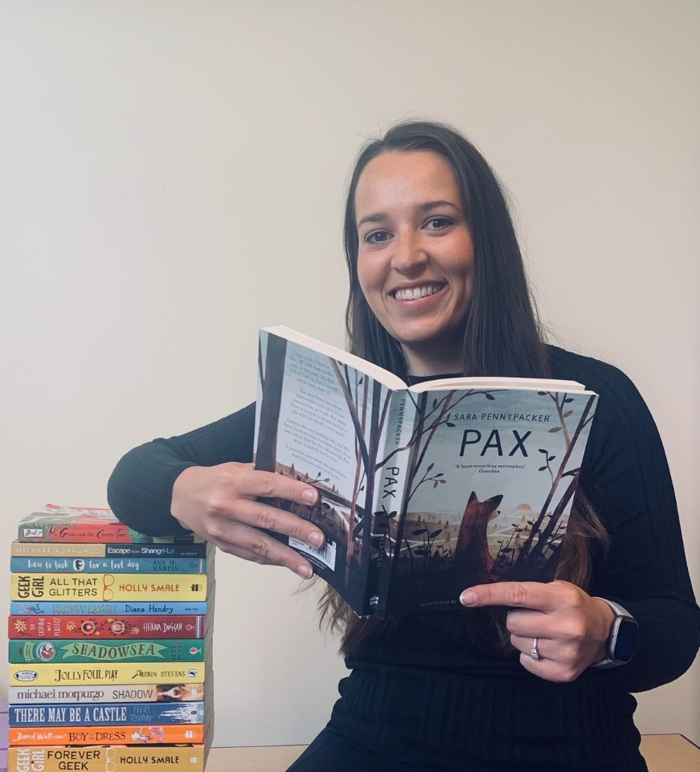
Class 18
Mrs Magowan

Slide 7
Year 6 Teaching Assistant
Mrs How

Slide 8
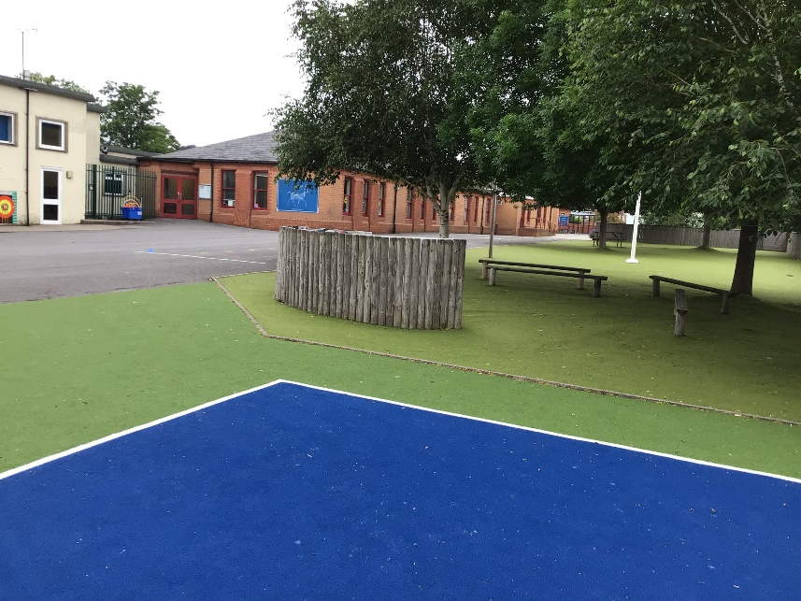
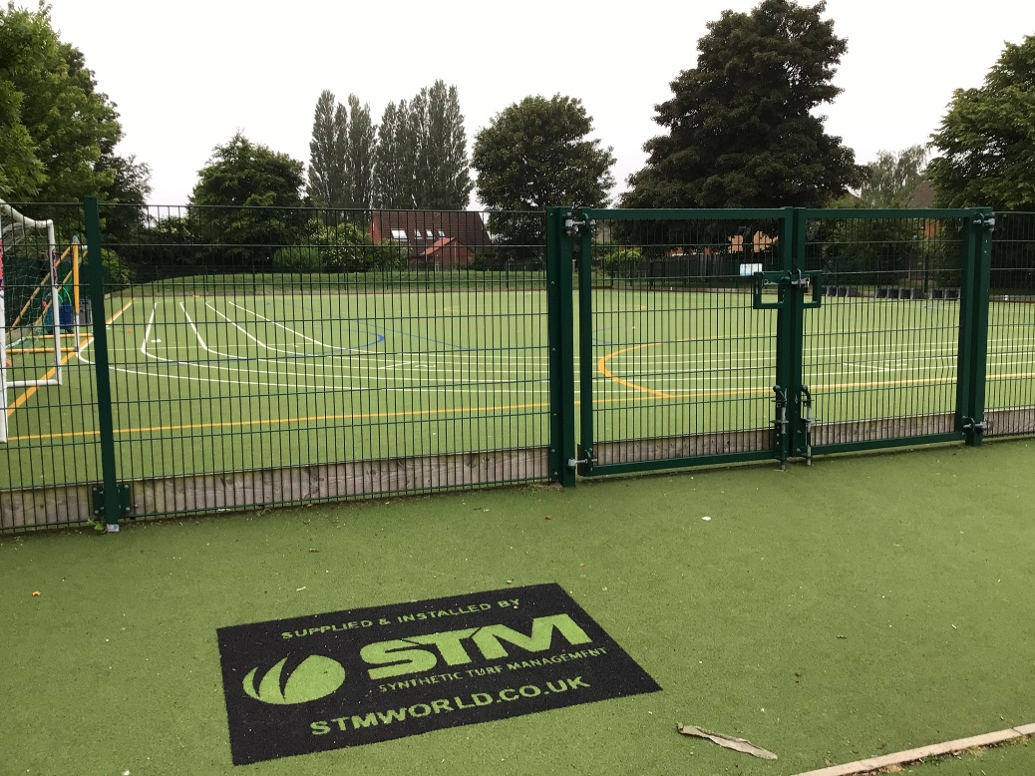
Outdoor Space.

Slide 9
You will eat your dinner here.

Slide 10
This is what your day will look like.
9:00 – Registration
9:05 – Reading
9:30 - English
10:45 – Break
11:00 – Maths
12:15 Lunch
13:15 – Afternoon lesson
14:15 – Break
14:30 – Afternoon lesson
15:30 - Home
Your timetable may differ sometimes to allow for other activities.

Slide 11
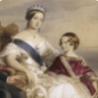
This is what you will be learning about.
Autumn 1: Revolution Autumn 2: Blood Heart
Are you listening? What is 27 plus 45? Come on, faster now. We haven’t got all day. Find out about super strict schools by travelling back in time to a Victorian classroom.
Crimson, scarlet, burgundy, cherry. Blood flows through our bodies in all its vibrant shades of red. Let’s explore our circulation system.

Slide 12
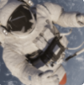
Spring: Stargazers
Journey through space, the final frontier. Navigate beyond the Sun, the magnificent, blazing star at the centre of our Solar System. Investigate the eight planets: Mercury, Venus, Earth, Mars, Jupiter, Saturn, Uranus and Neptune. Take a look at the Moon, a celestial body that orbits Earth.

Slide 13
Summer 1: ID
Summer 2: Hola Mexico
Who do you think you are? Are you an extrovert or an introvert, a singleton, a twin or even a triplet? Let’s discover what makes you, you! From your fingerprints and footprints, to your genes and DNA, everything is unique to you.
Welcome to Mexico. Get ready to explore this unique country, from its towering temples and stunning geography to its pulsing rhythms and fun festivals.

Slide 14
You will leave through this door.
You will finish school at 3:25.
Photo of door
We will inform you of any changes due to our COVID risk assessment.

Slide 15
We cannot wait
to see you in September!
Have a lovely summer and stay safe.

