Slide 1
Welcome Assembly
Year 5 and 6

Slide 2

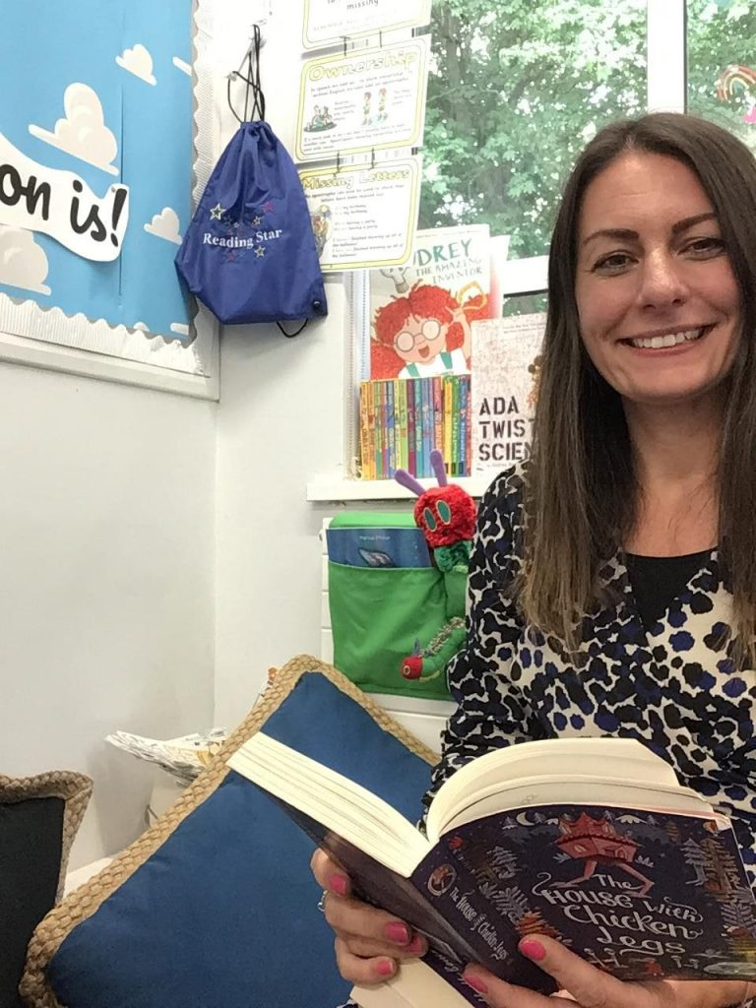
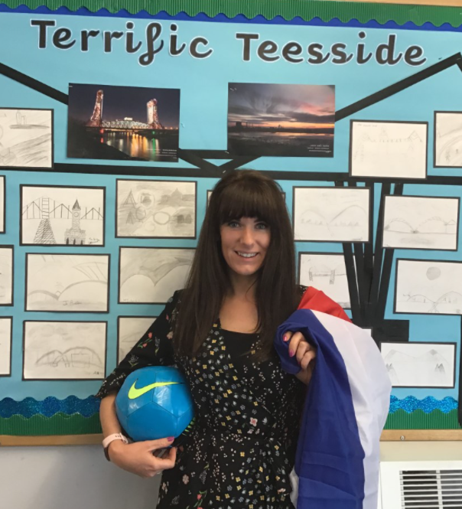
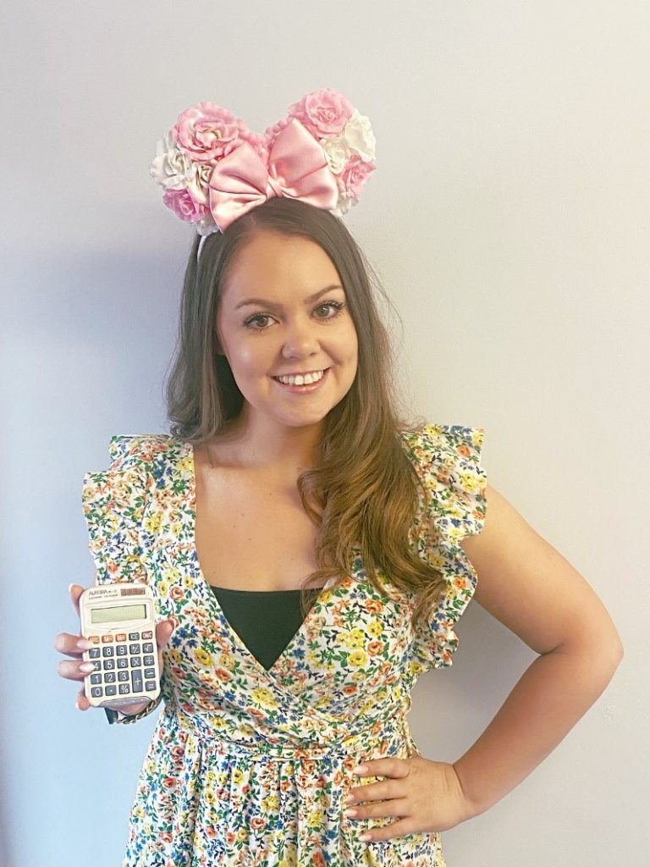
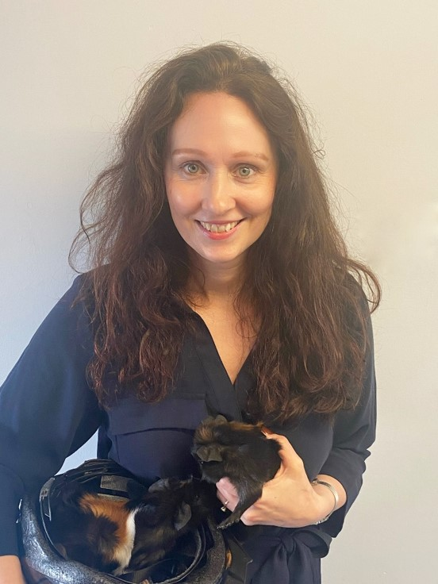
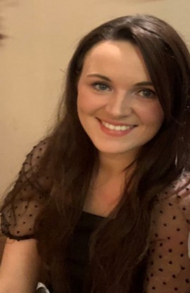
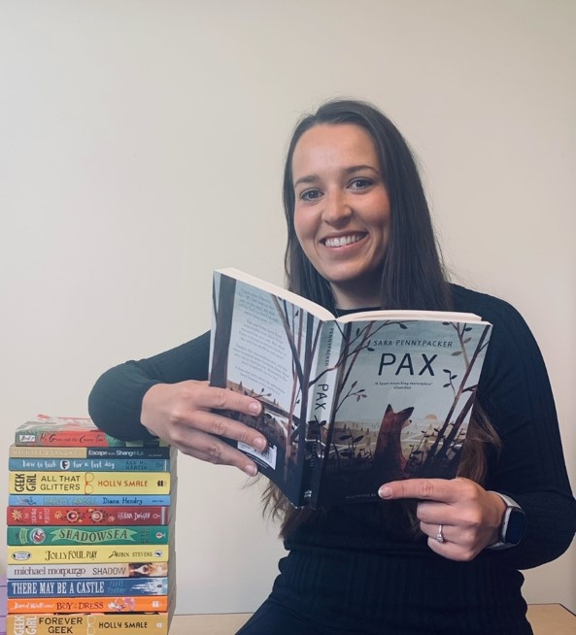
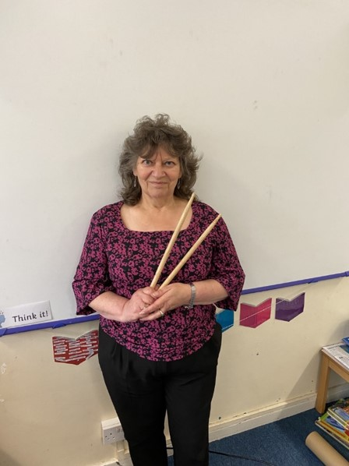
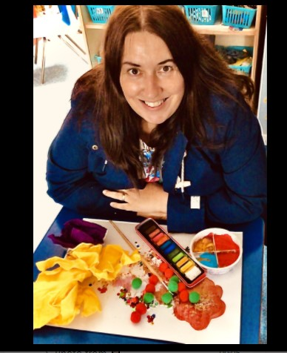
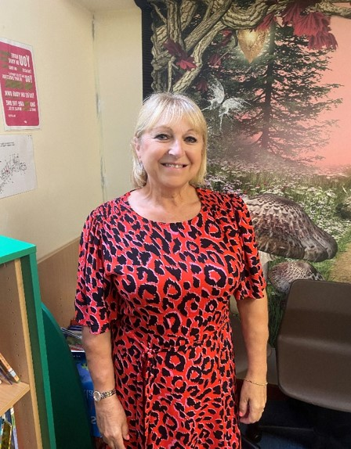
Mrs Brown
(Year 5 AM
KS Leader)
Miss Collins (Year 5)
Miss Denton
(Year 5)
Miss Danby
(Year 5/6)
Miss McCarthy
(Year 6)
Mrs Magowan
(Year 6)
Mrs Ditchburn
(TA)
Mrs How
(TA)
Mrs Nicholls
(TA)

Slide 3
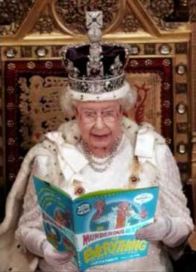
Reading
School reading book and Reading Record
John Murray Layered Approach
Reading Plus
Reading for pleasure

Slide 4

Writing
Extended pieces of writing.
Hartburn Handwriting
Different genres of writing including recounts, diaries, non-chronological reports and short stories.
We write for a purpose

Slide 5
Maths
Daily emphasis on talking through maths problems in pairs, in preparation for mental arithmetic tests.
Fluency, Reasoning and Problem Solving
Times Tables Rock Stars.
Daily Times Tables included in every maths lesson
Active Maths

Slide 6
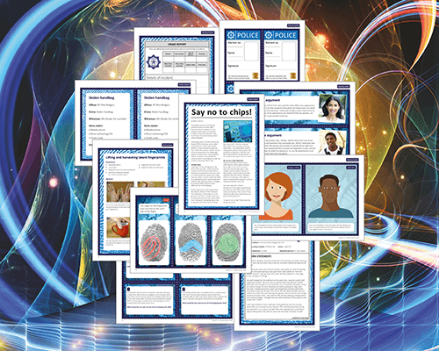
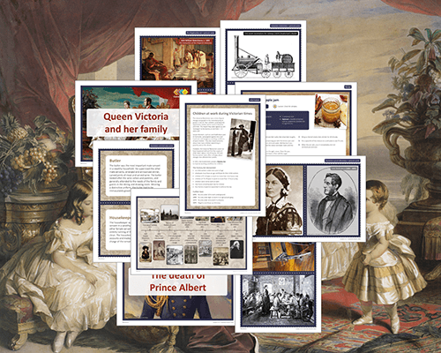
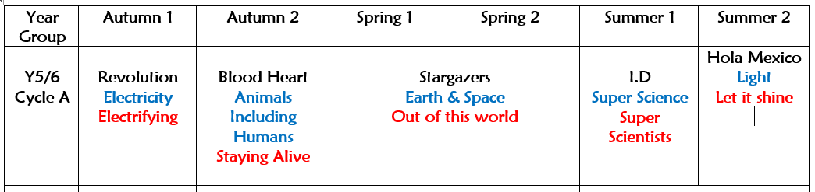
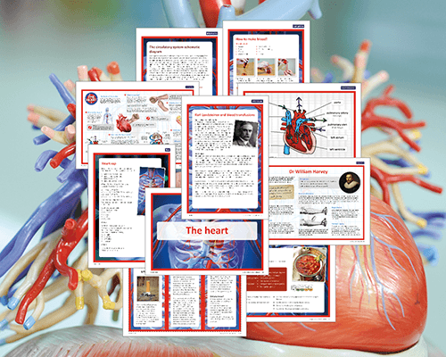
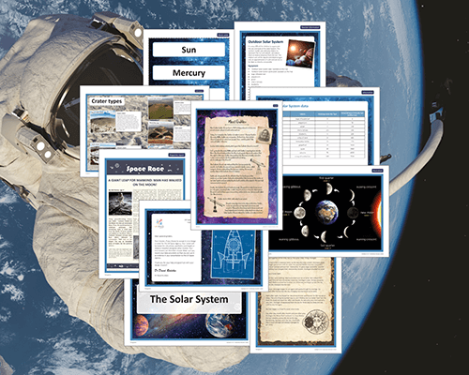
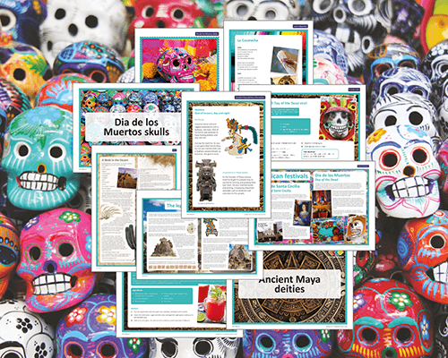
Overview of the Year

Slide 7
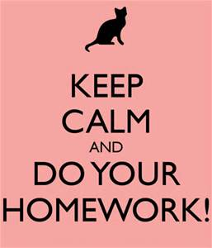
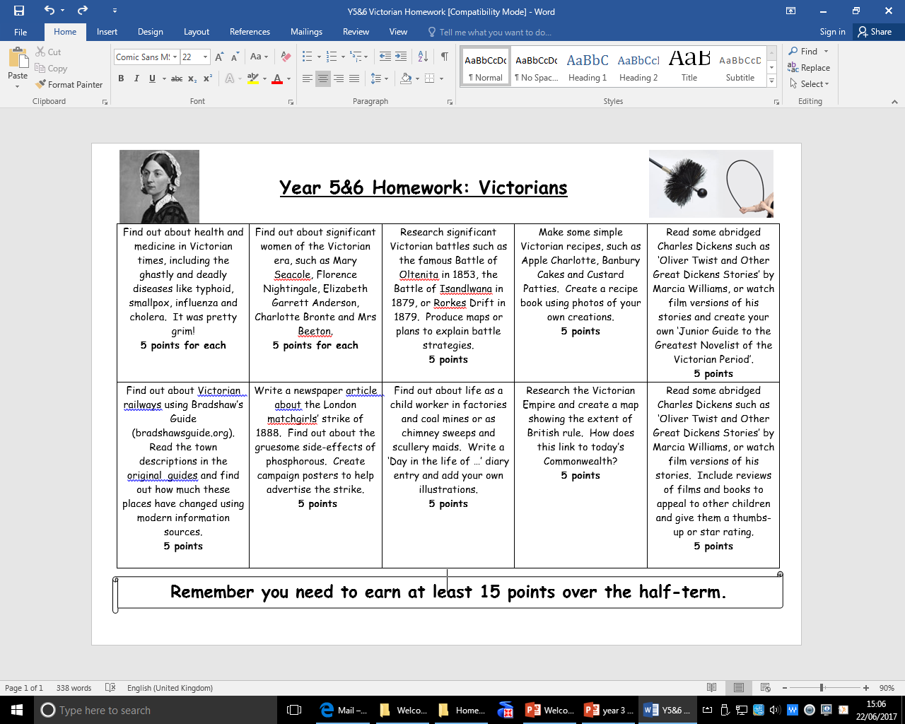
Homework
English - spelling and Reading Plus
Maths – variety of activities to consolidate prior learning, usually done on Conquermaths
(Set Friday, due Friday)
    Creative homework
    Linked to the topic.

Slide 8

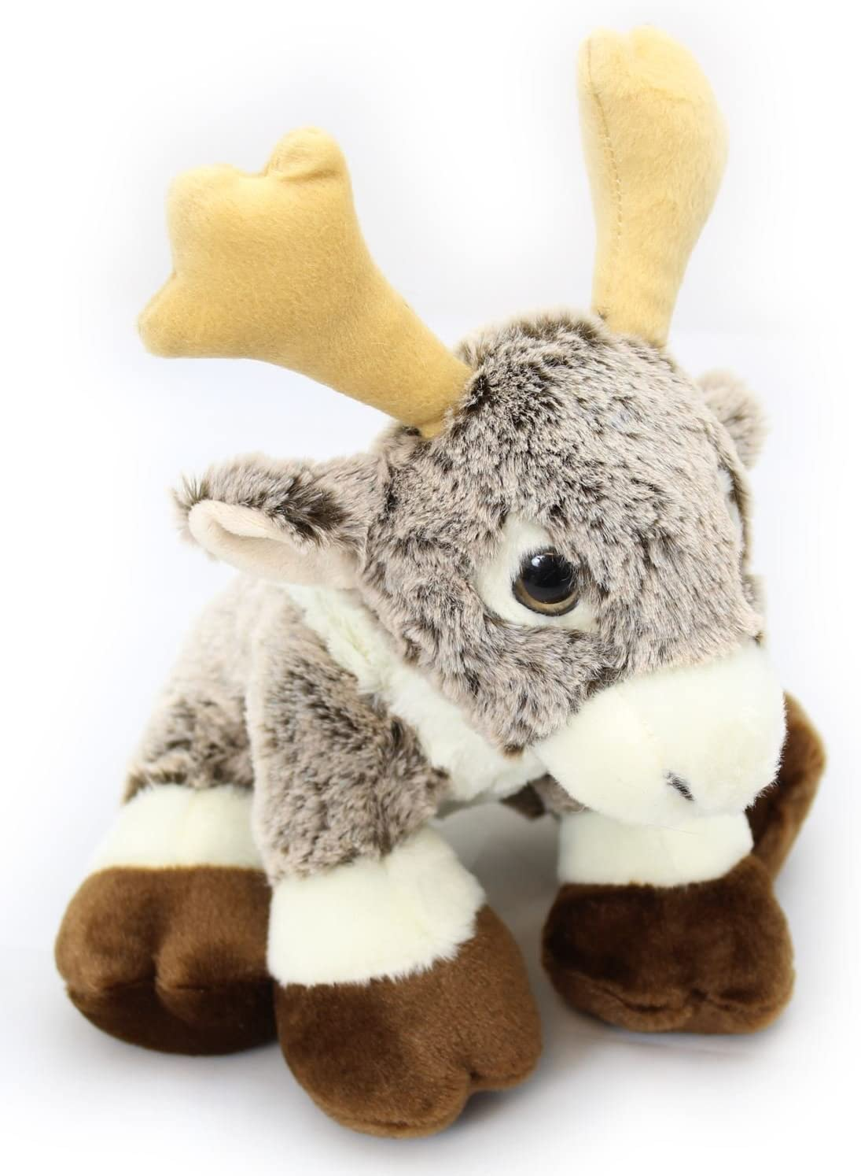
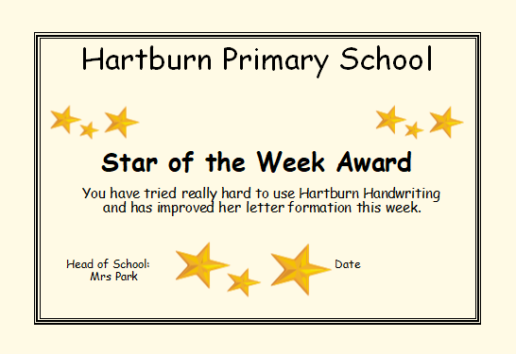

Celebrating Success!
Celebration Assembly - weekly, hosted by Mrs Park or Mrs Wain.
Reading Star – 1 child from each year group will be awarded the Reading Star bag each week. It contains Rodney the reading reindeer, a snack, hot chocolate and a book to read.

Slide 9
Reminders
Arrive on time, but not too early!
School Uniform – no jewellery or nail varnish
P. E. Kit on P.E days – non branded
Water bottles
Reading Records everyday, spelling book on a Friday.
Support with Homework

Slide 10
Dates for your diary
Individual and family photographs – 7th October
Beamish – Thursday 14th October
Parent’s Evening via Schoolcloud –
1st and 2nd November

