Slide 1
Welcome to
Year 1

Slide 2
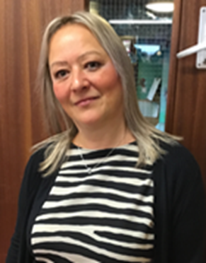
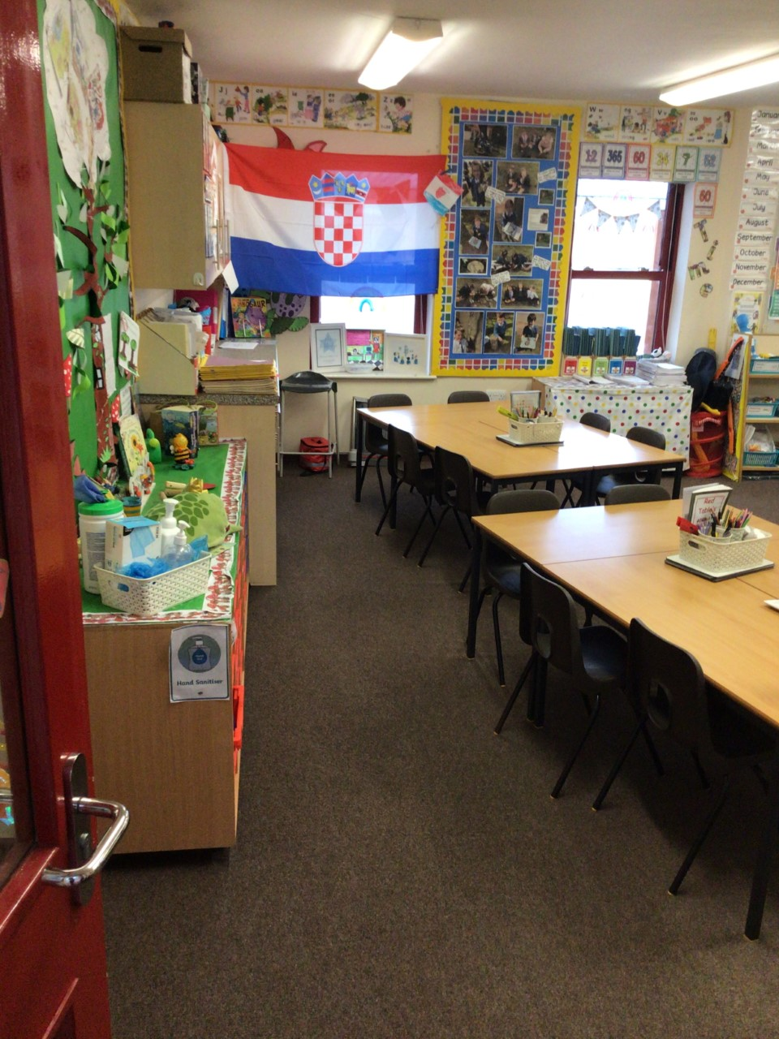
Class 4 – Mrs Adams

Slide 3
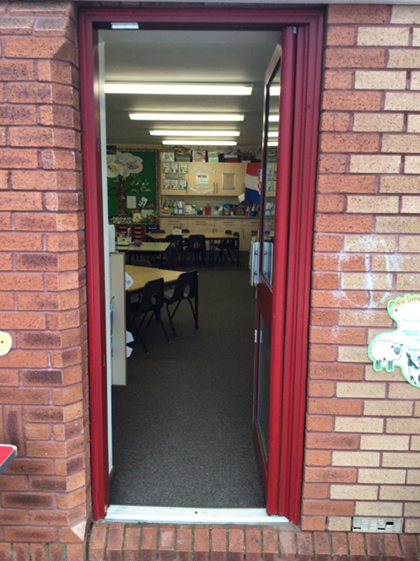
Class 4 you will come in through this door.
Doors open at 8:45am and school starts a 9:00am.
It is really important that you are on time every morning!

Slide 4
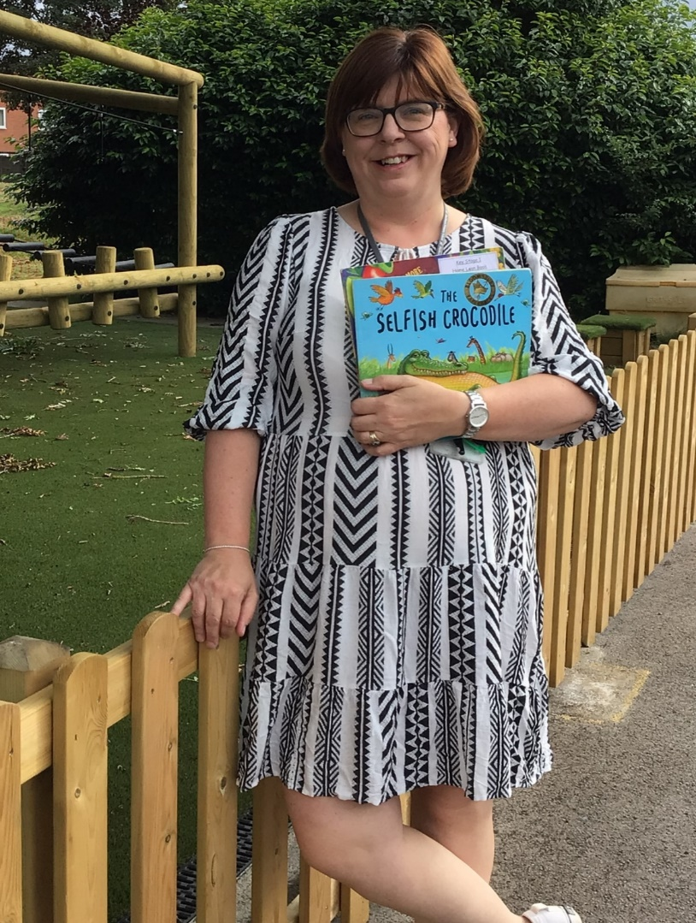
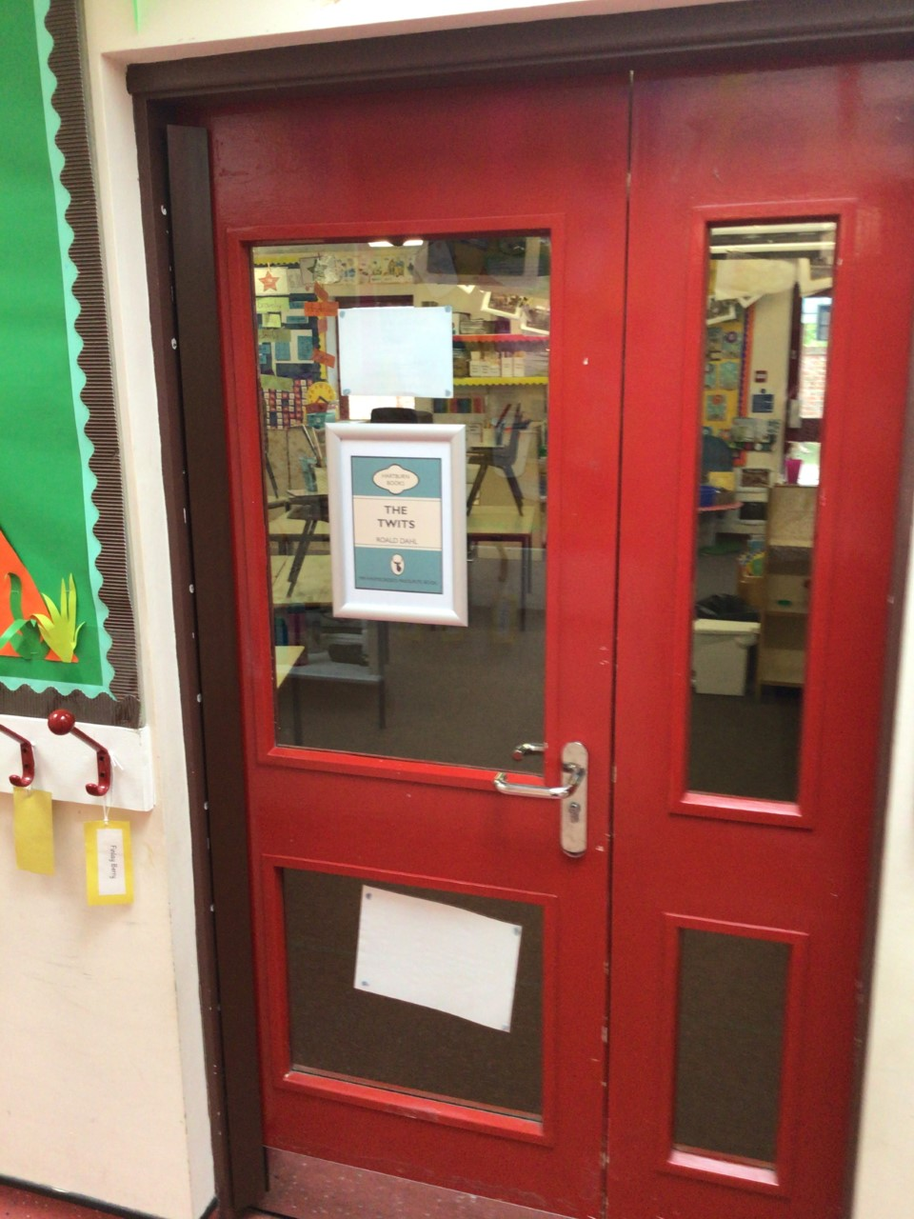
Class 5 – Mrs Swales

Slide 5
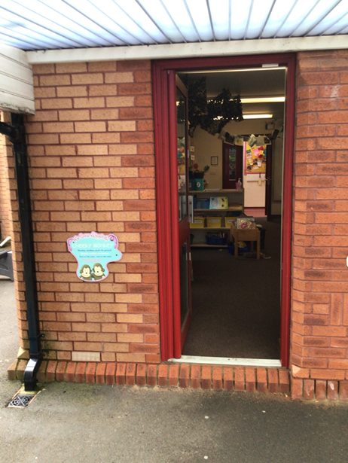
Class 5 you will come in through this door.
Doors open at 8:45am and school starts a 9:00am.
It is really important that you are on time every morning!

Slide 6
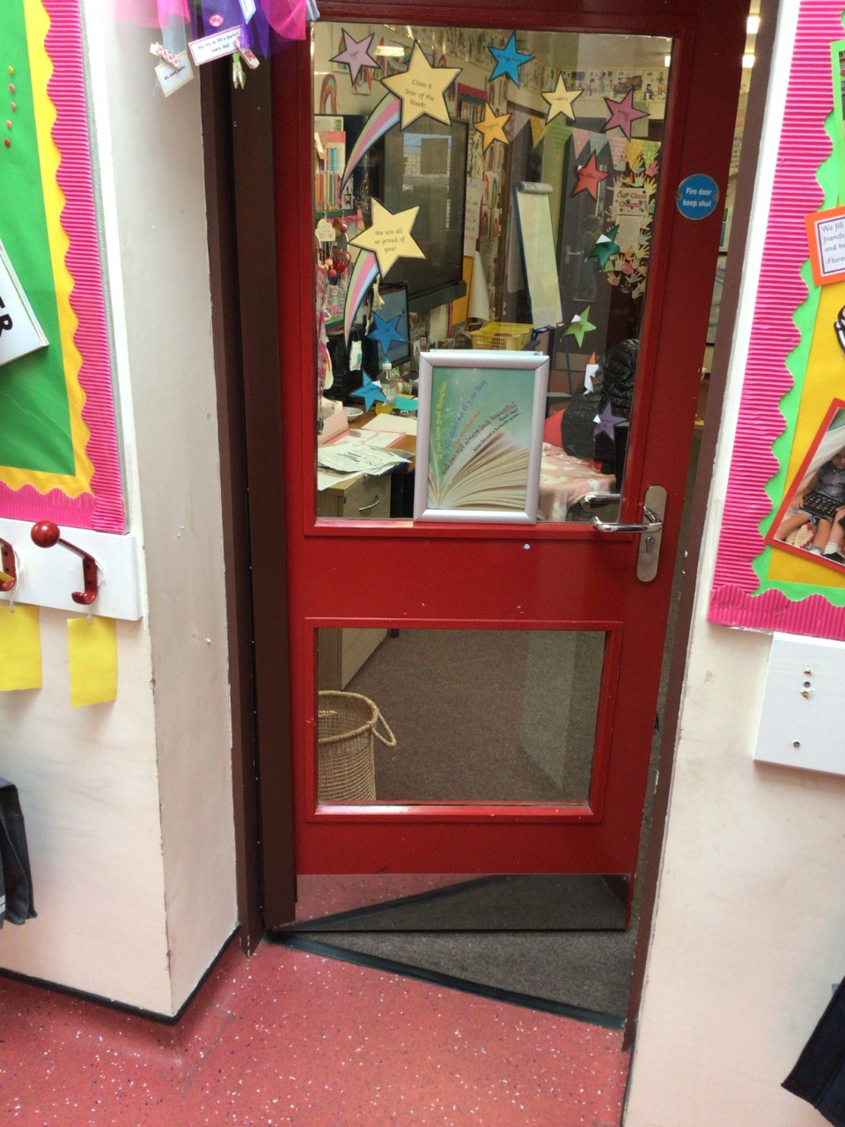
Class 6 – Mr Whitecross

Slide 7
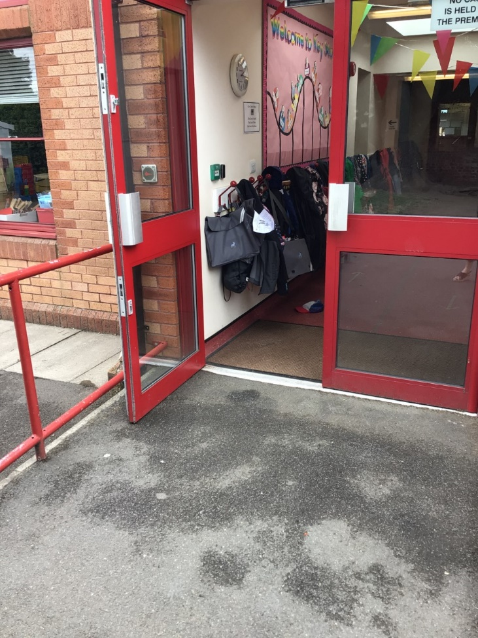
Class 6 you will come in through this door.
Doors open at 8:45am and school starts a 9:00am.
It is really important that you are on time every morning!

Slide 8
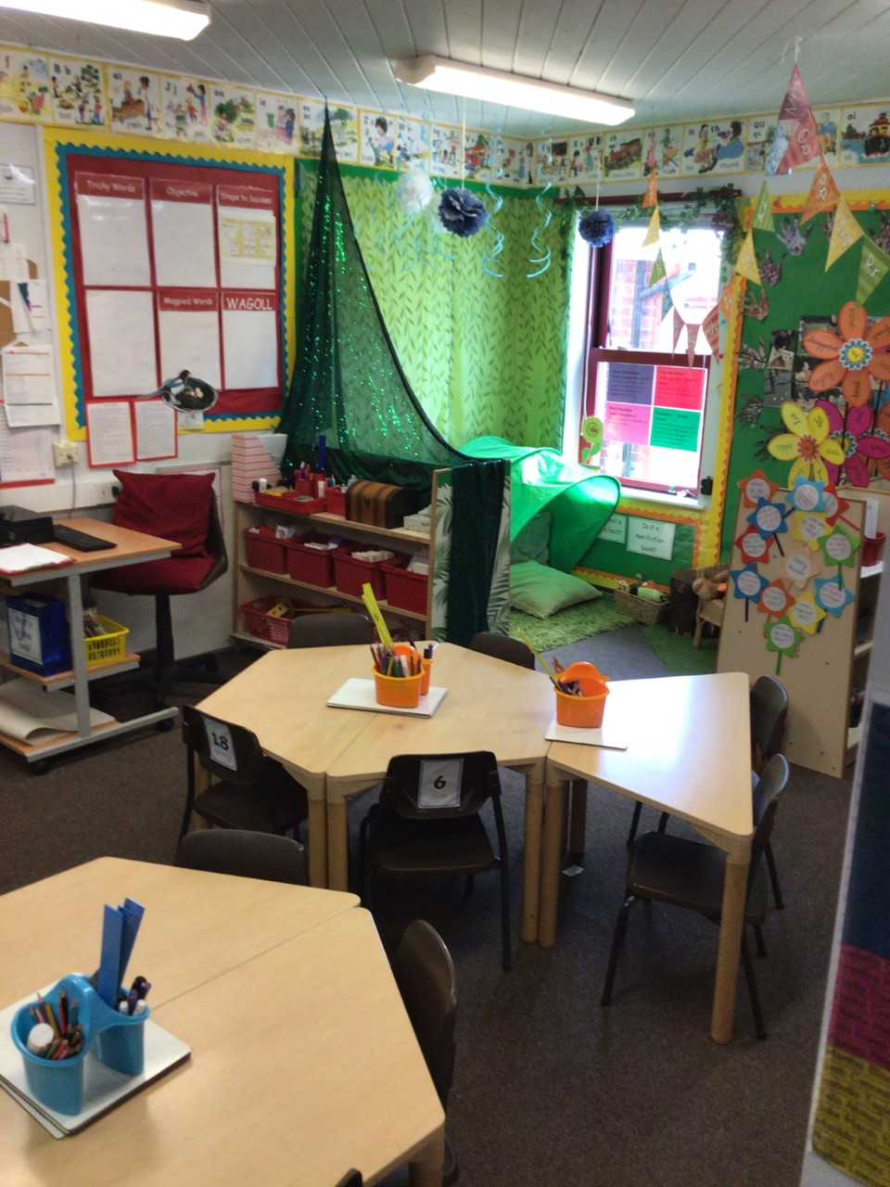
Year 1 Maths and English teacher – Miss Thompson

Slide 9
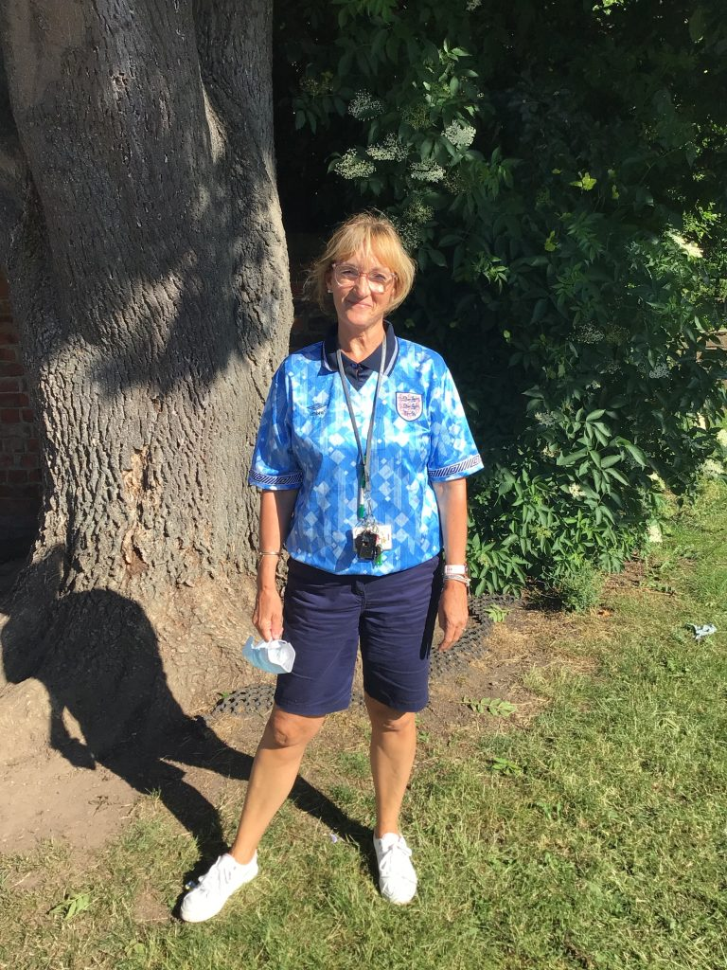
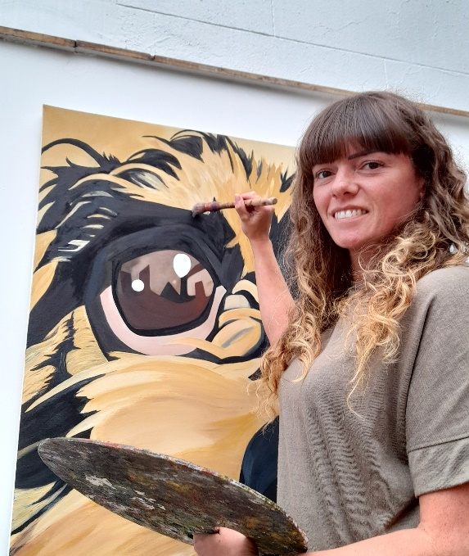
Our Terrific Teaching Assistants
Mrs George
Mrs Athey
Miss Sullock

Slide 10
Outdoor Space – you will have your playtime here.

Slide 11
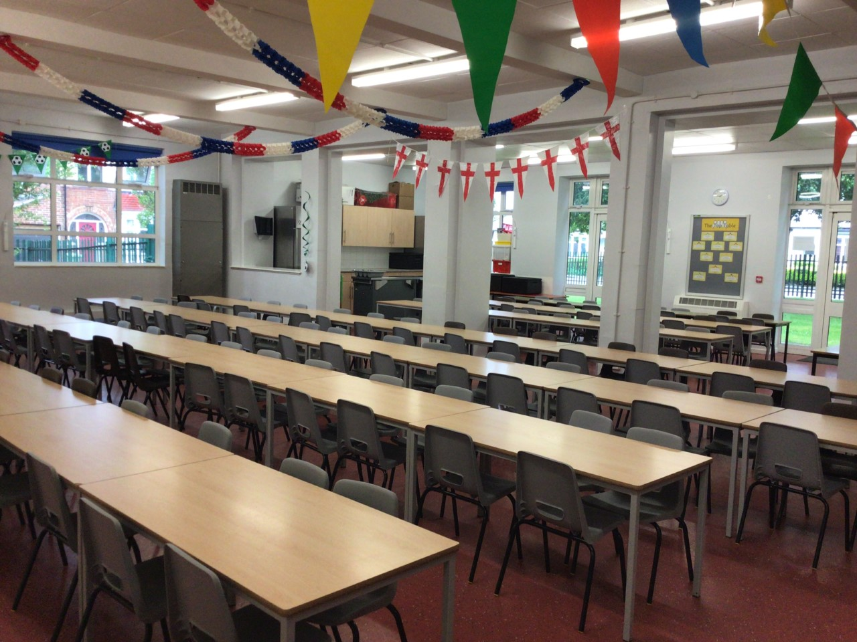
You will eat your dinner here.

Slide 13
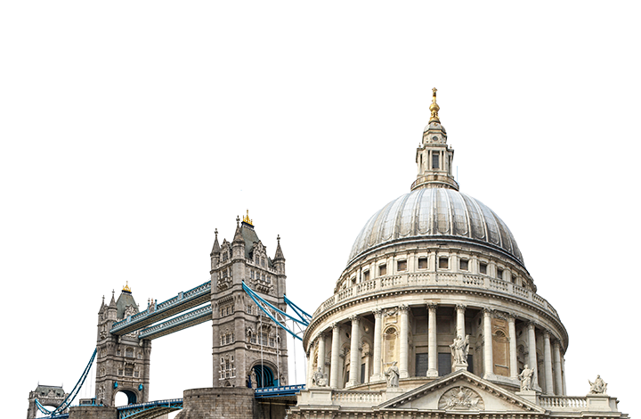
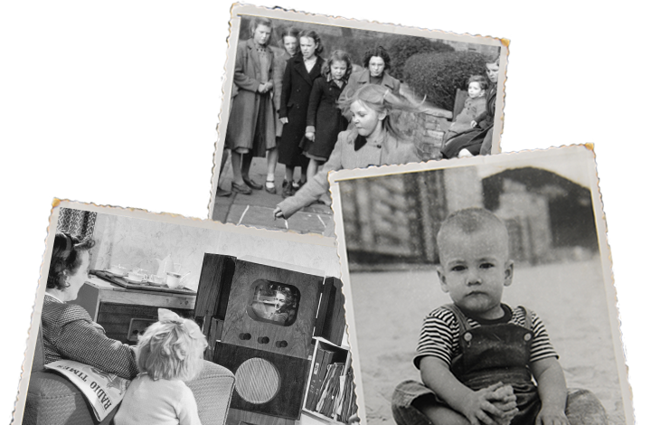
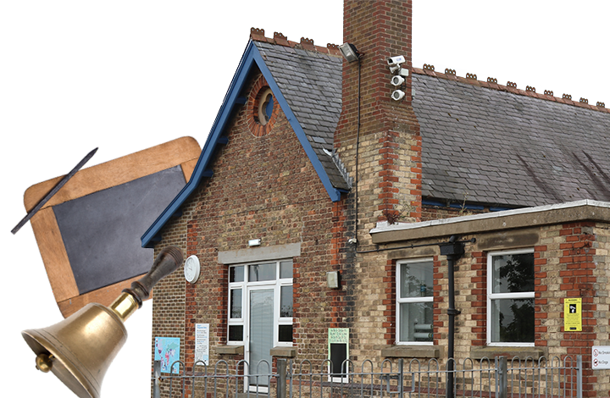
This is what you will be learning about.
Childhood
Bright Lights, Big City
School Days
Your timetable may differ sometimes to allow for other activities.

Slide 14
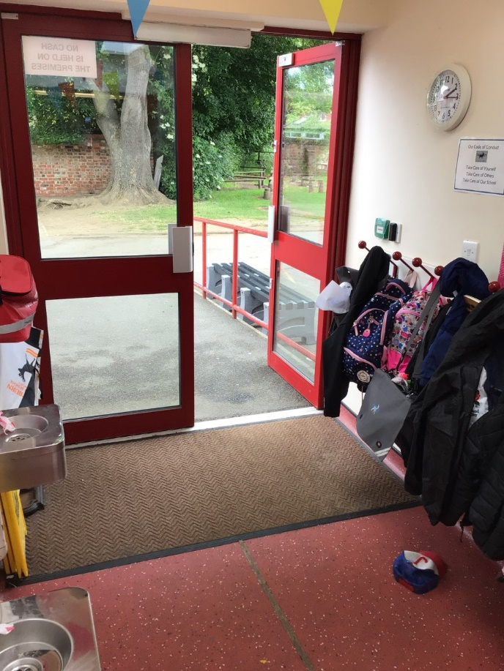
Class 6 you will leave through this door.
You will finish school at 3.15pm.

Slide 15
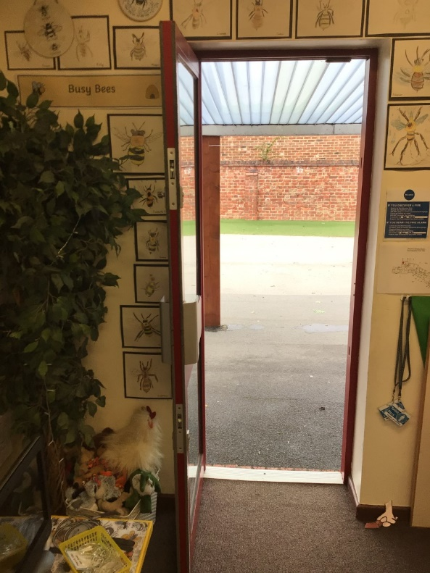
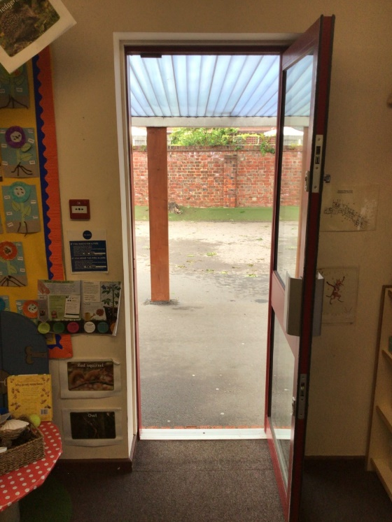
Class 4 and 5 you will leave through your classroom doors.
You will finish school at 3.15pm.
Class 4
Class 5

Slide 16
We cannot wait
to see you in September!
Have a lovely summer and stay safe.

