Slide 1
Welcome to
Year 2

Slide 2
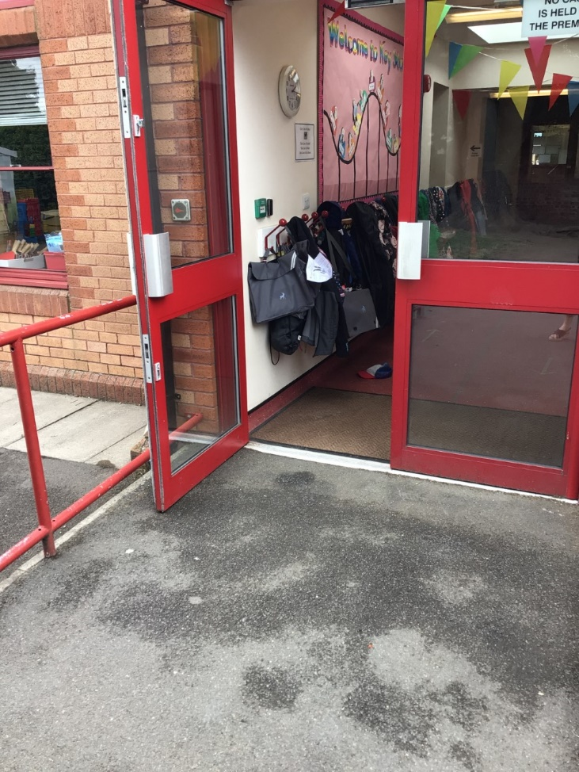
You will come in through this door.
Doors open at 8:45am and school starts a 9:00am.
It is really important that you are on time every morning!

Slide 3
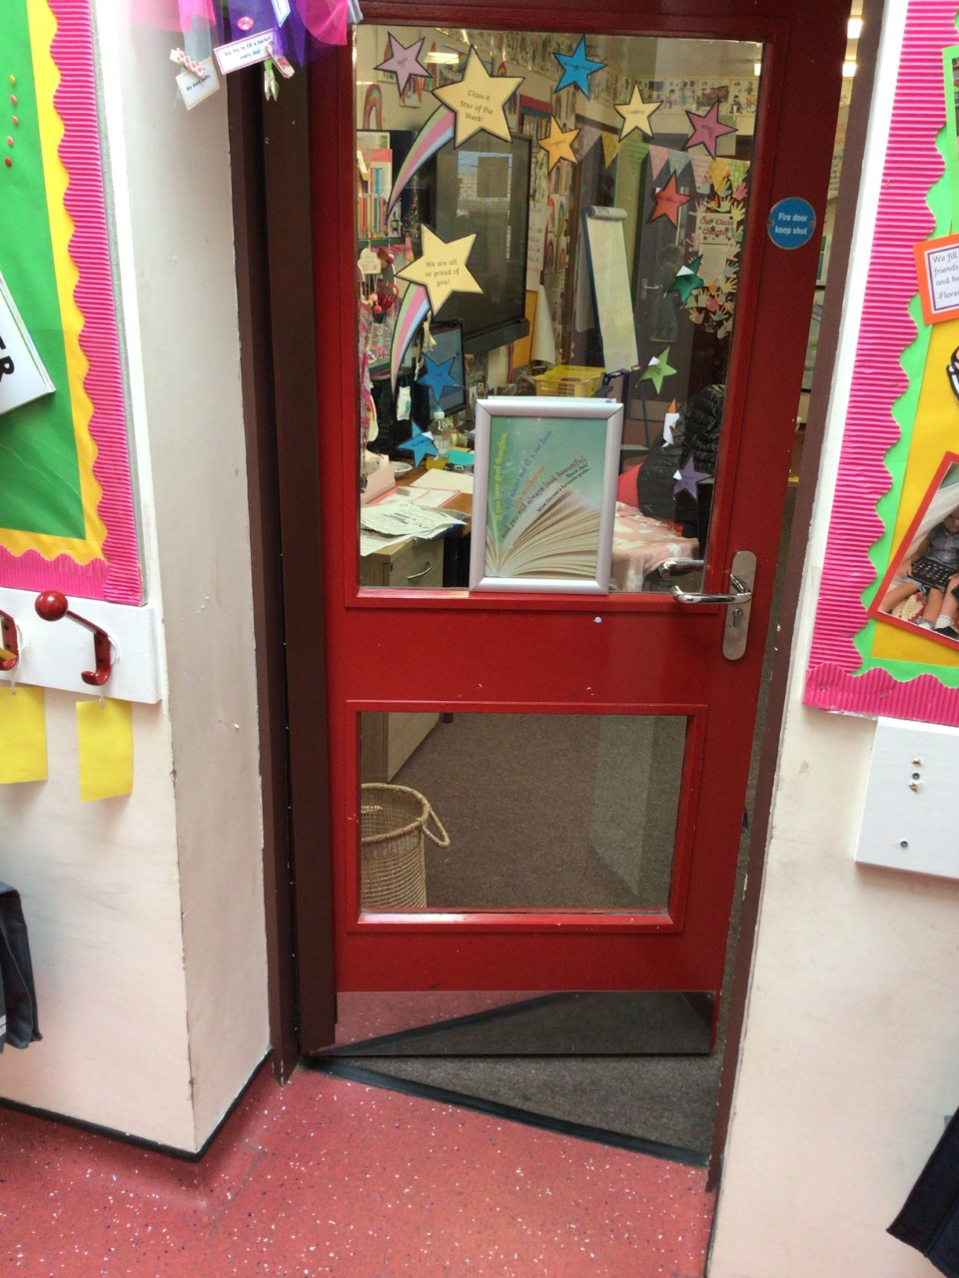
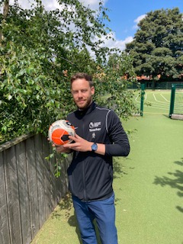
Class 6 – Mr Whitecross

Slide 4
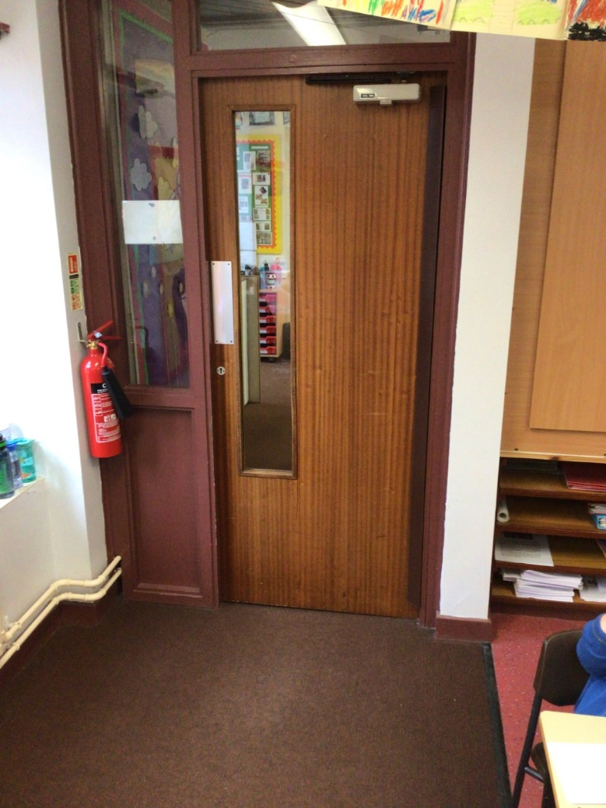
Class 7 – Miss Hoskin

Slide 5
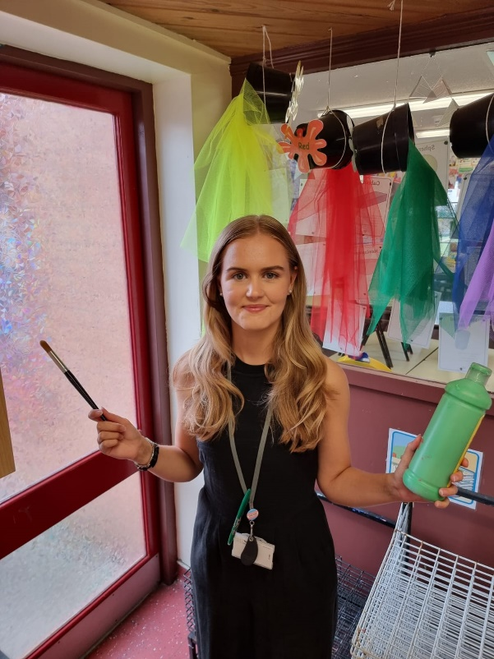
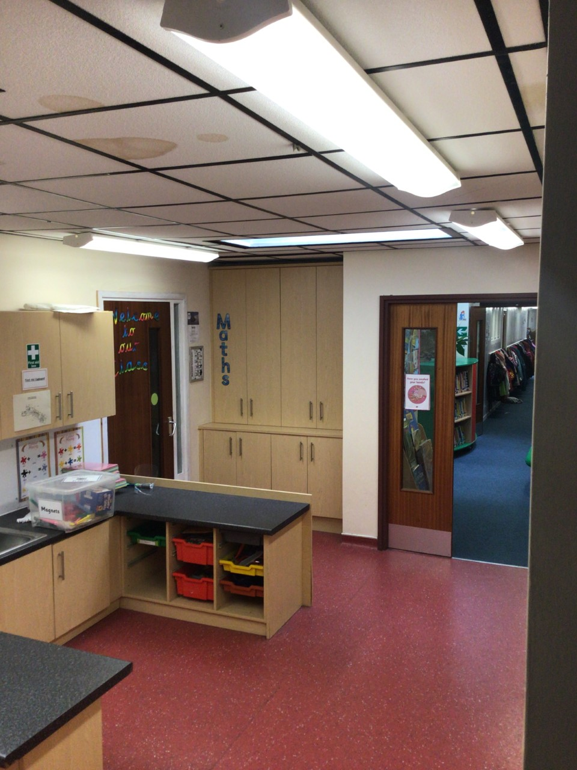
Class 8 – Miss Jones

Slide 6
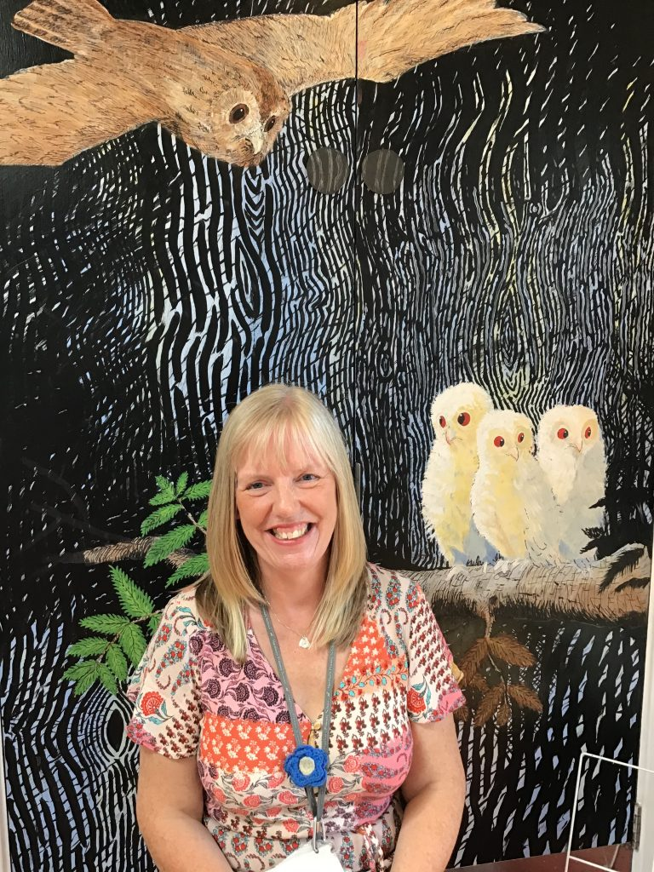
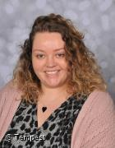
Our Terrific Teaching Assistants
Mrs Smith
Miss Cornforth

Slide 7
Outdoor Space.

Slide 8
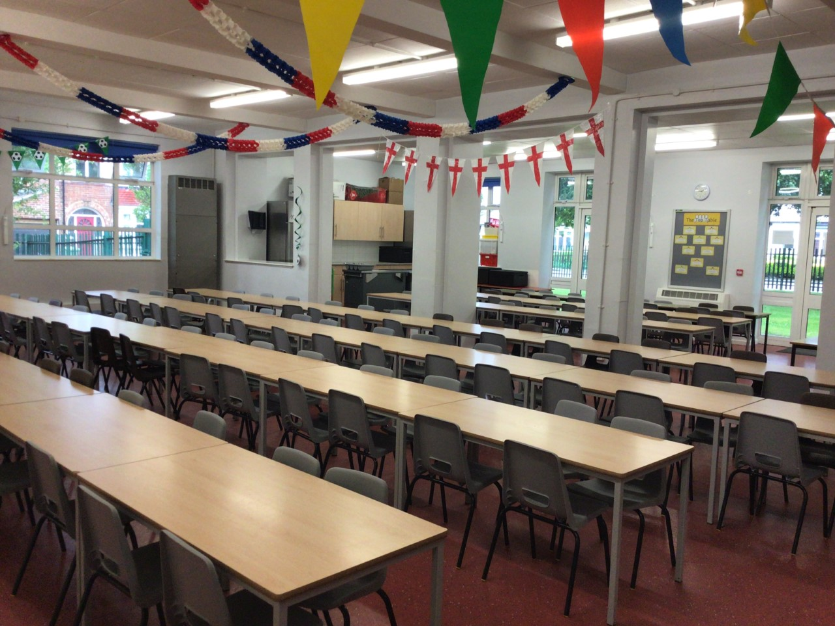
You will eat your dinner here.

Slide 9
This is what your day will look like.
9:00 – Registration
9:05 – Phonics/Spelling
9:30 - English
10:30 – Play Time
10.45 – Maths
12:00 Lunch
13:00 – Reading Time
13:30 – Afternoon lesson
15:15 – Home Time
Your timetable may differ sometimes to allow for other activities.

Slide 10
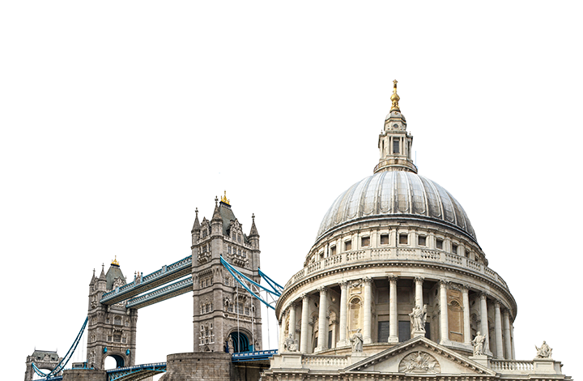
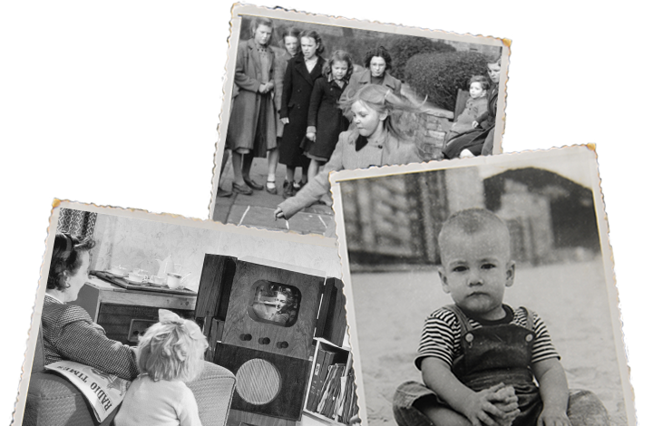
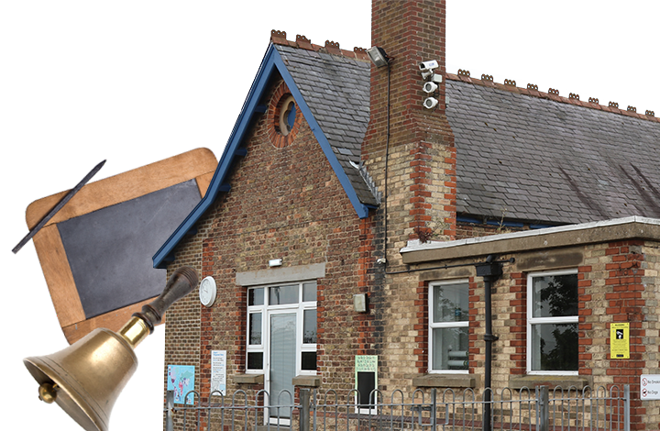
This is what you will be learning about.
Childhood
Bright Lights, Big City
School Days
Your timetable may differ sometimes to allow for other activities.

Slide 11
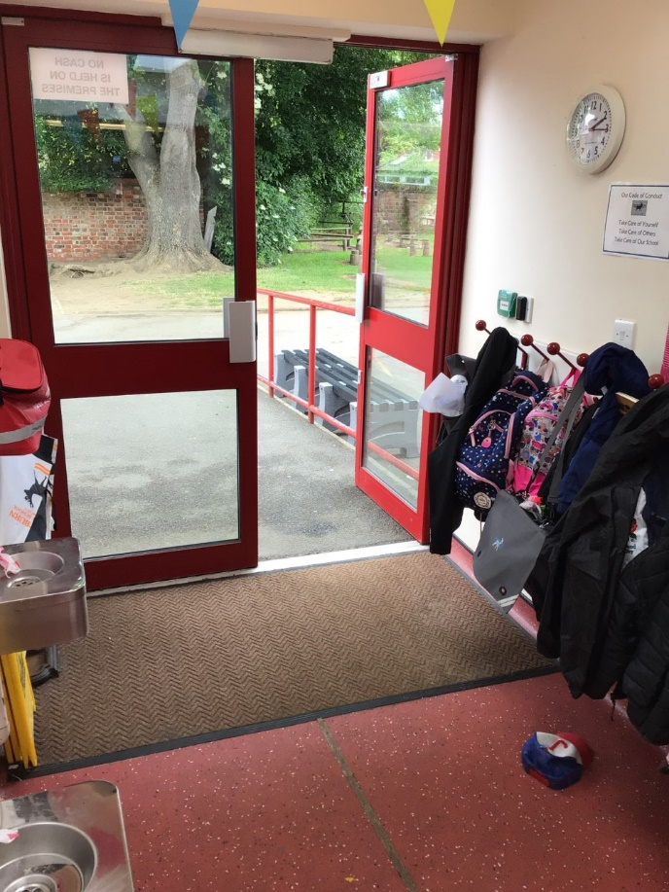
You will leave through this door.
You will finish school at 3.15pm.

Slide 12
We cannot wait
to see you in September!
Have a lovely summer and stay safe.

