Slide 1
Welcome to
Year 6

Slide 2
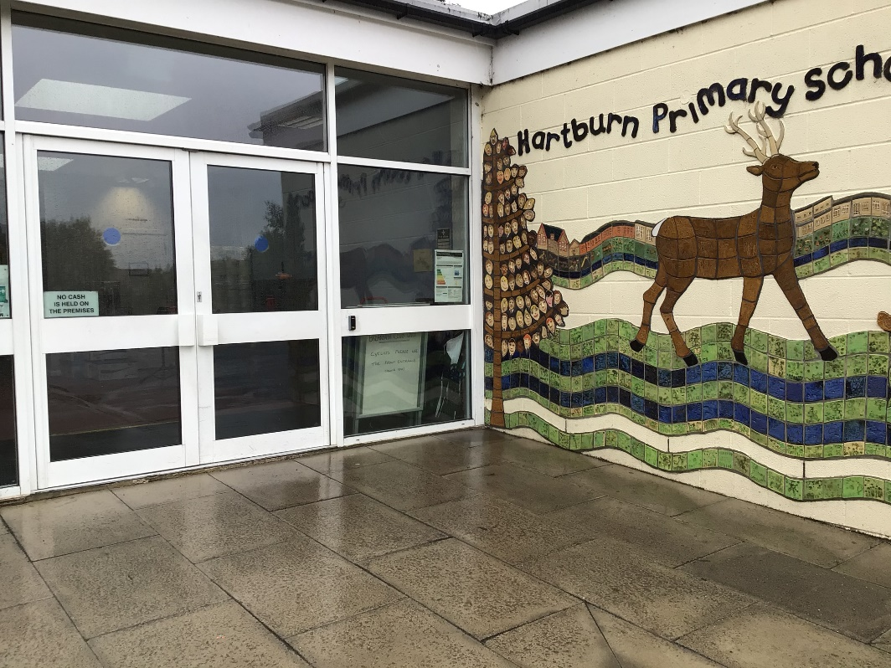
You will come in through this door.
Doors open at 8:45am and school starts at 9:00am.
Photo of door
It is really important that you are on time every morning!

Slide 3
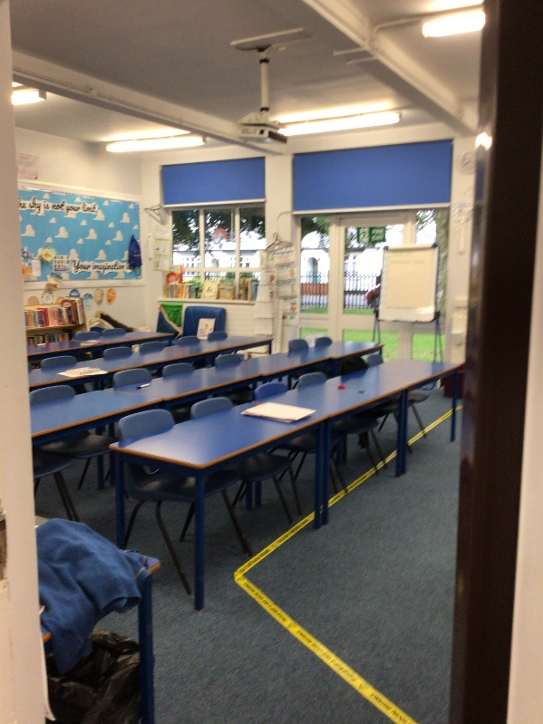
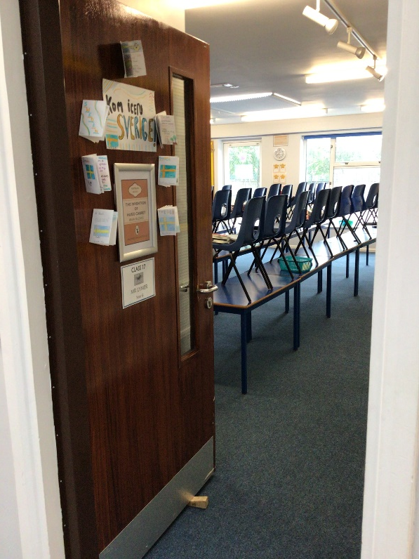
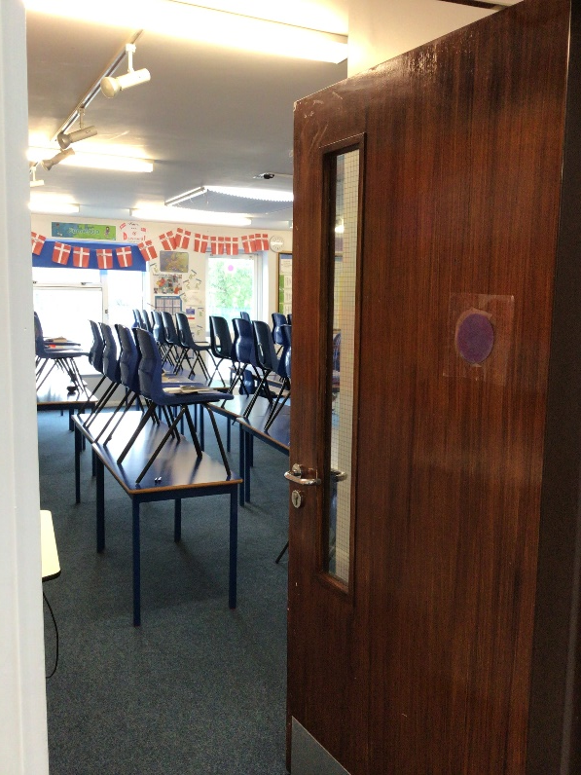
We have 3 classrooms in Year 6. Class 16, 17 and 18.
16
17
18

Slide 4
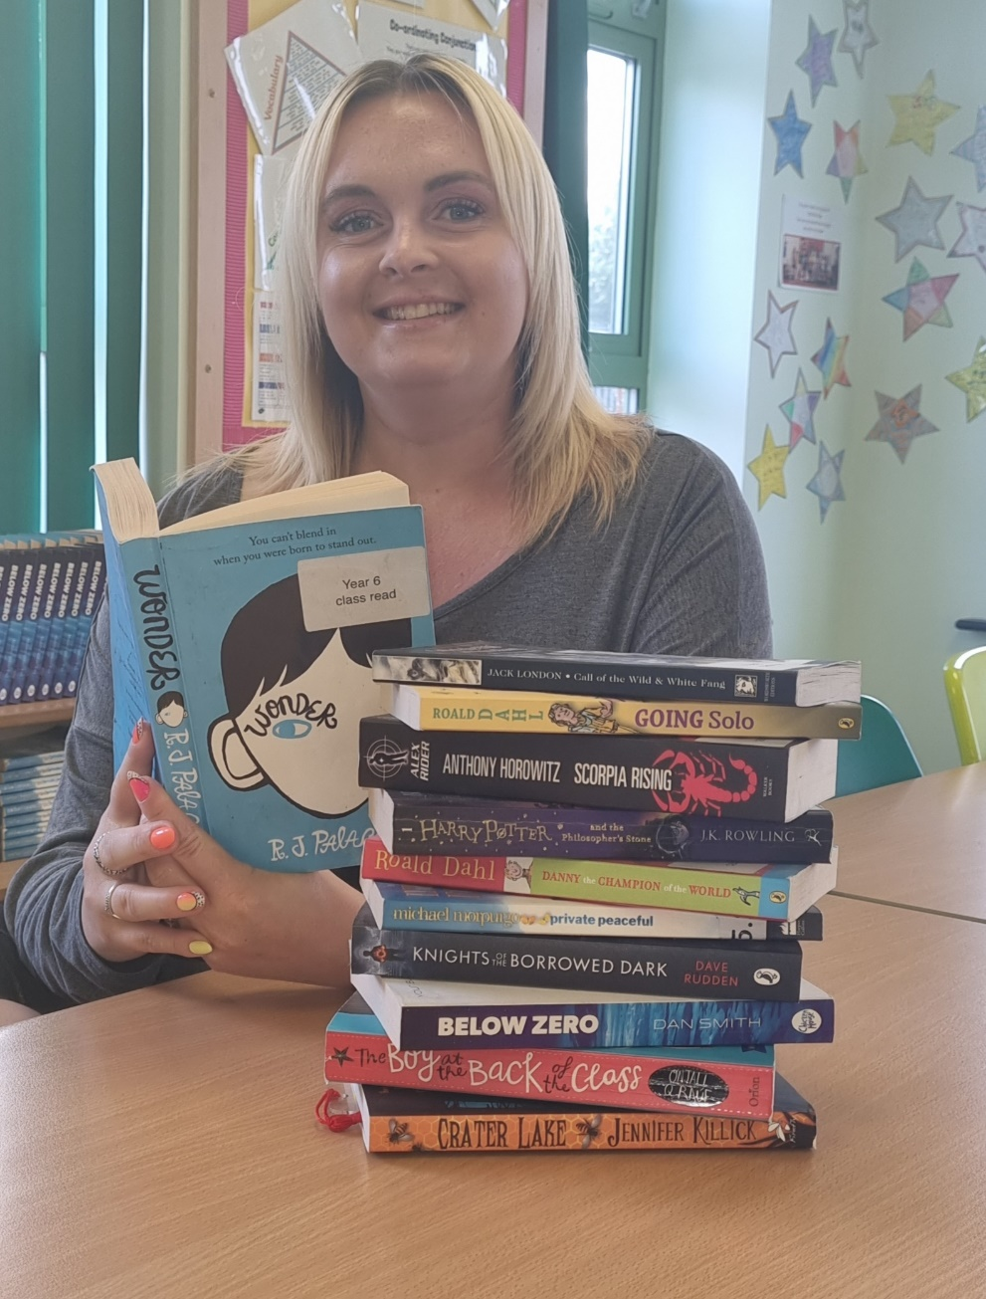
Some of you may also be taught by Mrs Holdsworth.

Slide 5
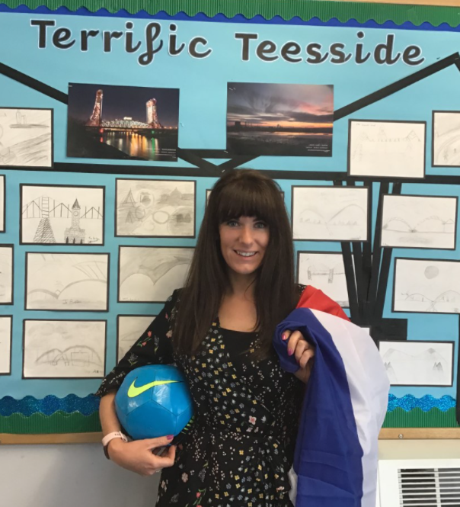
Class 16
Mrs Magowan

Slide 6
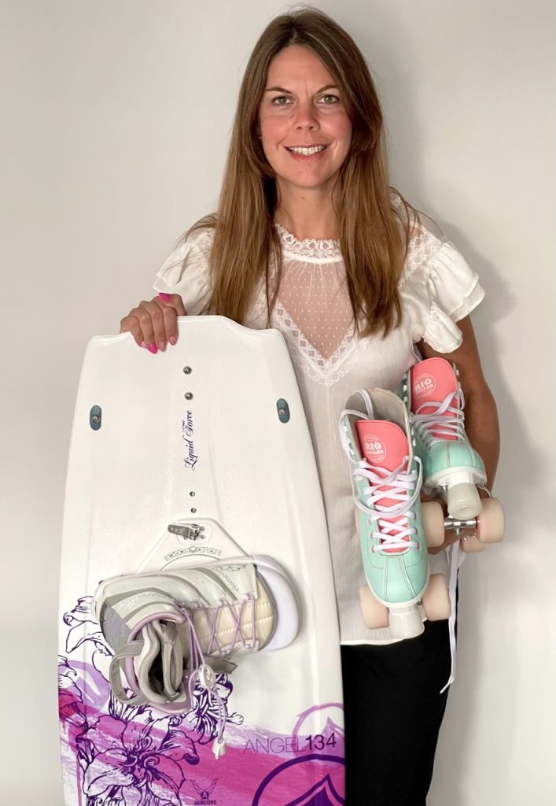
Class 17
Mrs Hills

Slide 7
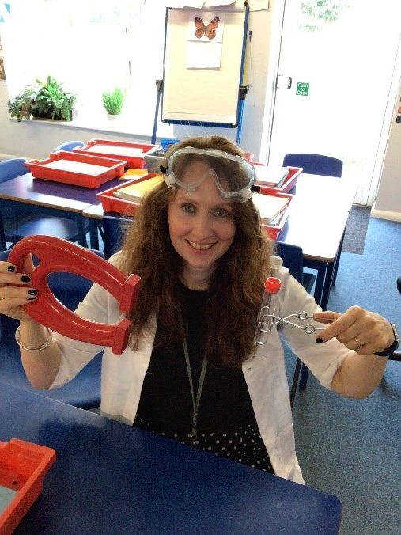
Class 18
Miss Danby

Slide 8
Some of you may also be taught by Mrs Holdsworth.

Slide 9
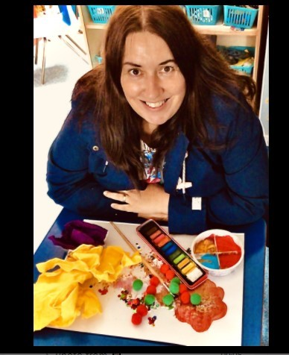
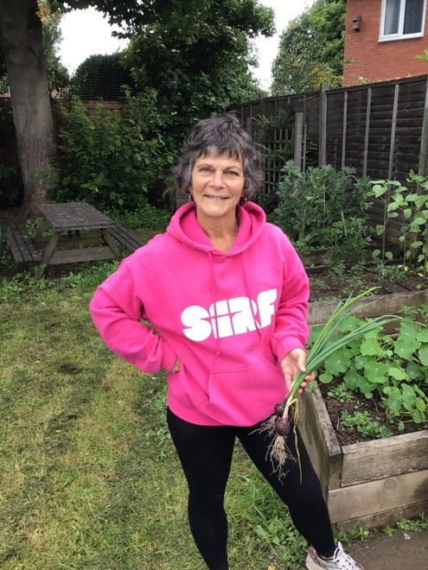
Year 6 Teaching Assistant
Mrs Neish
Mrs Nicholls
Mrs How

Slide 10
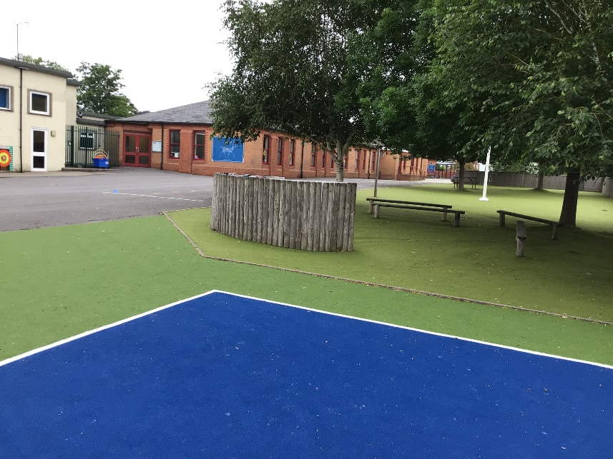
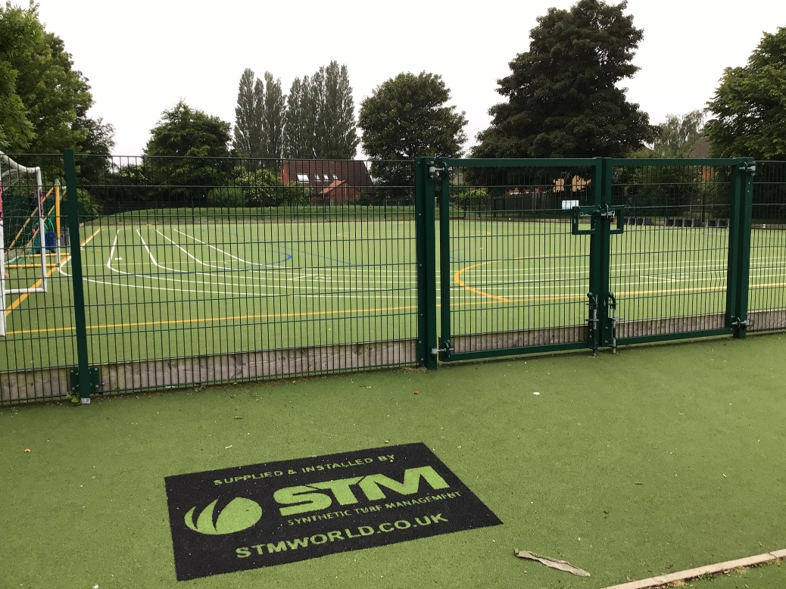
Outdoor Space.

Slide 11
You will eat your dinner here.

Slide 12
This is what your day will look like.
9:00 – Registration
9:15 – Reading
9:45 - English
10:45 – Break
11:00 – Maths
12:15 Lunch
13:15 – Afternoon lesson
15:15 - Home
Your timetable may differ sometimes to allow for other activities.

Slide 13
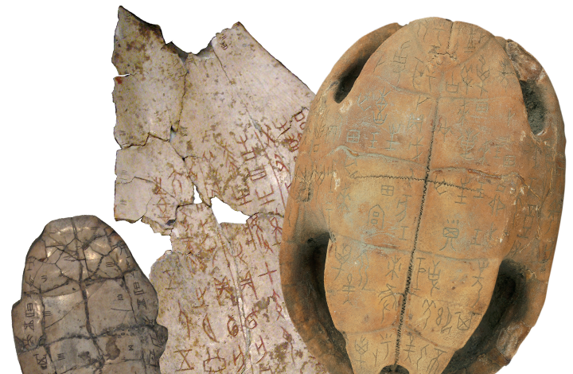
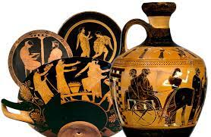
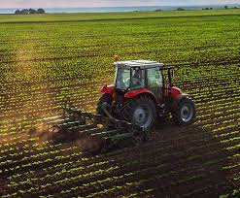
This is what you will be learning about.
Dynamic Dynasties
Sow, Grow and Farm
Groundbreaking Greeks

Slide 14
You will leave through this door.
You will finish school at 3:15 p.m.
Photo of door

Slide 15
We cannot wait
to see you in September!
Have a lovely summer and stay safe.

