Slide 1


Welcome to
Year 1

Slide 2
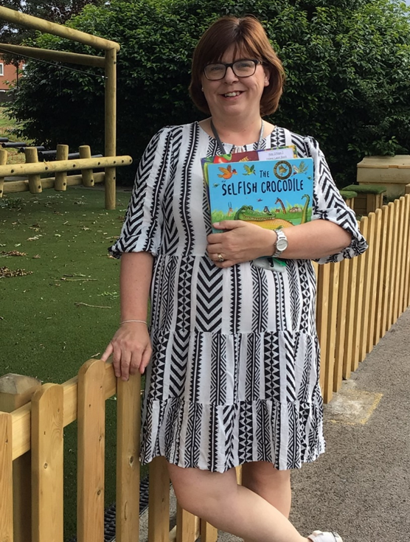
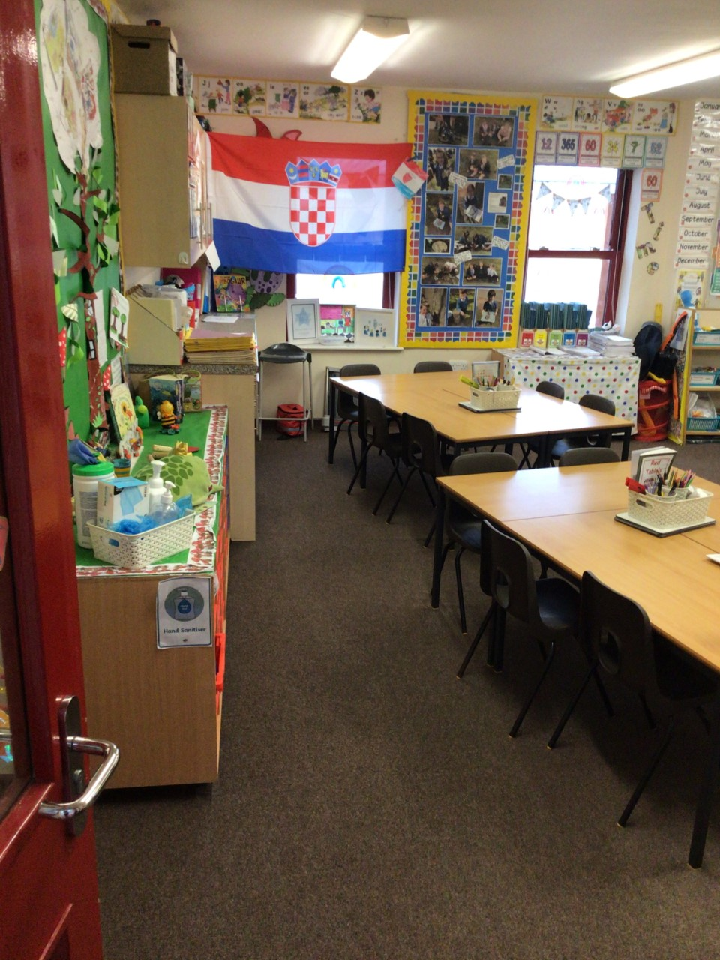
Class 4 – Mrs Swales

Slide 3
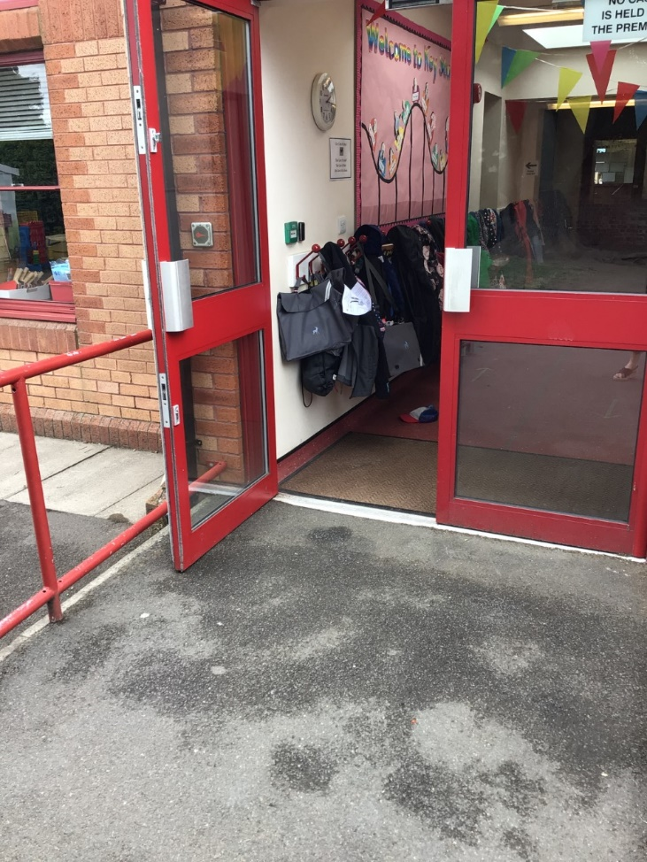
Class 4 you will come in through this door.
Doors open at 8:45am and school starts a 9:00am.
It is really important that you are on time every morning!

Slide 4
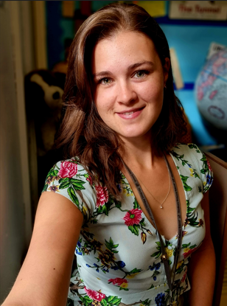
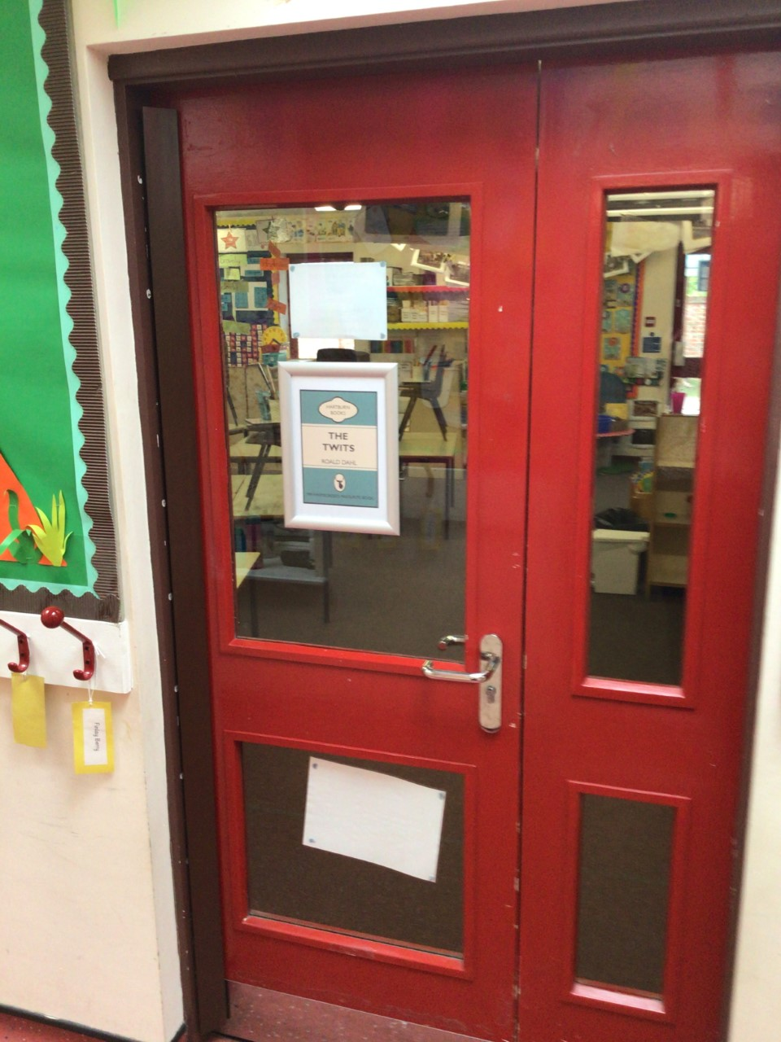
Class 5 – Miss Hoskin

Slide 5
Class 5 you will come in through this door.
Doors open at 8:45am and school starts a 9:00am.
It is really important that you are on time every morning!

Slide 6
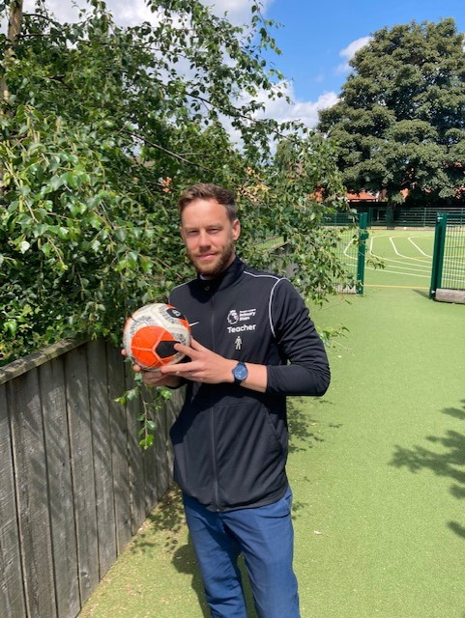
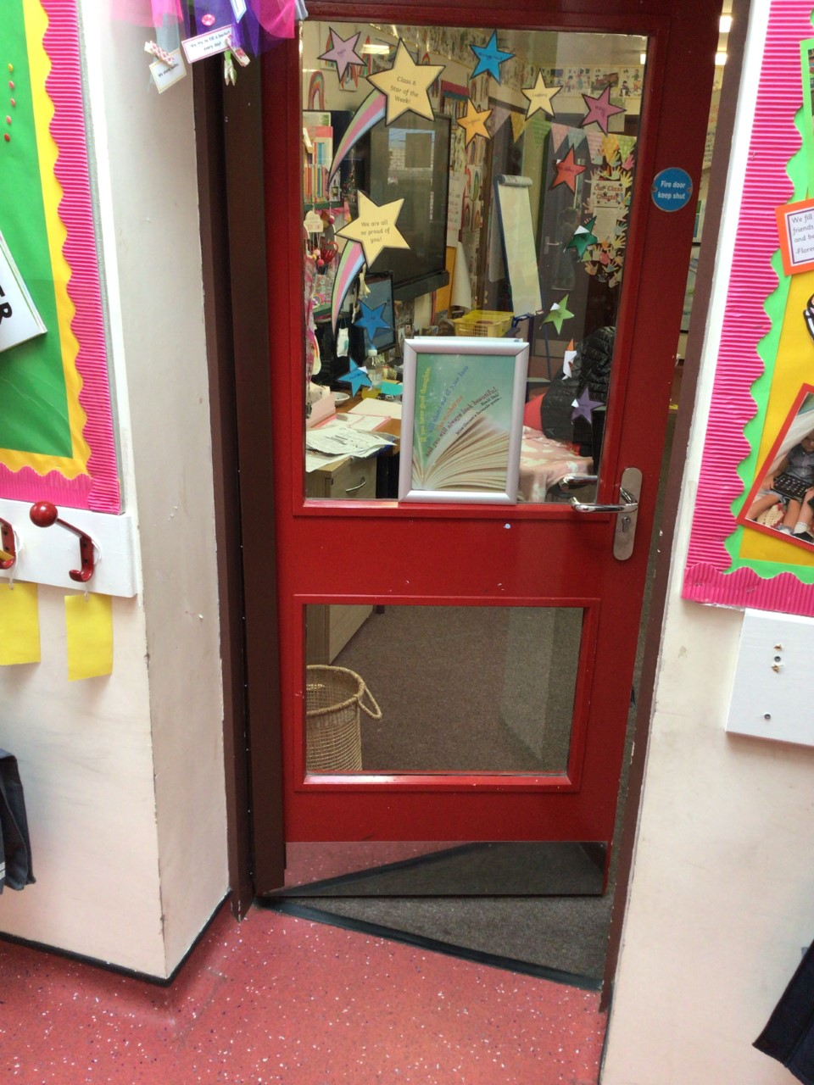
Class 6 – Mr Whitecross

Slide 7
Class 6 you will come in through this door.
Doors open at 8:45am and school starts a 9:00am.
It is really important that you are on time every morning!

Slide 8
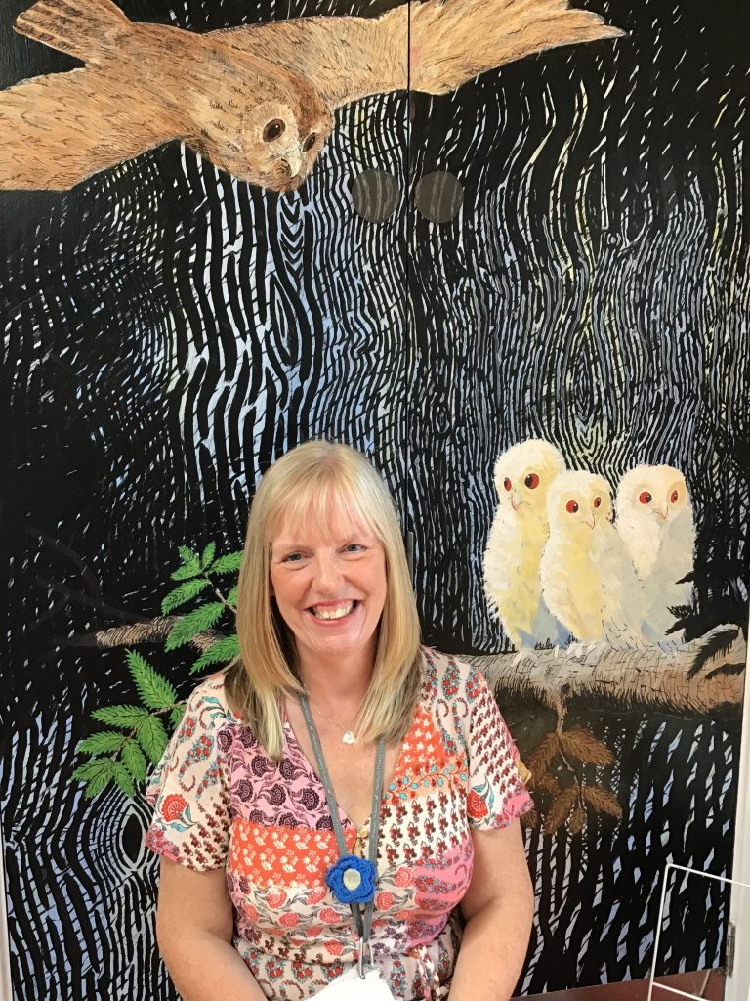
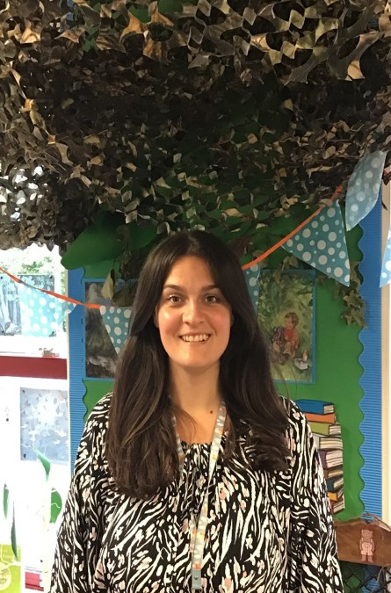
Our Terrific Teaching Assistants
Mrs Smith
Mrs Brennan

Slide 9
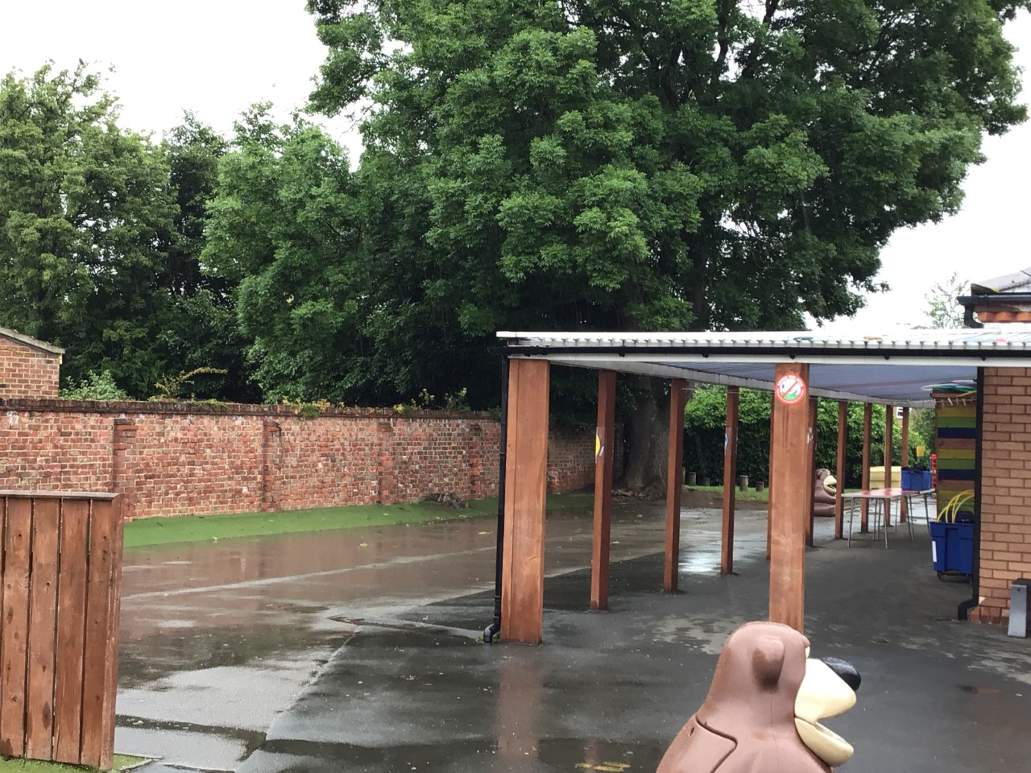
Outdoor Space – you will have your playtime here.

Slide 10
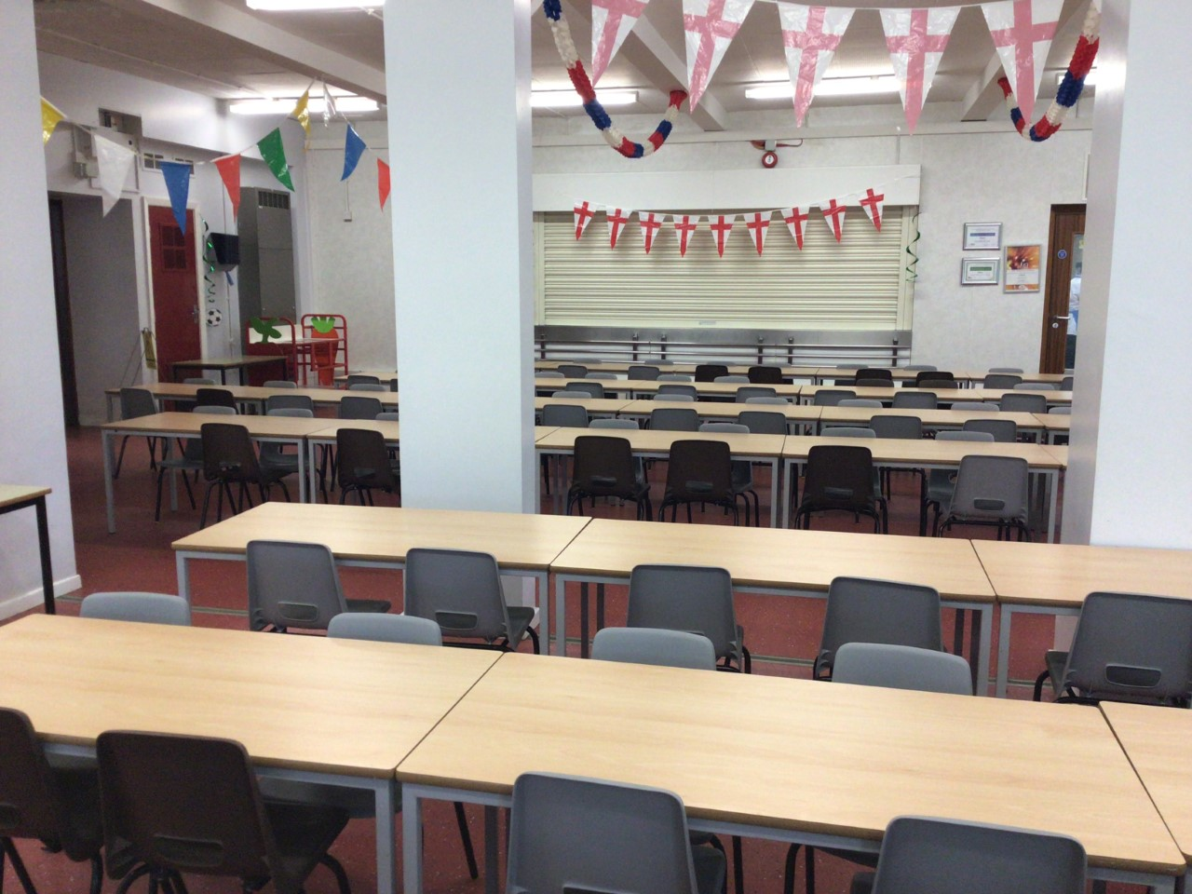
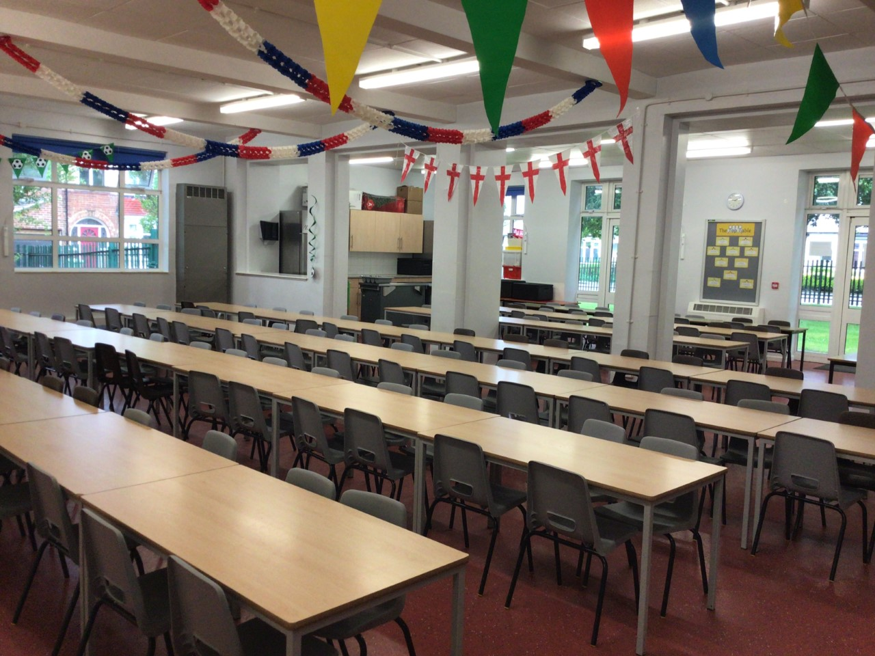
You will eat your dinner here.

Slide 11
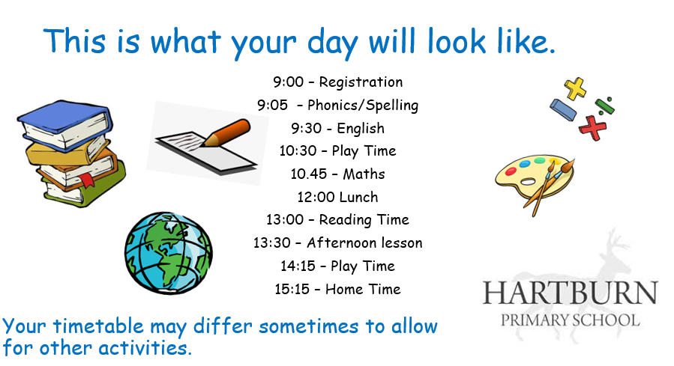

Slide 12
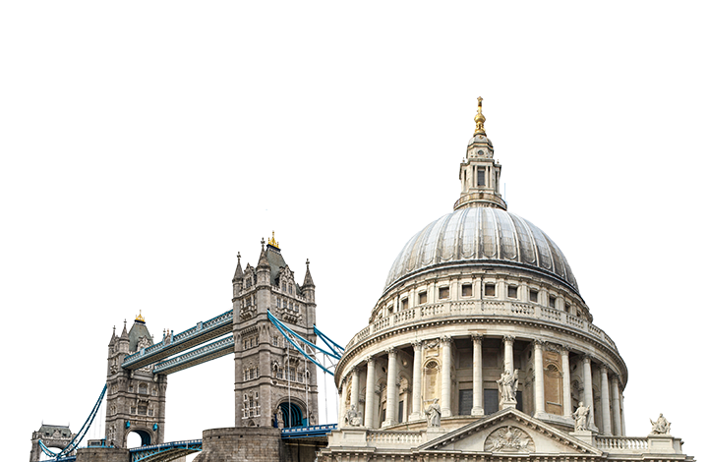

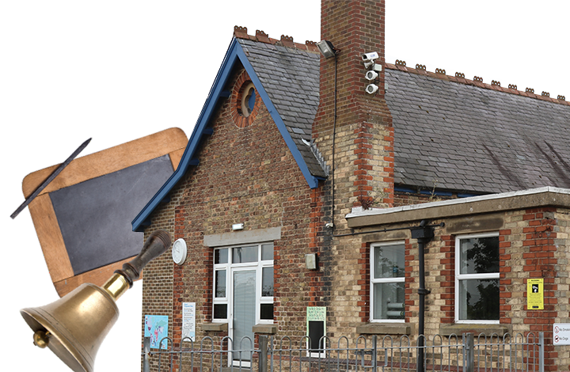
This is what you will be learning about.
Superheroes
Bright Lights, Big City
School Days
Your timetable may differ sometimes to allow for other activities.

Slide 13
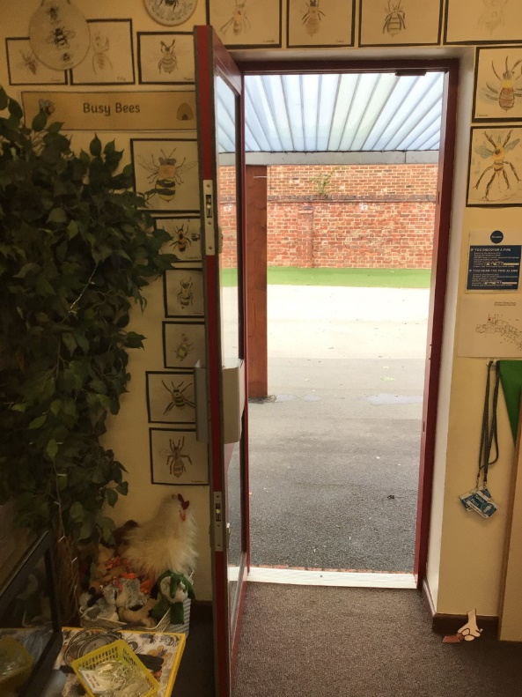
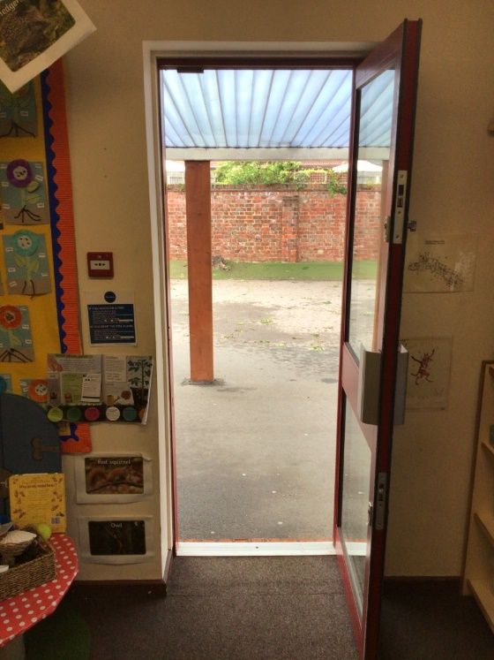
Class 4 and 5 you will leave through your classroom doors.
You will finish school at 3.15pm.
Class 4
Class 5

Slide 14
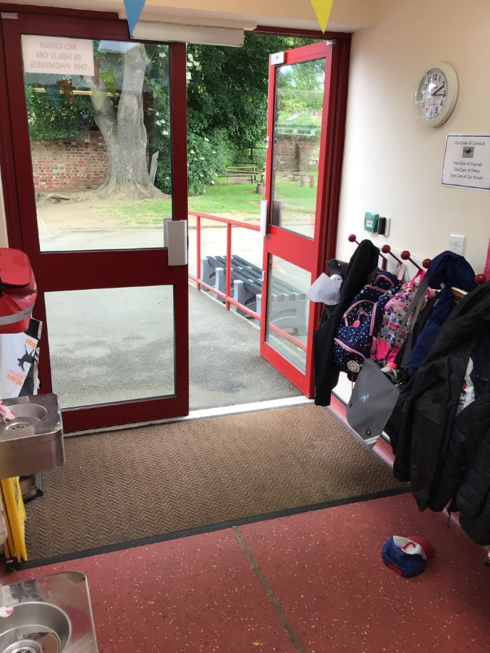
Class 6 you will leave through this door.
You will finish school at 3.15pm.

Slide 15
We cannot wait
to see you in September!
Have a lovely summer!

