Slide 1


Welcome to
Year 2

Slide 2
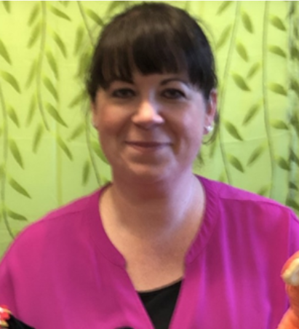
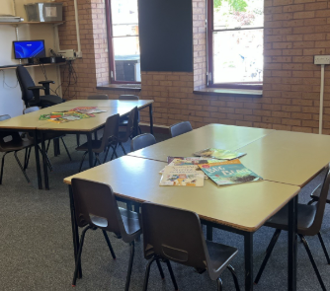
Class 7 – Miss Thompson

Slide 3
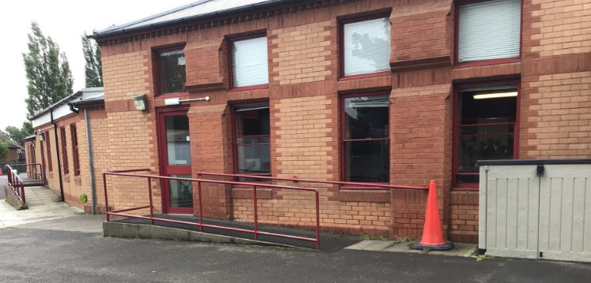
You will come in and leave through this door.
Doors open at 8:45am and school starts a 9:00am.
School finishes at 3:15pm.
It is really important that you are on time every morning!

Slide 4
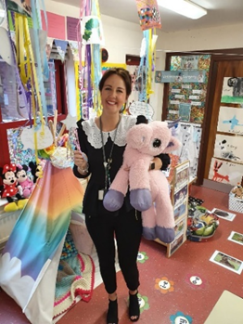
Class 8 – Mis Connett

Slide 5
You will come in and leave through this door.
Doors open at 8:45am and school starts a 9:00am.
School finishes at 3:15pm.
It is really important that you are on time every morning!

Slide 6
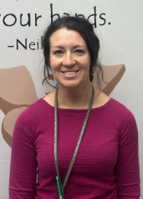
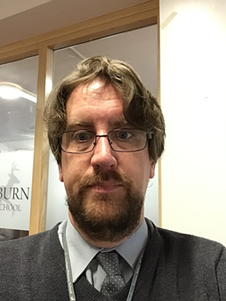
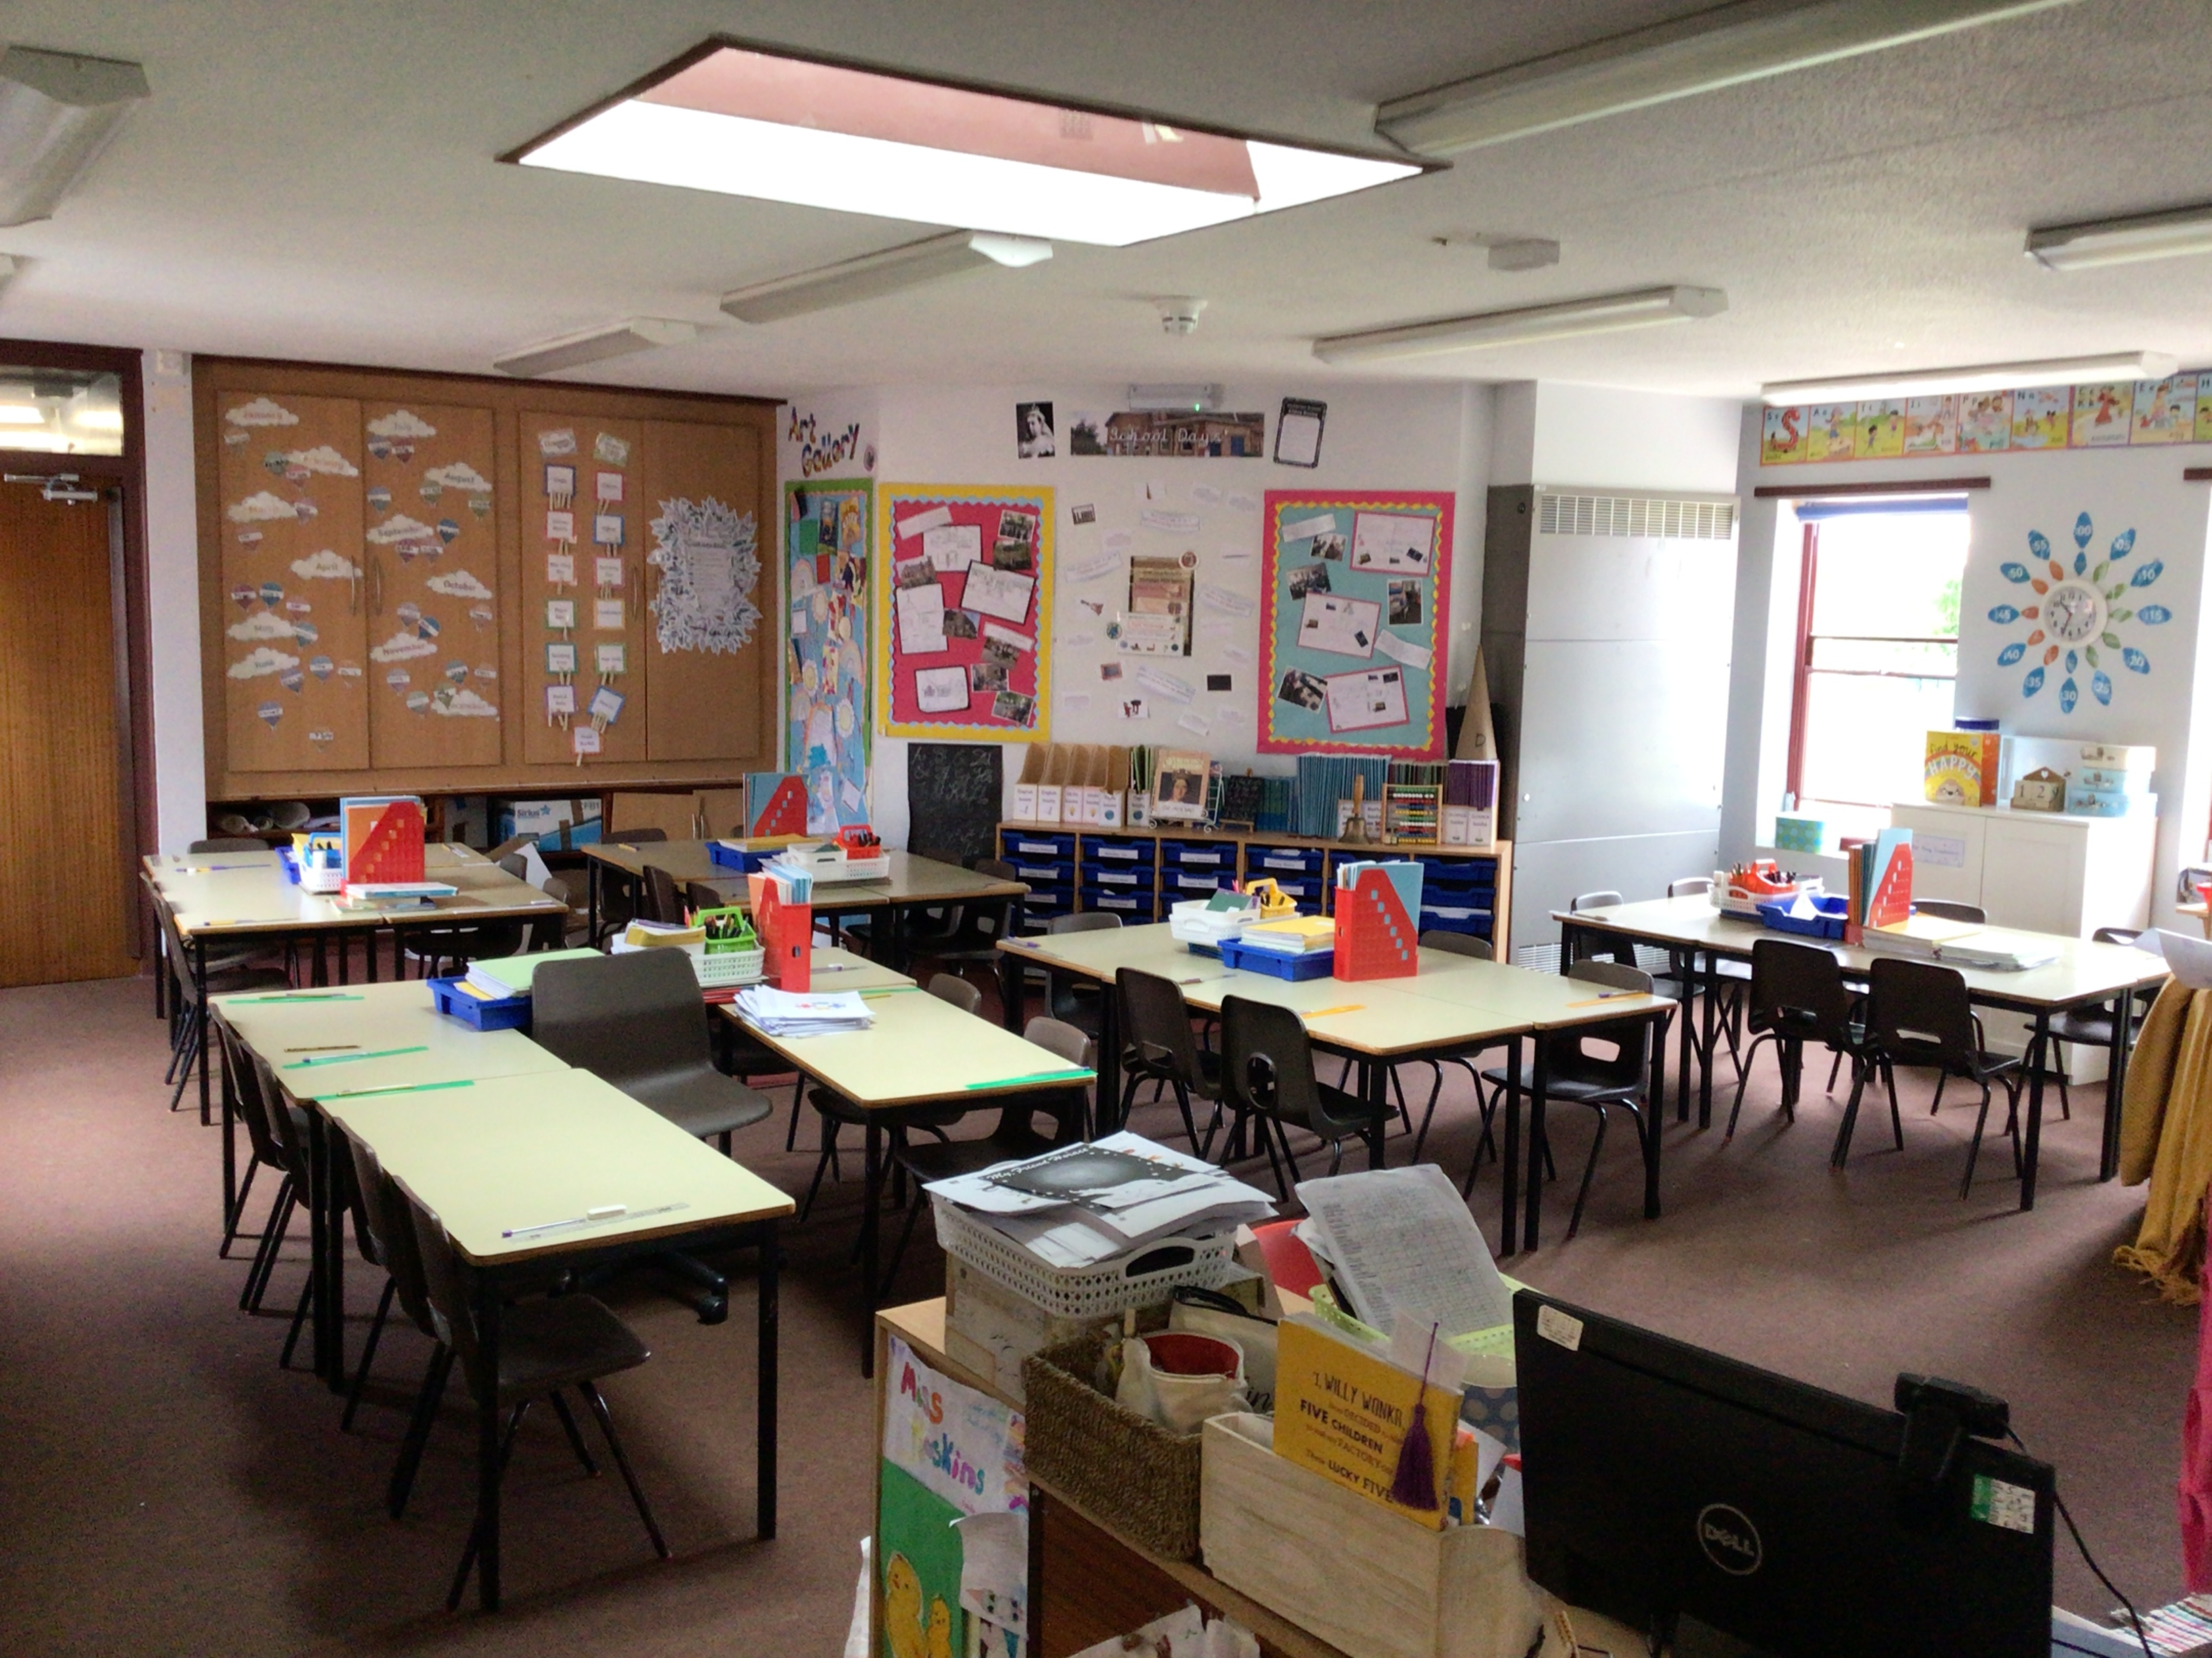
Class 9 – Mrs Crellin & Mr Nixon

Slide 7
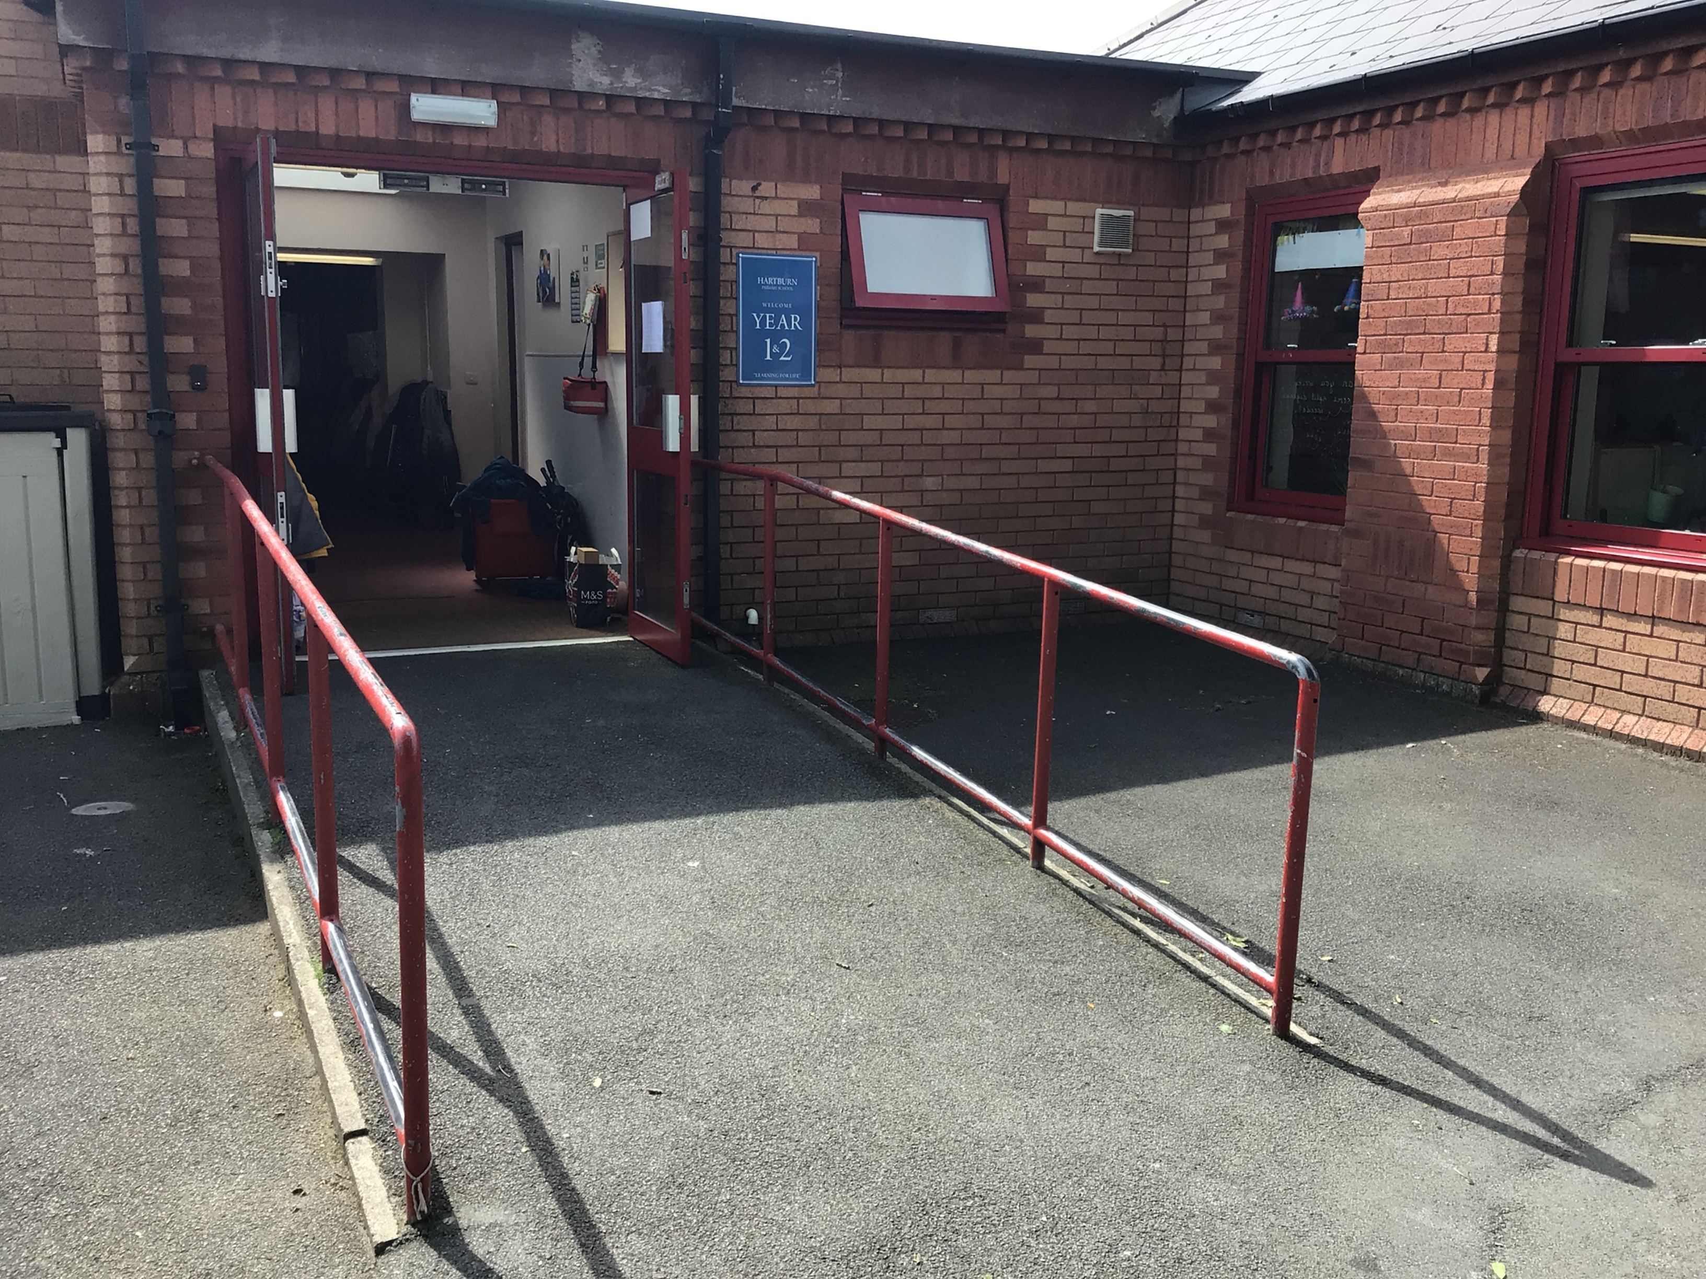
You will come in and leave through this door.
Doors open at 8:45am and school starts a 9:00am.
School finishes at 3:15pm.
It is really important that you are on time every morning!

Slide 8
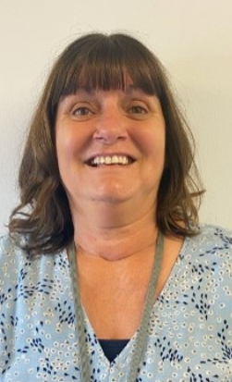
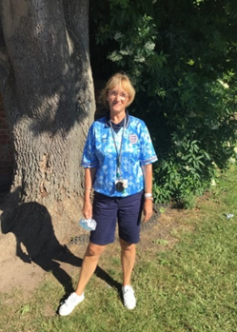
Our Terrific Teaching Assistants
Mrs George
Miss Lockwood

Slide 9
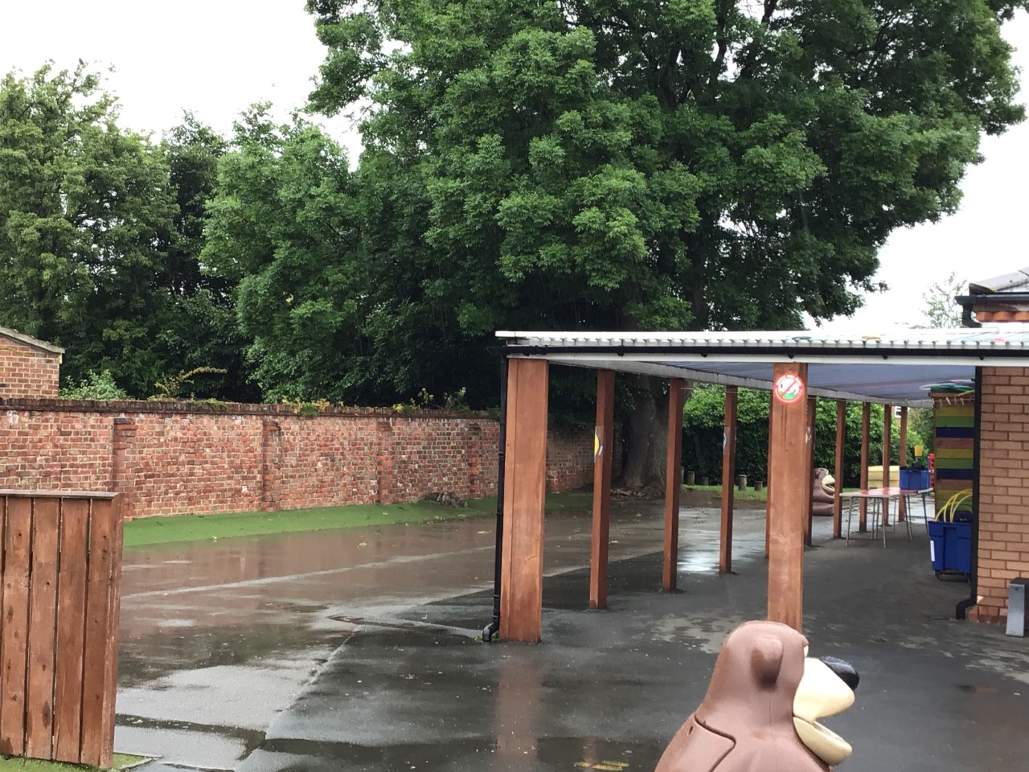
Outdoor Space.

Slide 10
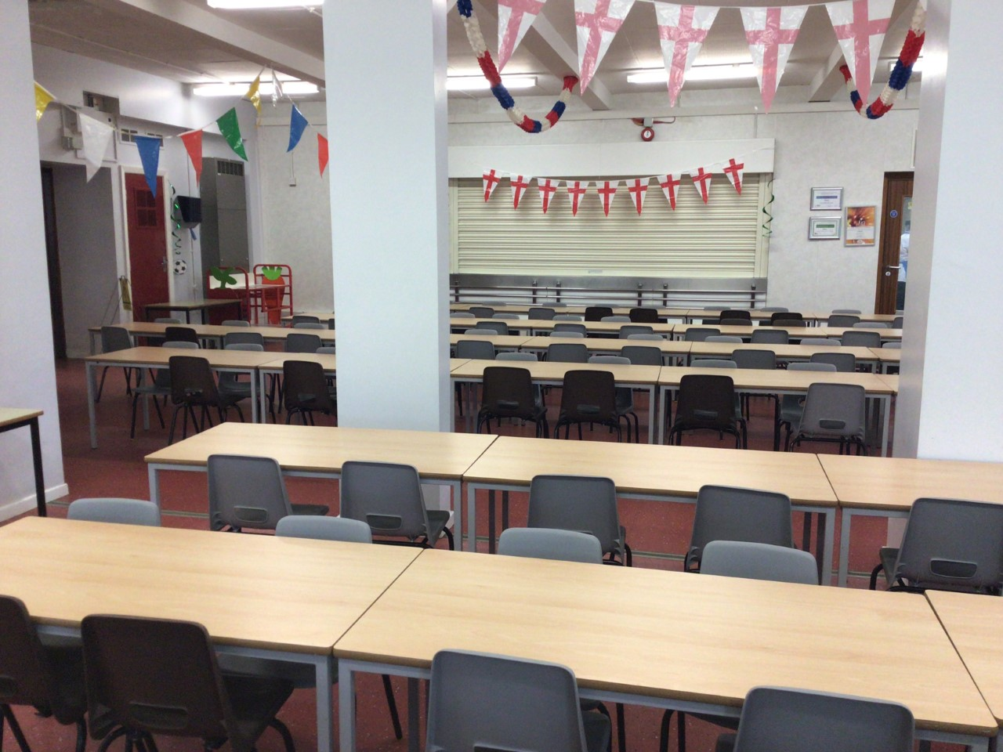
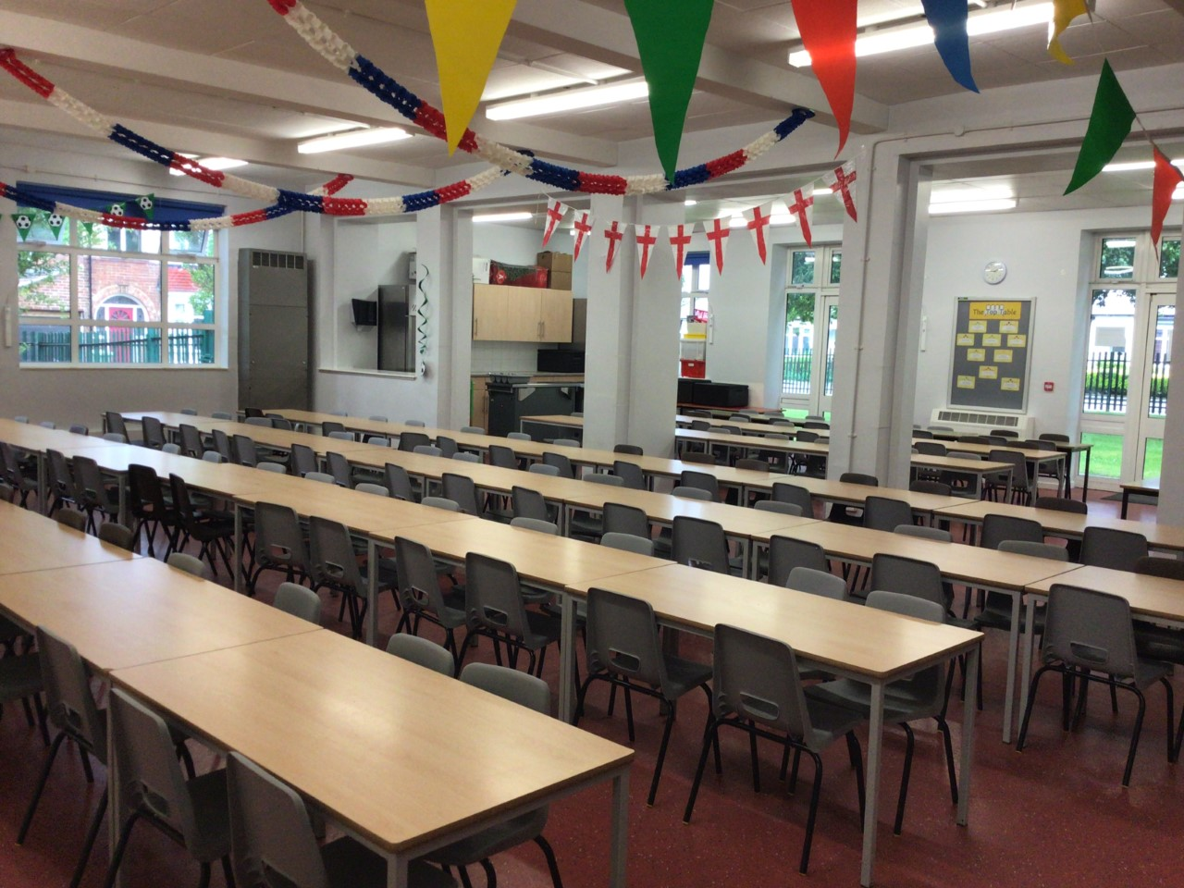
You will eat your dinner here.

Slide 11





This is what your day will look like.
9:00 – Registration
9:05 – Phonics/Spelling
9:30 - English
10:30 – Play Time
10.45 – Maths
12:00 Lunch
13:00 – Reading Time
13:30 – Afternoon lesson
2:15 – Play Time
15:15 – Home Time
Your timetable may differ sometimes to allow for other activities.

Slide 12
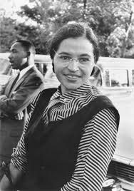
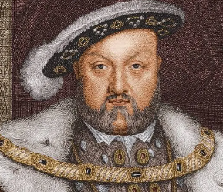
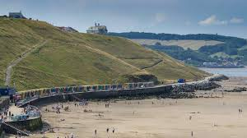
This is what you will be learning about.
Movers and Shakers
Coastline
Magnificent Monarchs

Slide 13
We cannot wait
to see you in September!
Have a lovely summer and stay safe.

