Slide 1


Welcome to
Year 3

Slide 2
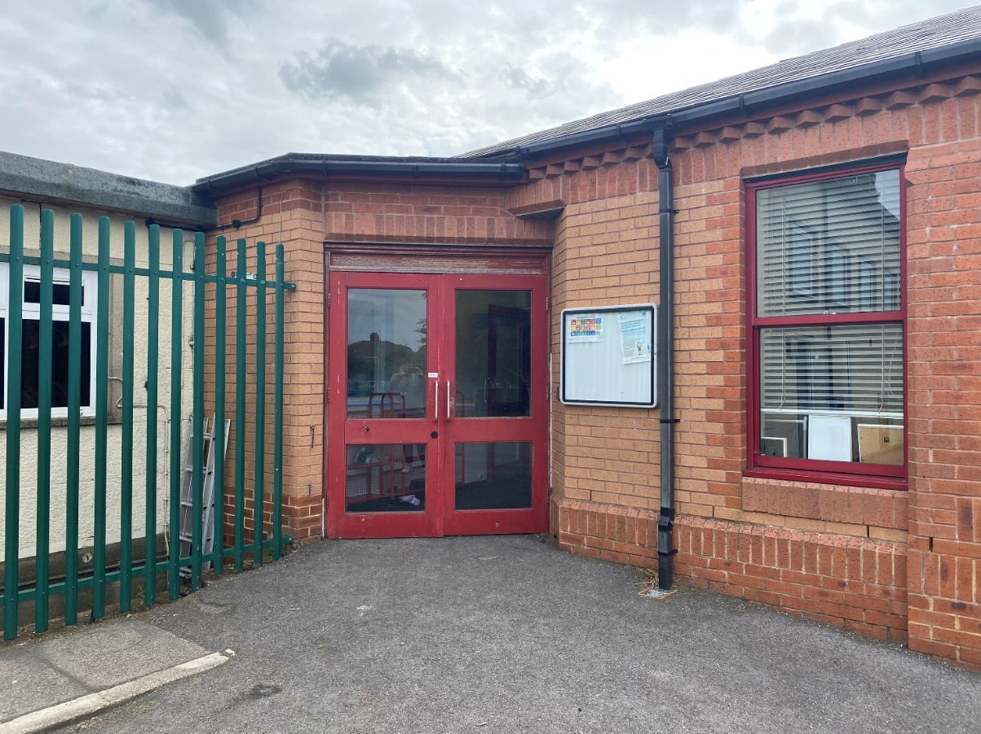
You will come in through this door.
Doors open at 8:45am and school starts a 9:00am.
It is really important that you are on time every morning!

Slide 3
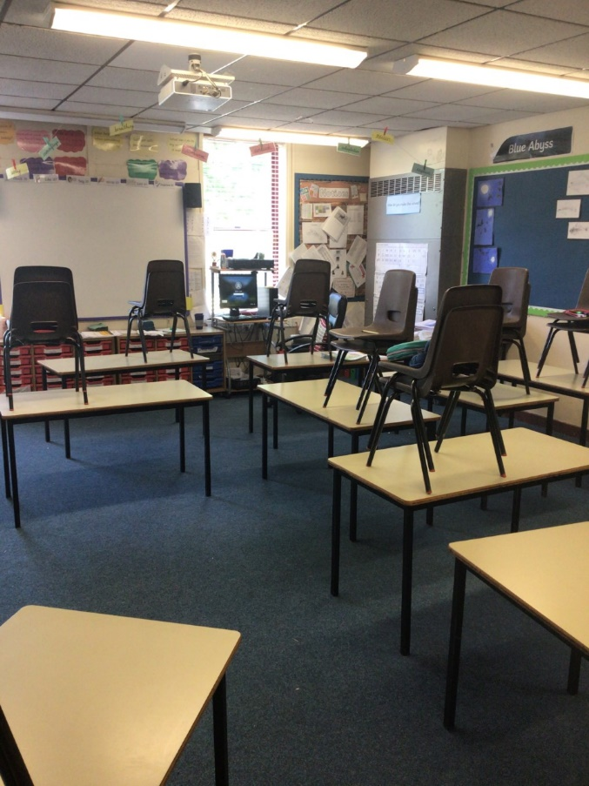
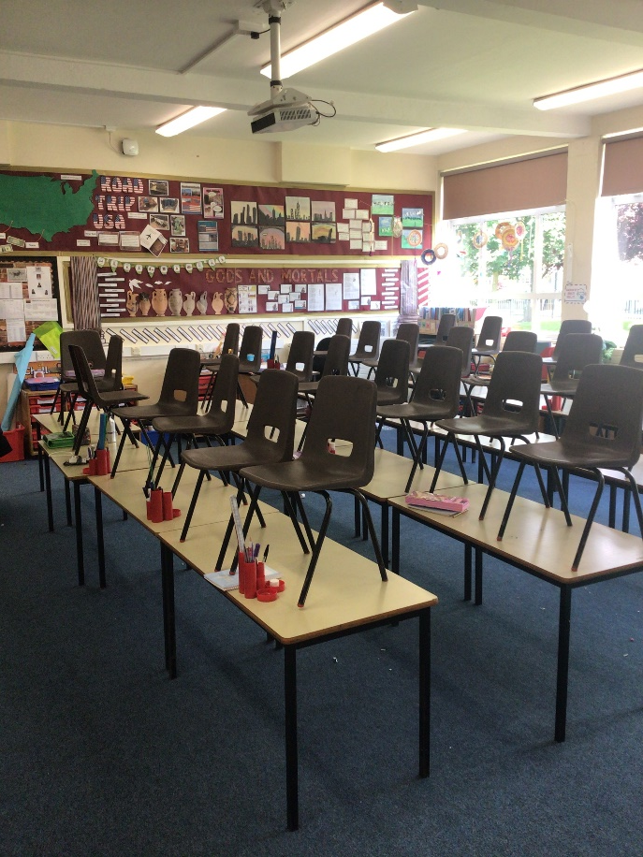
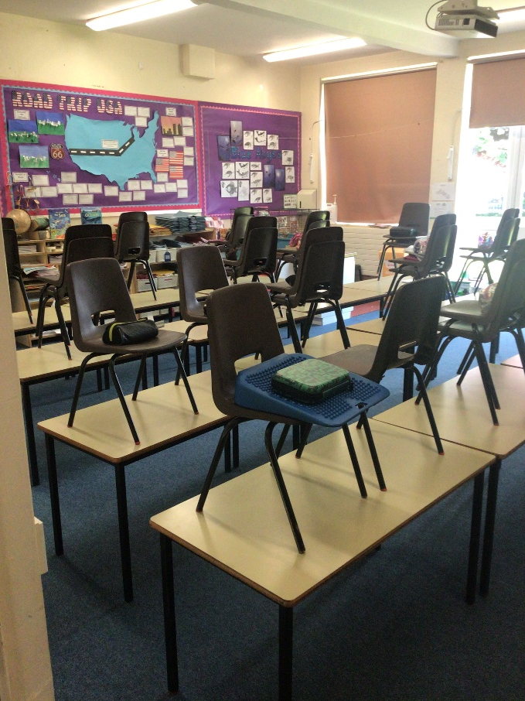
We have 3 classrooms in Year 3: Class 10, 11 and 12.
Class 10
Class 11
Class 12

Slide 4
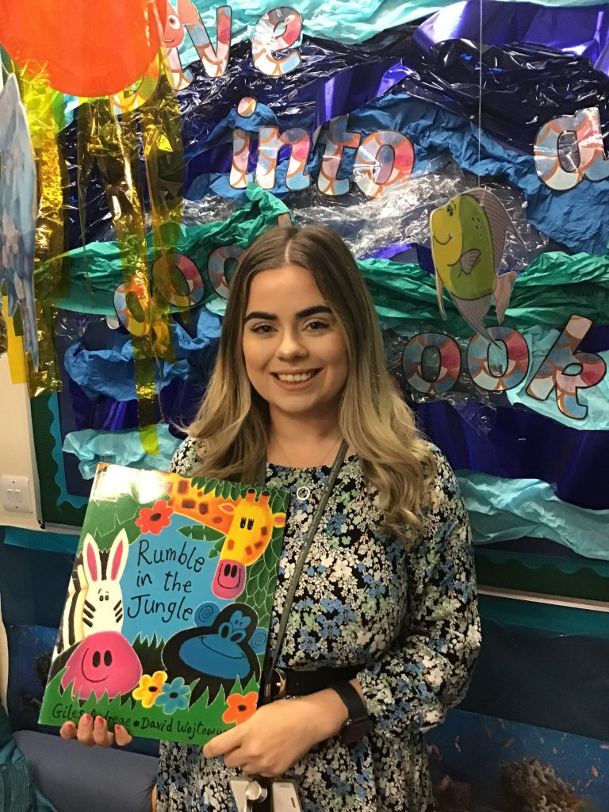
Class 10
Mrs Eddy

Slide 5
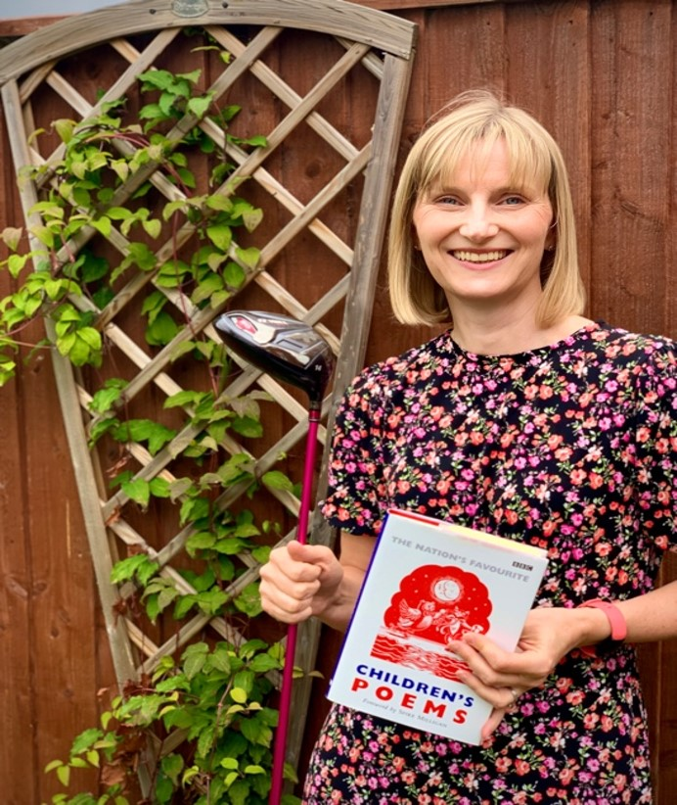
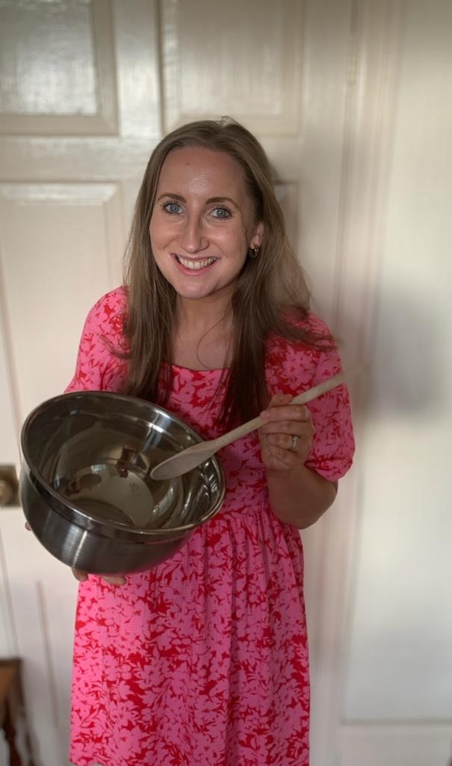
Class 11
Mrs Willox
Mrs Whem

Slide 6
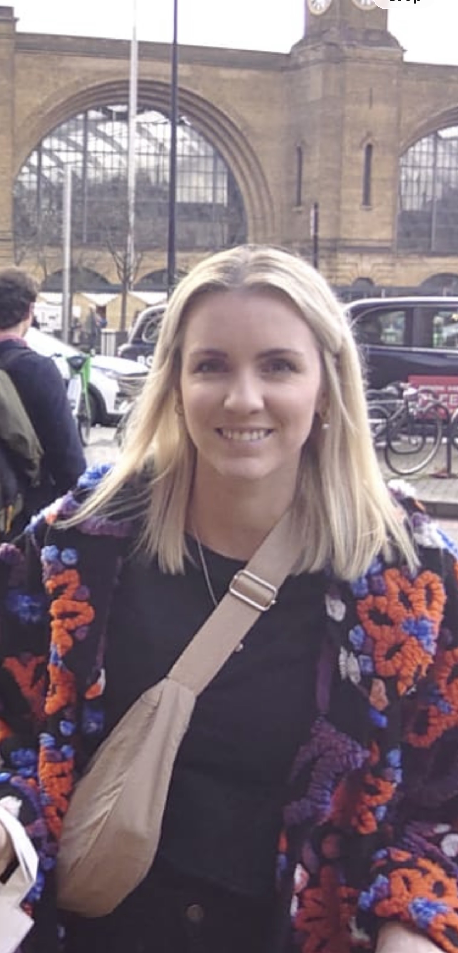
Class 12
Miss Walker

Slide 7
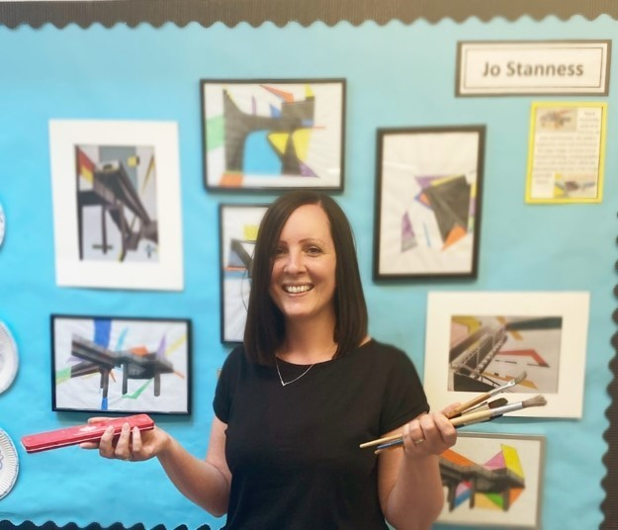
Some of you may also be taught by Mrs McKibben.

Slide 8
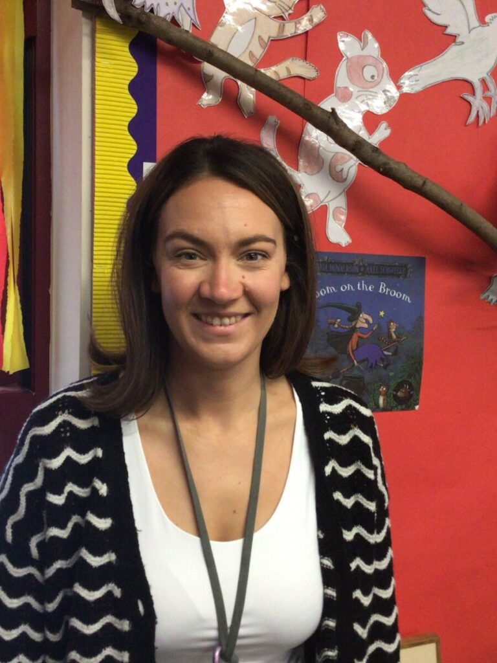
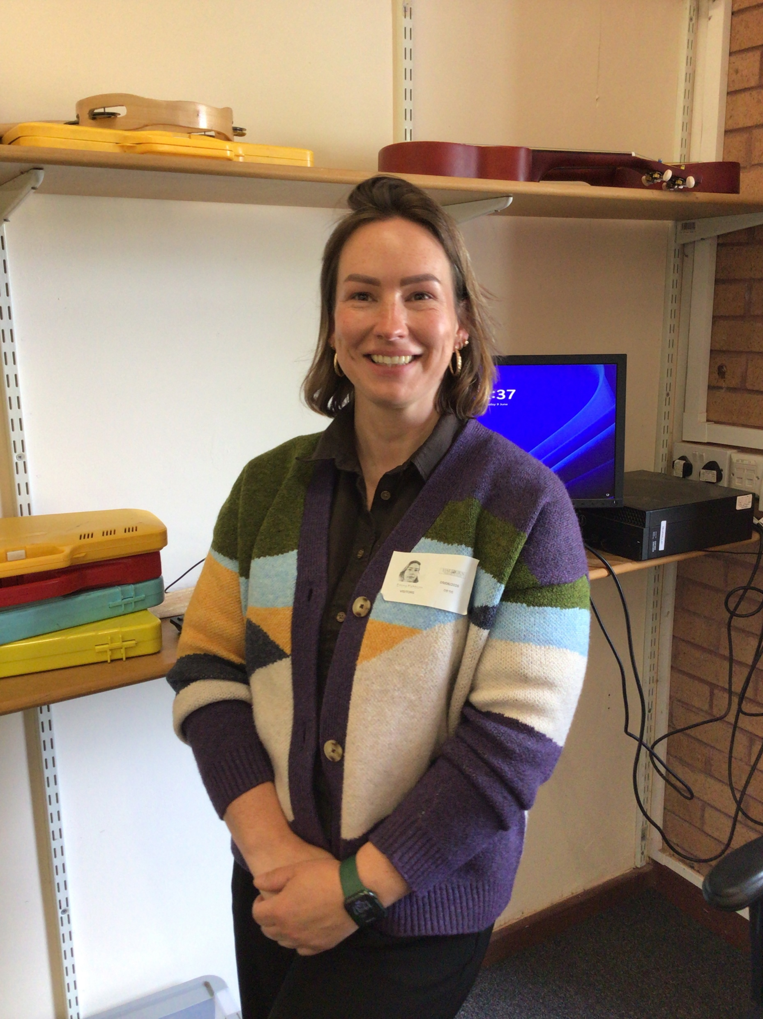
Our Fantastic Teaching Assistants
Mrs Garbutt
Miss Fishburn

Slide 9
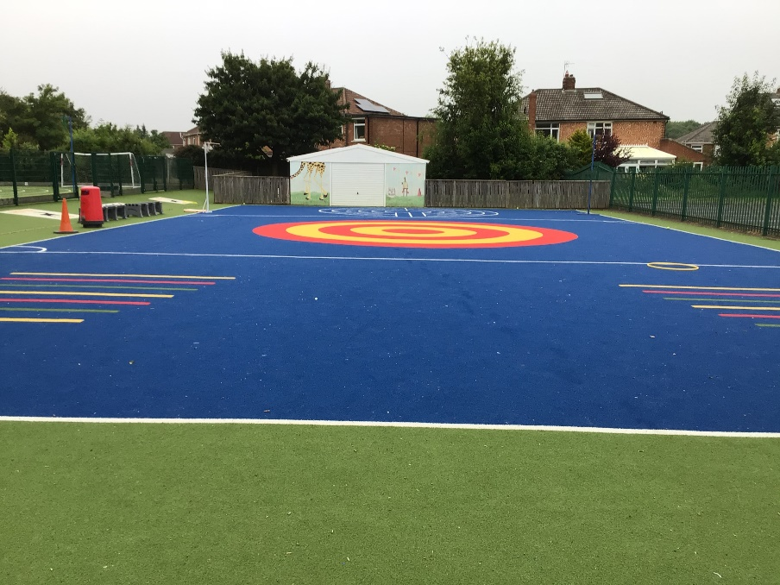
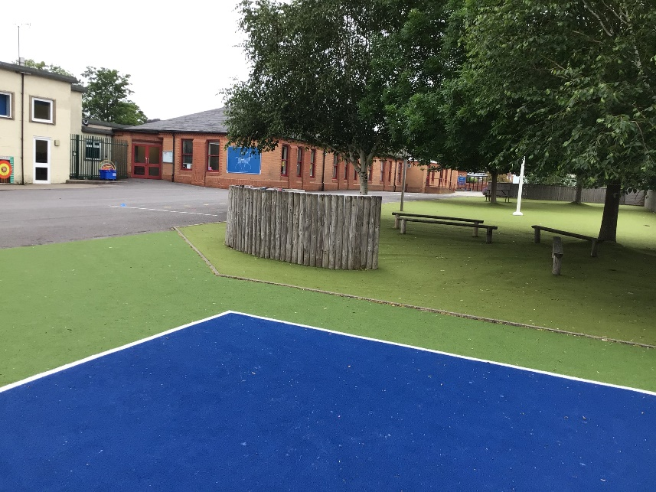
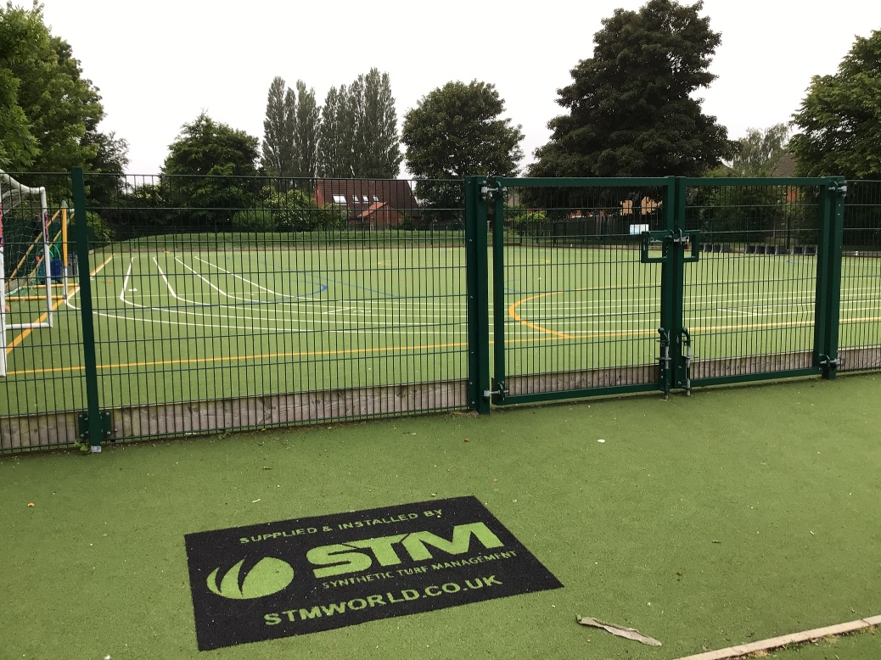
Outdoor Space.

Slide 10
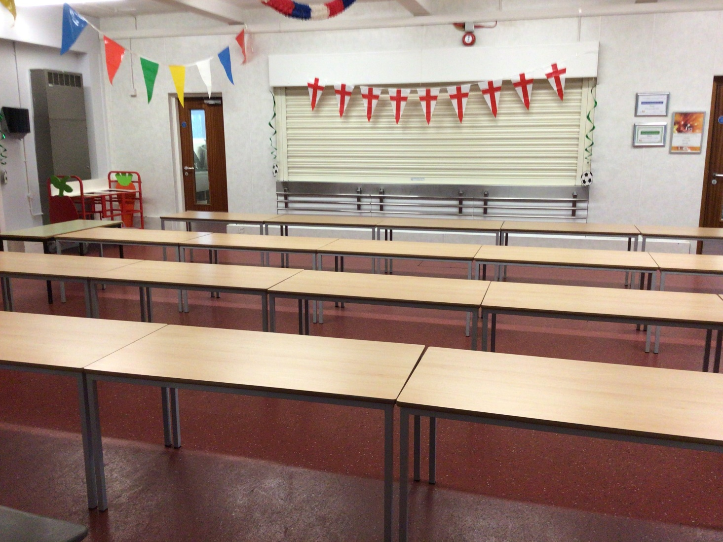
You will eat your dinner here.

Slide 11
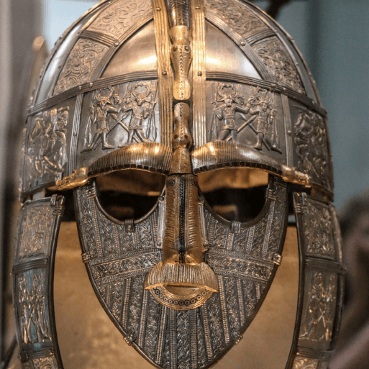
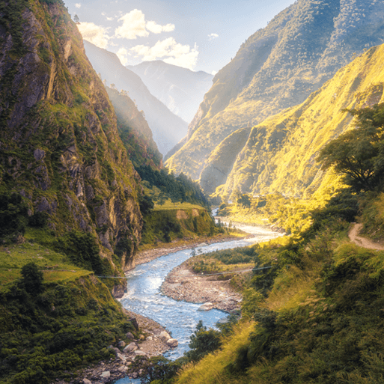
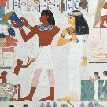
This is what you will be learning about.
Invasion
Misty Mountain, Winding River
Ancient Civilisations

Slide 12





This is what your day will look like.
9:00 – Registration
9:15 – Reading
9:30 - English
10:45 – Break
11:00 – Maths
12:15 Lunch
13:15 – Afternoon lesson
14:30 – Afternoon lesson
15:15 - Home
Your timetable may differ sometimes to allow for other activities.

Slide 13
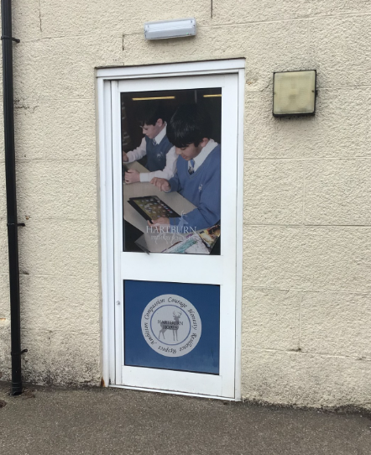
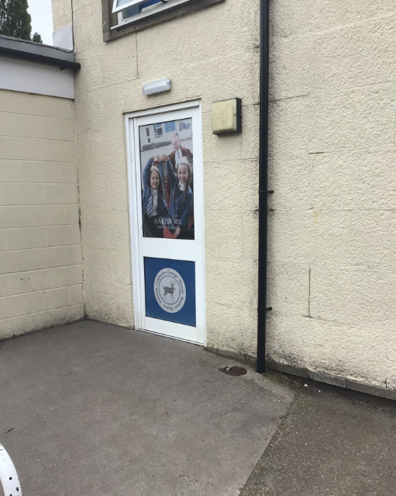

You will leave through this door.
Class 10
Class 11
Class 12
You will finish school at 3:15.

Slide 14
We cannot wait
to see you in September!
Have a lovely summer and stay safe.

