Slide 1


Welcome to
YEAR 5

Slide 2
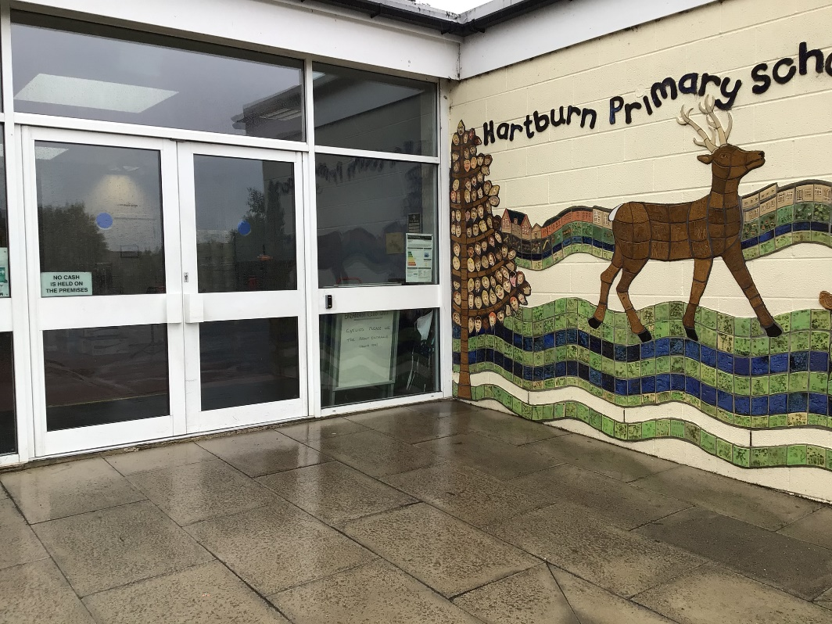
You will come in through this door.
Doors open at 8:45am and school starts at 9:00am.
Photo of door
It is really important that you are on time every morning!

Slide 3
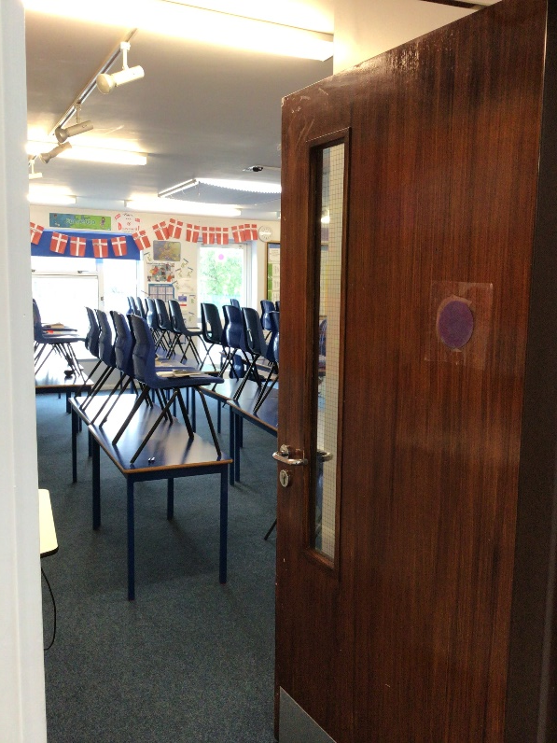
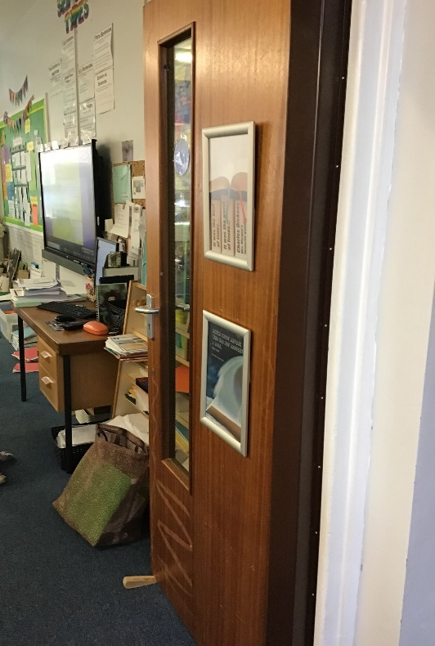
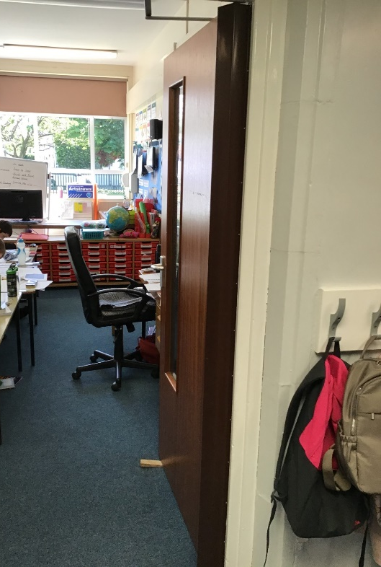
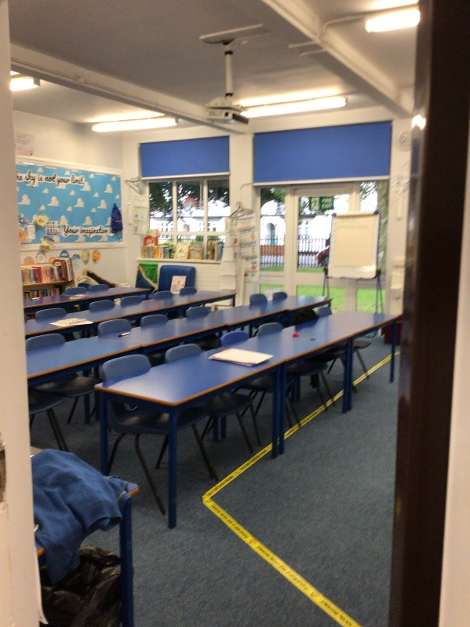
We have 3 classrooms in Year 5.
Class 15, 16 and 17.
15
16
17

Slide 4
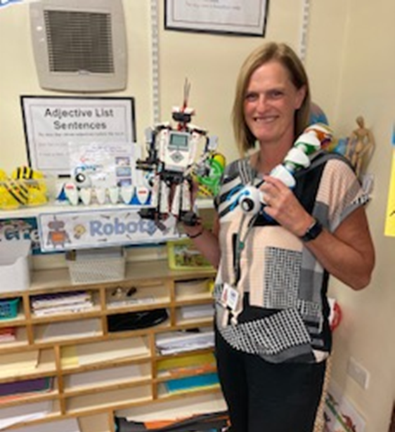
Class 15
Miss Wildridge

Slide 5
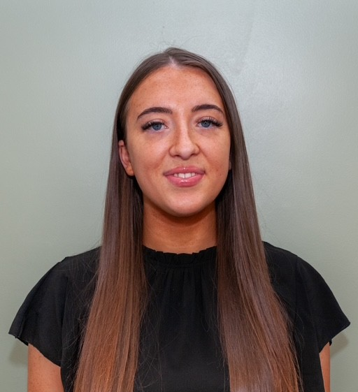
Class 16
Miss Reid

Slide 6
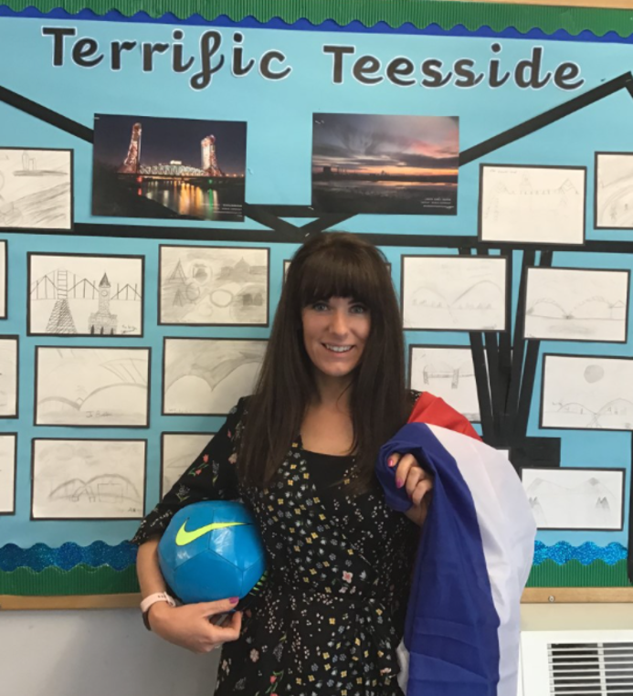
Class 17
Miss Collins

Slide 7
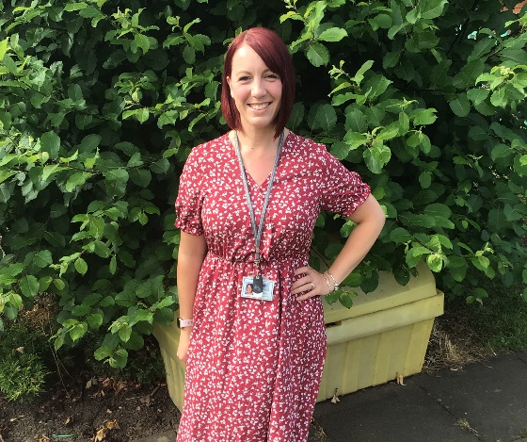
Year 5 Teaching Assistant
Mrs Thurlwell

Slide 8
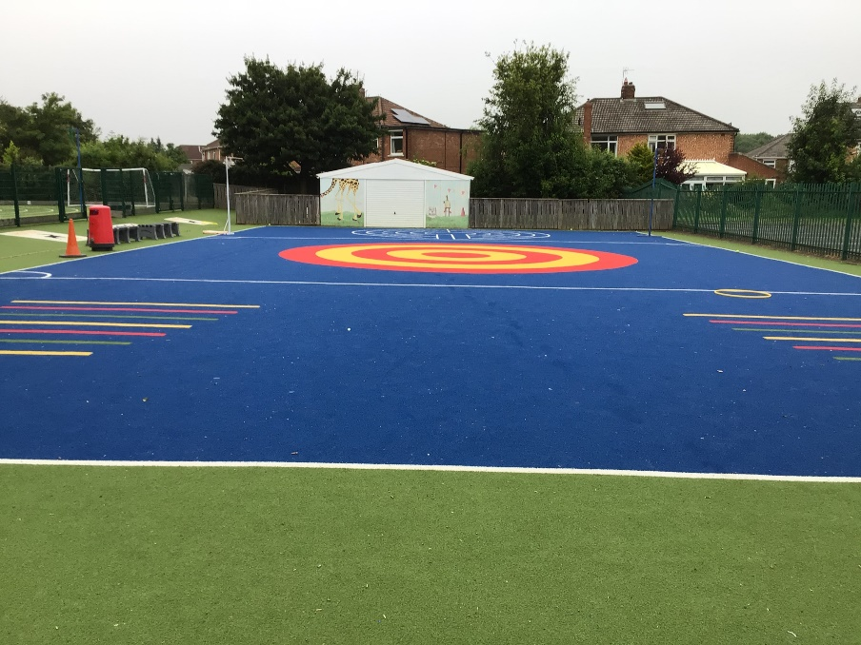
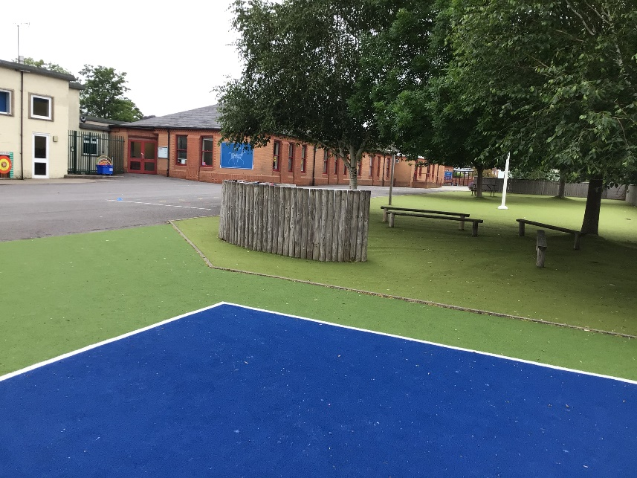
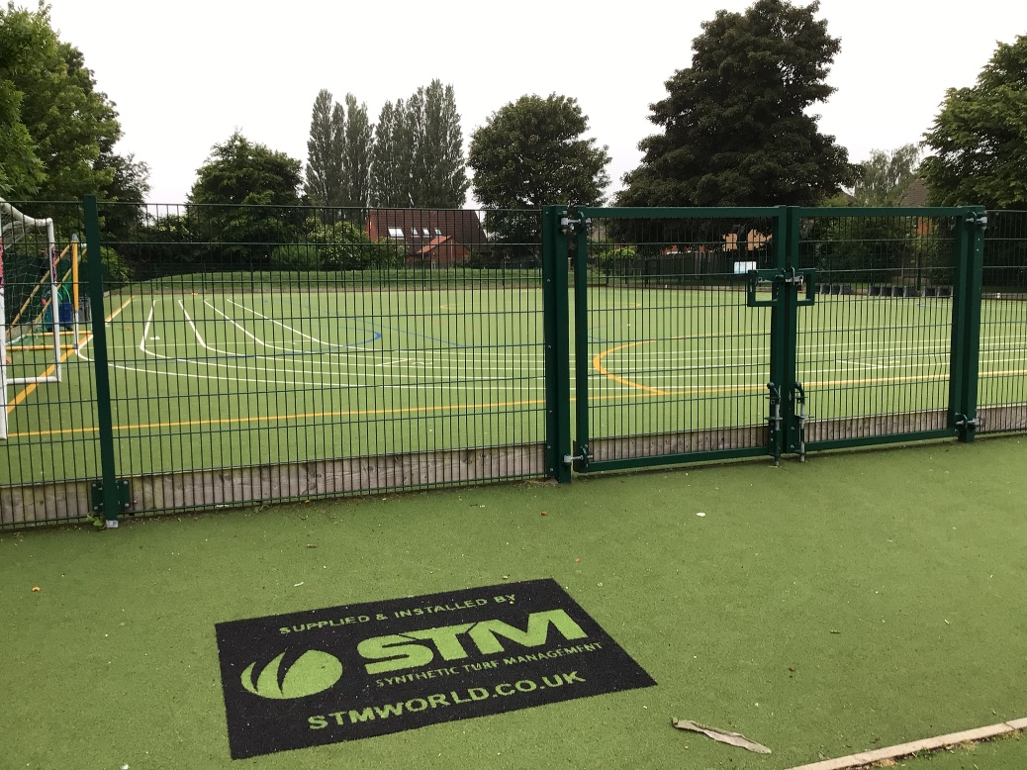
Outdoor Space.

Slide 9
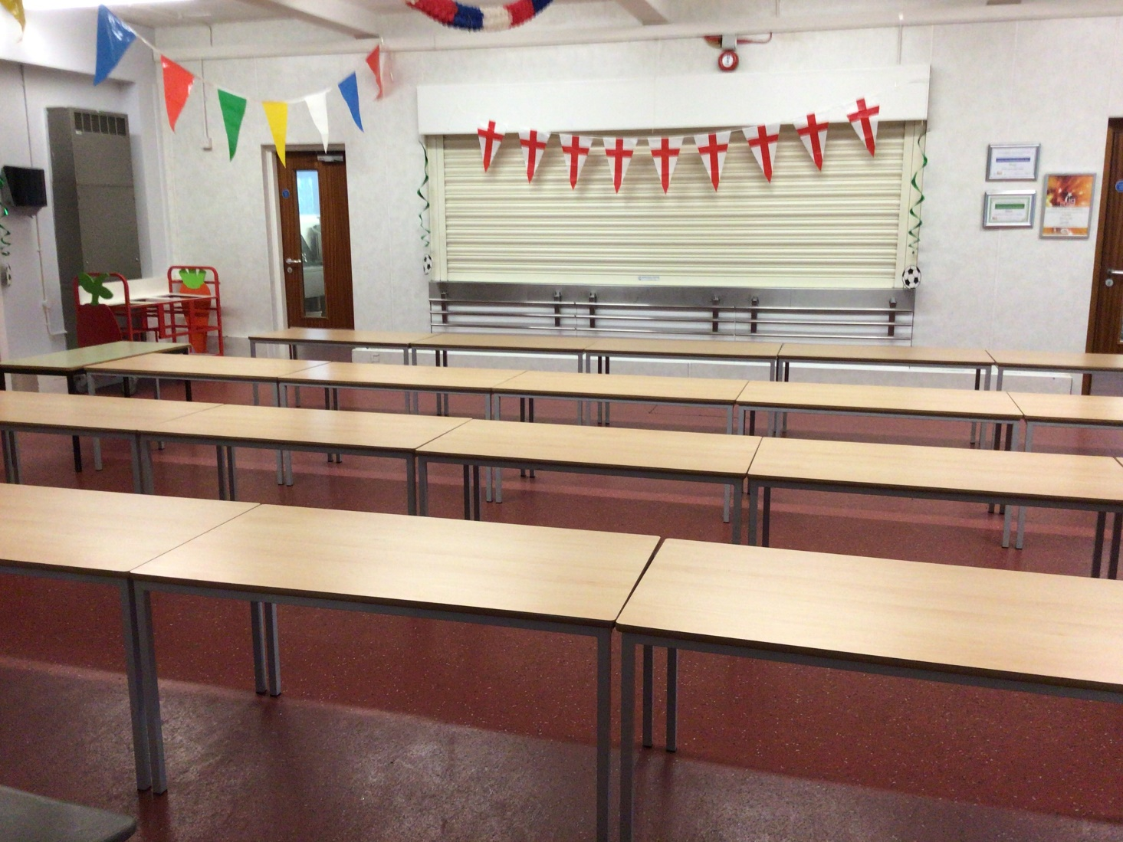
You will eat your dinner here.

Slide 10






This is what your day will look like.
9:00 – Registration
9:05 – Reading
9:15 - English
10:45 – Break
11:00 – Maths
12:15 Lunch
13:15 – Afternoon lesson
15:15 - Home
Your timetable may differ sometimes to allow for other activities.

Slide 11
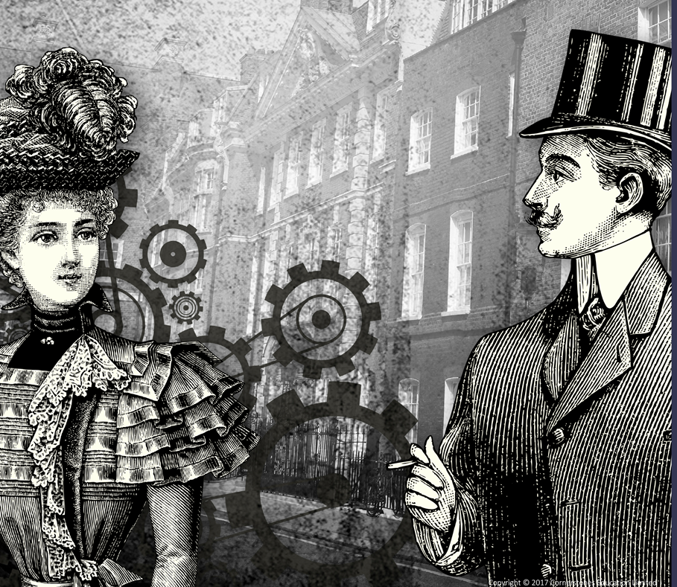


This is what you will be learning about.
Revolution
Frozen Kingdoms
Britain at War

Slide 12
You will leave through this door.
Photo of door
You will finish school at 15.15.

Slide 13
We cannot wait
to see you in September!
Have a lovely summer and stay safe.

