Slide 1


Welcome to
Year 4

Slide 2
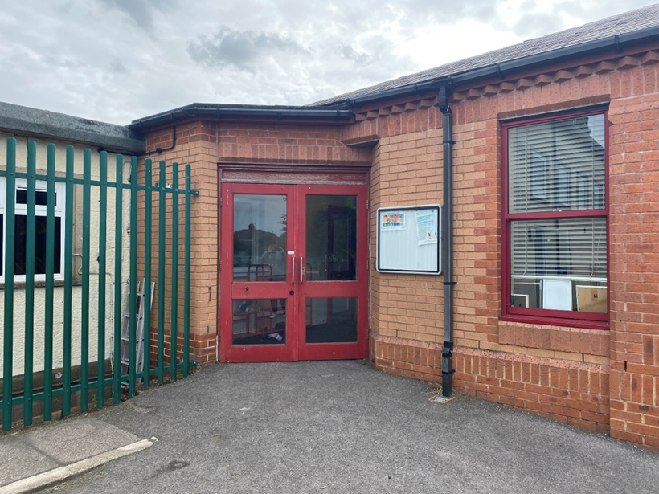
You will come in through this door.
Doors open at 8:45am and school starts a 9:00am.
It is really important that you are on time every morning!

Slide 3
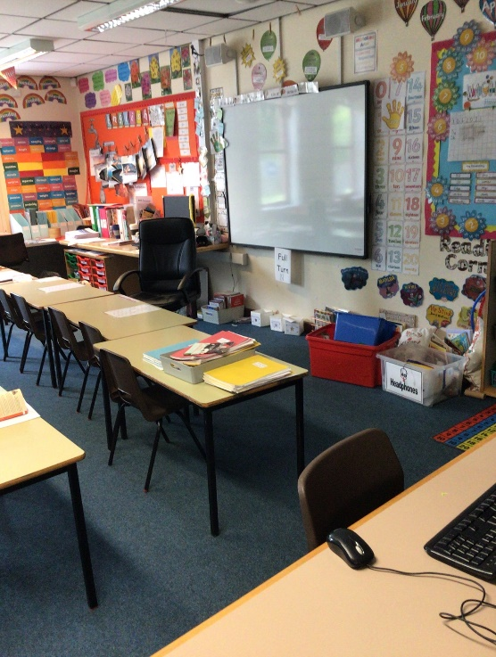
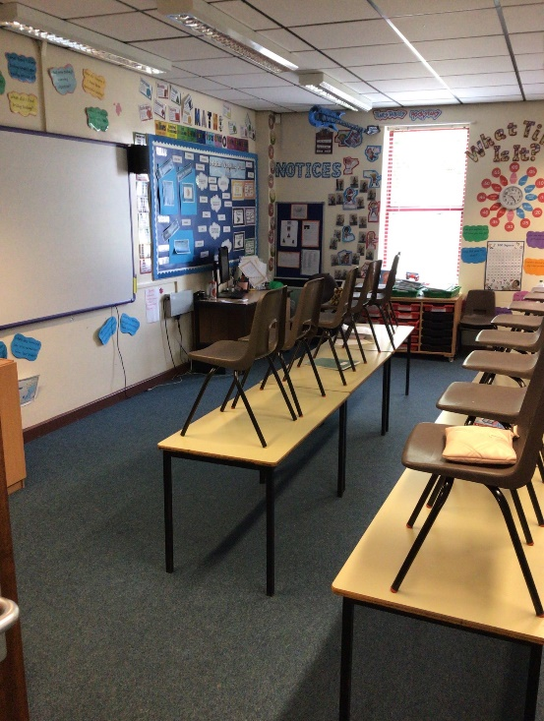
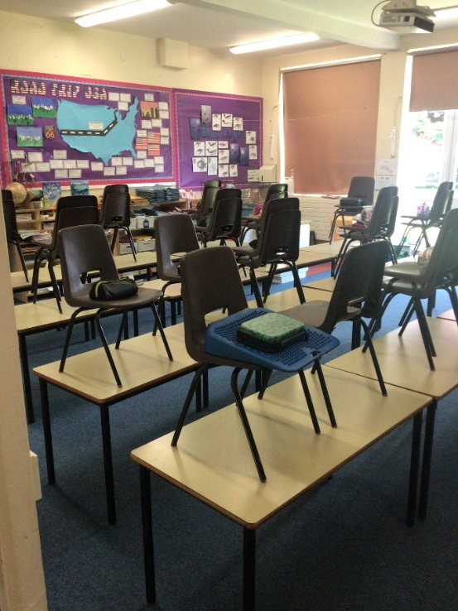
We have 3 classrooms in Year 4: 12, 13 and 14.
Class 12
Class 13
Class 14

Slide 4
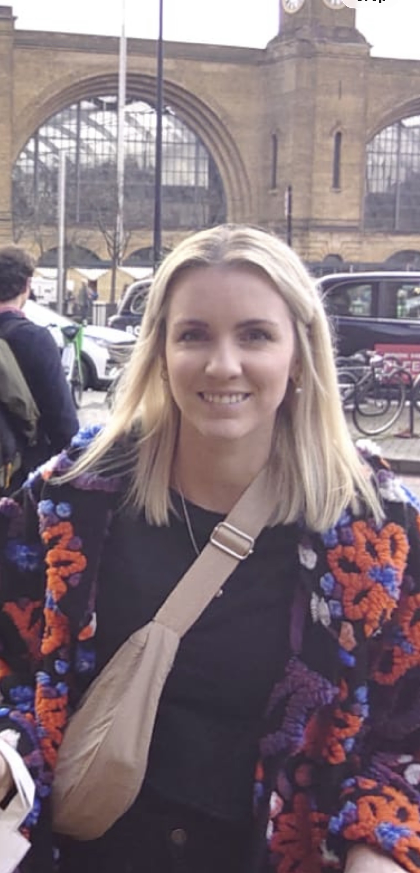
Class 12
Miss Walker

Slide 5
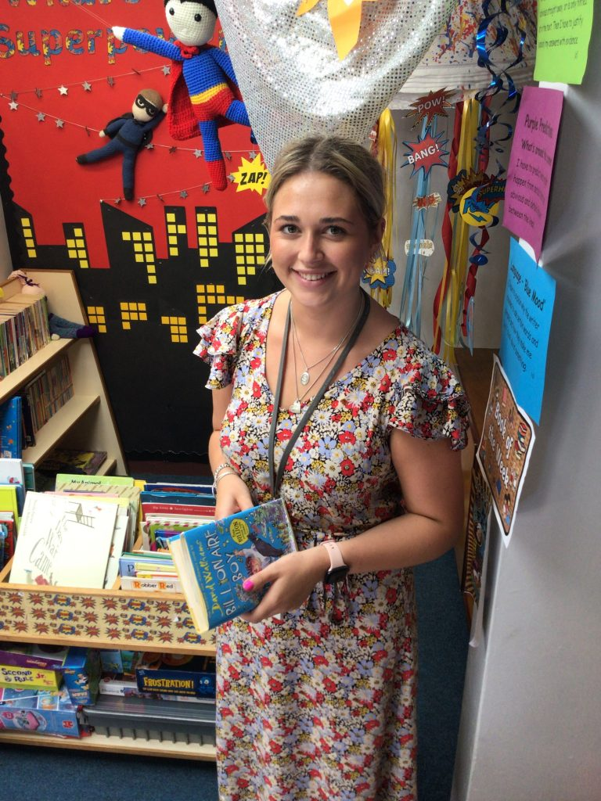
Class 13
Miss Knox

Slide 6
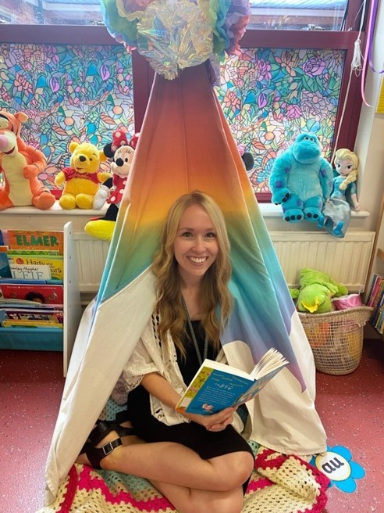

Class 14
Mrs Magowan
Mrs Close

Slide 7
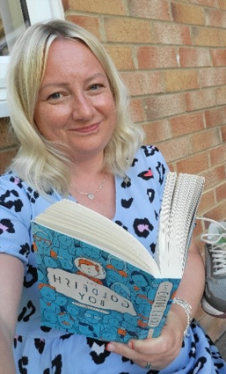
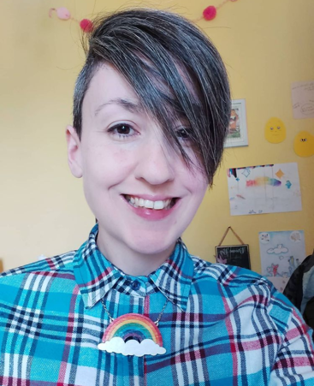
Mrs Burrell
Mrs Marshall
Our Terrific Teaching Assistants

Slide 8
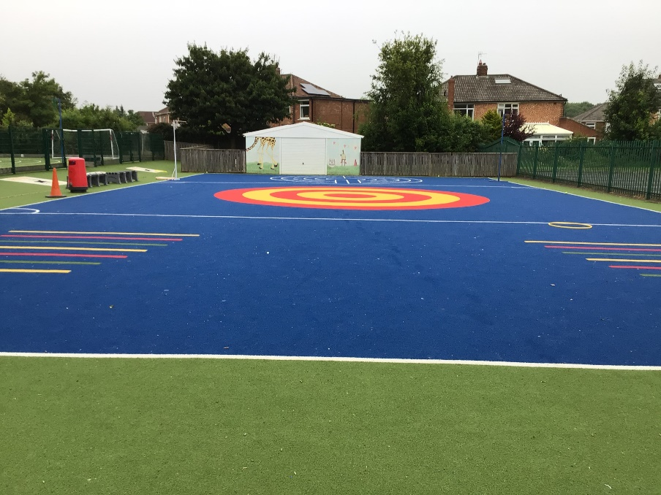
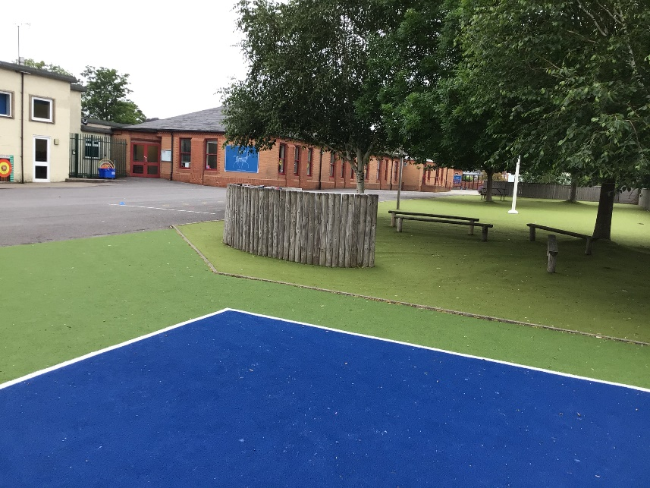
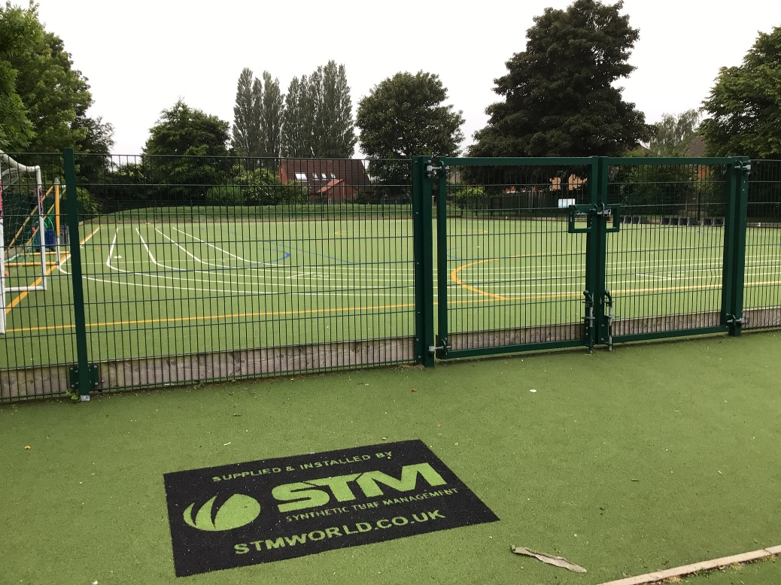
Outdoor Space.

Slide 9
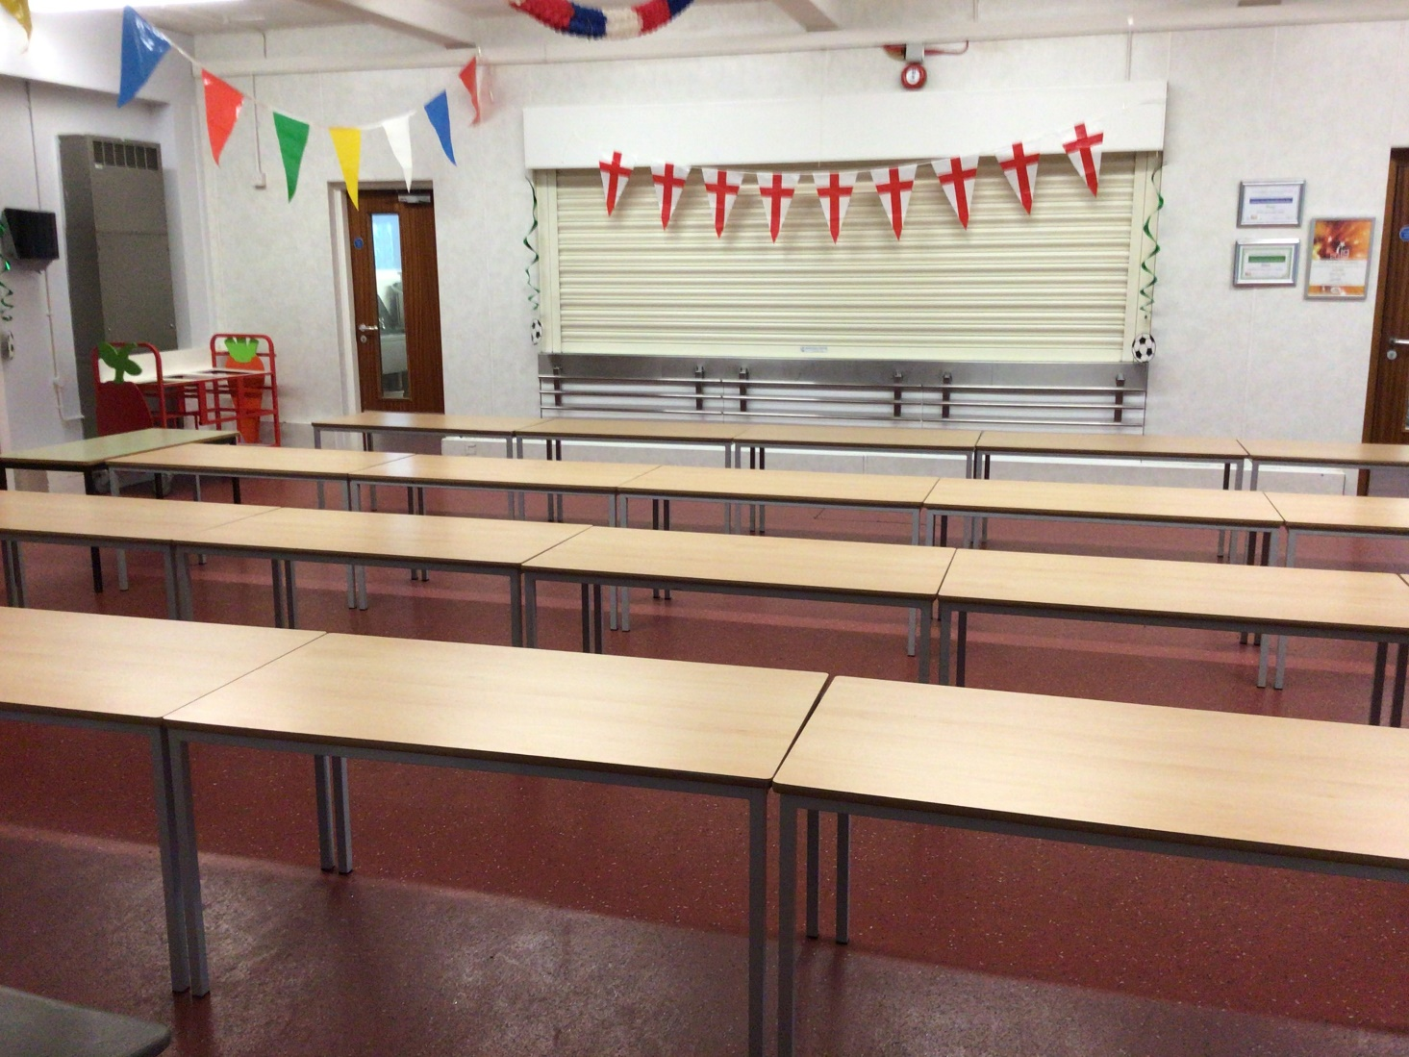
You will eat your dinner here.

Slide 10





This is what your day will look like.
9:00 – Registration
9:15 – Reading
9:45 - English
10:45 – Break
11:00 – Maths
12:15 Lunch
13:15 – Afternoon lesson
14:30 – Afternoon lesson
15:15 - Home
Your timetable may differ sometimes to allow for other activities.

Slide 11

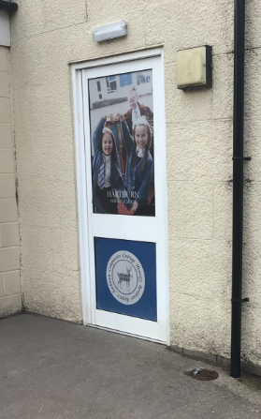
You will leave through this door.
Class 12 will leave through this
door.
You will finish school at 3:15.

Slide 12
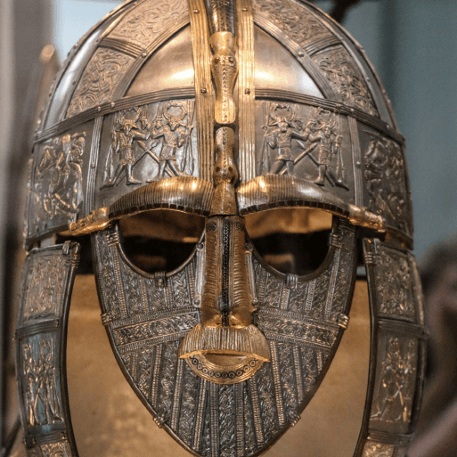
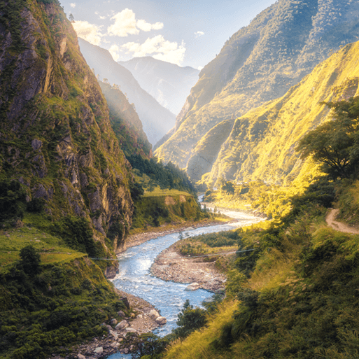
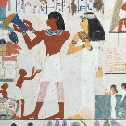
This is what you will be learning about.
Invasion
Misty Mountain, Winding River
Ancient Civilisations

Slide 13
We cannot wait
to see you in September!
Have a lovely summer and stay safe.

